Slide 1

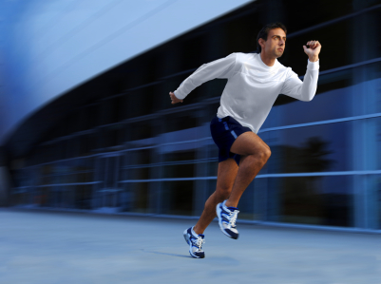

Chapter 1
Motion
The universe consists of matter in motion

Slide 2
Chapter’s Objectives
To introduce the properties of motion (position, speed and velocity, and acceleration.)
To use the metric (or SI) system of measurement.
To differentiate between speed and velocity.
To differentiate between velocity and acceleration.
To learn how to analyze problem statements and to translate the information into a recipe, and
To develop a problem solving skill.

Slide 3
What is Motion?
Motion is a change in the object’s position with respect to time
Motion can be along straight line (horizontal or vertical) or curve
Direction is sometimes important
The Greek philosopher divided it into to two kinds.
Natural motion
Violent motion

Slide 4
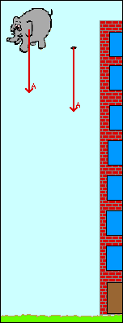


Natural motion
Motion that is caused by no external forces. For example,
the downward motion of a falling stone and
the rise of smoke

Slide 5
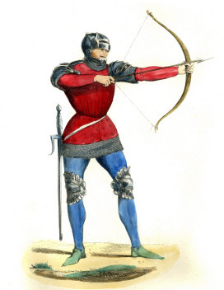
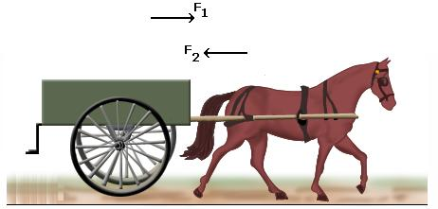
Violent motion
Motion that is caused by an external force. For example,
the motion of a cart pulled by a horse and
the motion of an arrow by a stretched bow.

Slide 6


Scalar
A scalar quantity is a quantity that has magnitude only and has no direction in space
Examples of Scalar Quantities:
Length
Area
Volume
Time
Mass

Slide 7
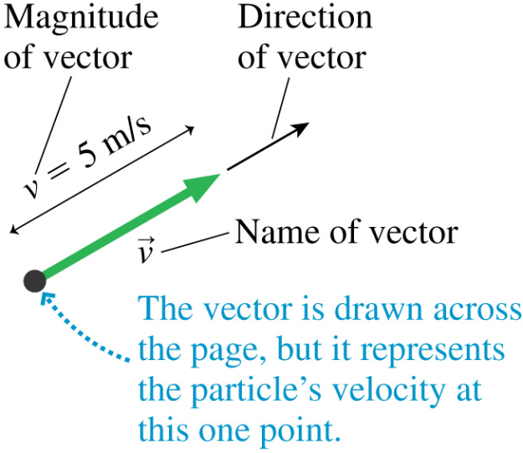

Vector
A vector quantity is a quantity that has both magnitude and a direction in space
Examples of Vector Quantities:
Displacement
Velocity
Acceleration
Force

Slide 8
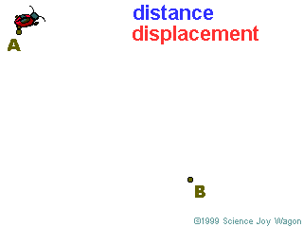
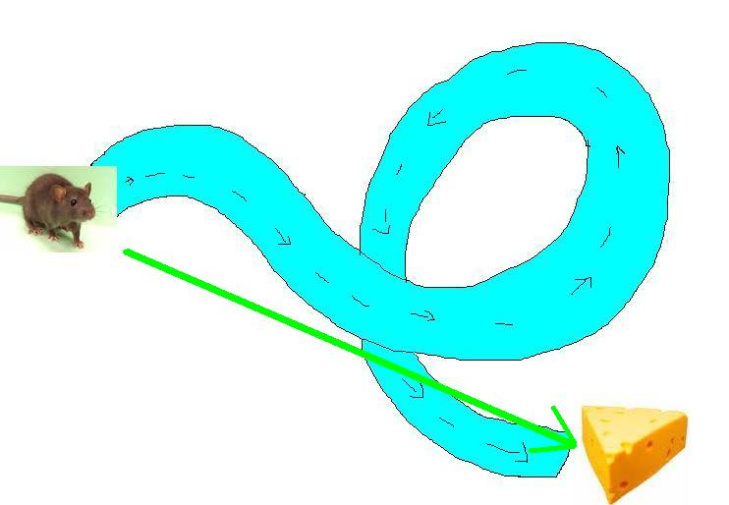
Distance and Displacement

Slide 9
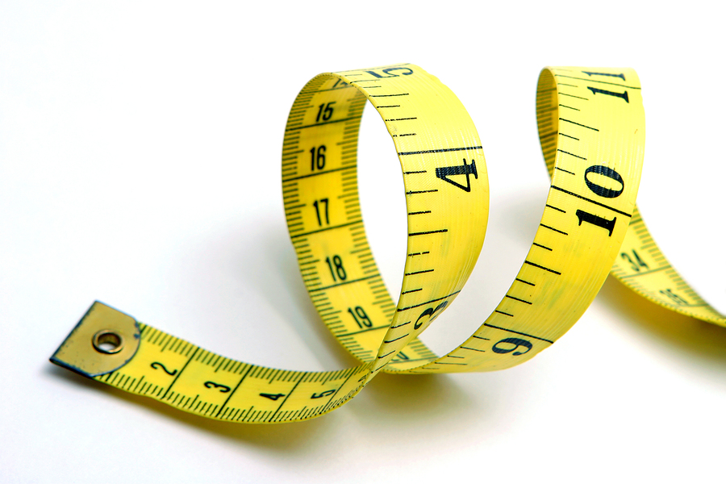
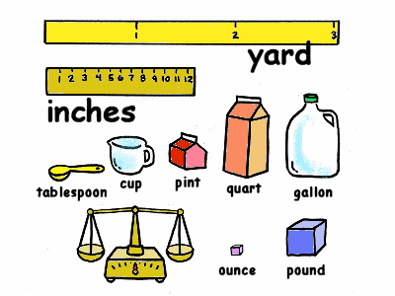
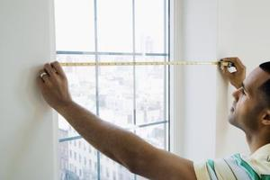
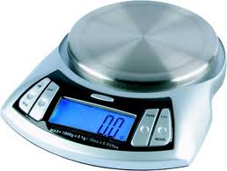
Measurement

Slide 10
Systems of Units
MKS
meter-kilogram-second
CGS
centimeter-gram-second
FPS
foot-pound-second

Slide 11
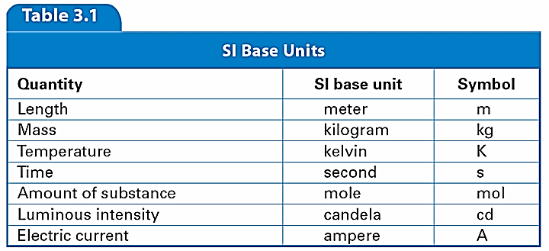

Slide 12
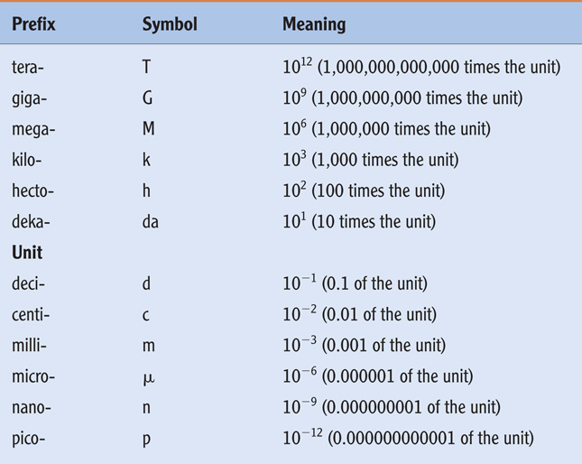
Some prefixes

Slide 13
Scientific Notation
Write the following numbers in a scientific notation
Mass of human is 78 kg = ------------ kg
Diameter of earth is 12800000 m = ------------- m
Length of a virus is 0.0000024 cm = ------------- cm

Slide 14
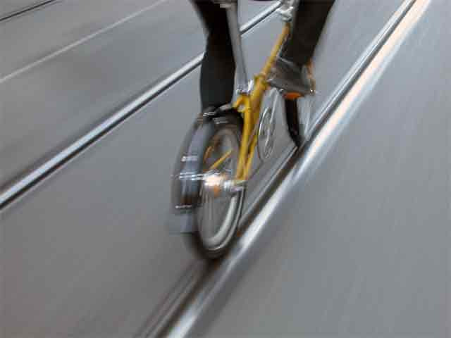
Velocity
Describes how fast an object
is moving.

Slide 15

Speed and Velocity
Change in position with respect to time
It is a scalar quantity
Its S.I unit is m/sec
Average velocity

Slide 16
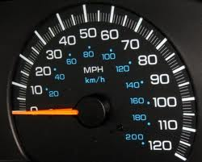
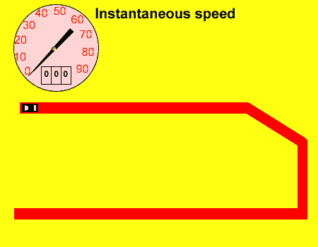
INSTANTANEOUS VELOCITY

Slide 17
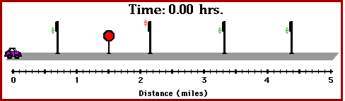
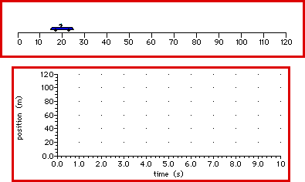

Slide 18
Examples
You travel a distance of 260 km in a time of 3 hours. What is your average speed
A car has an average speed of 10m/sec. How far will it be traveling in 10 second?

Slide 19
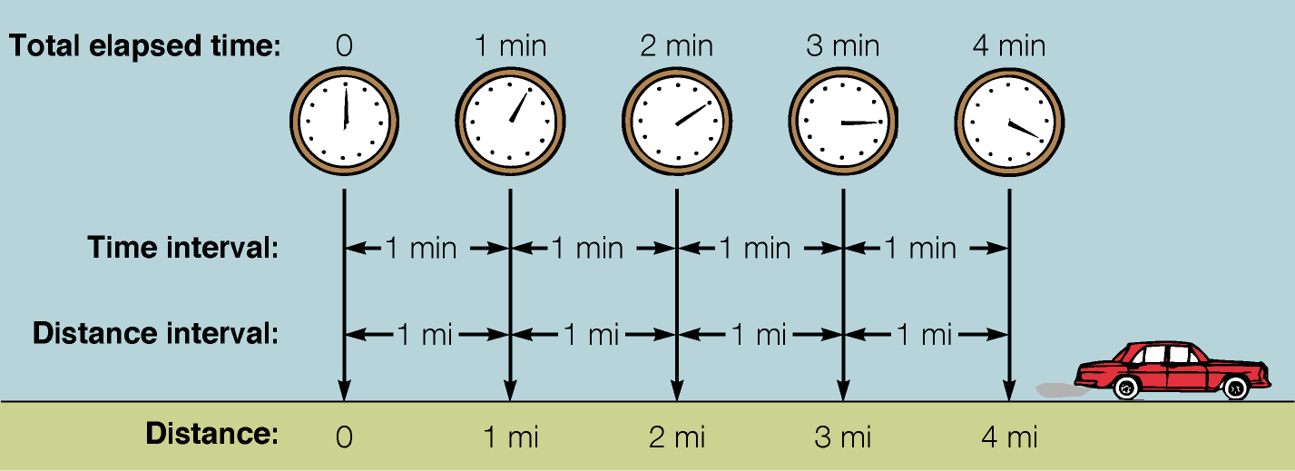
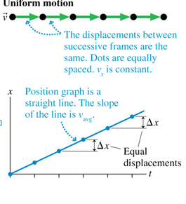
Types of Motion
Uniform (constant)motion:
Straight line motion in which equal distances cover during any successive equal time intervals

Slide 20
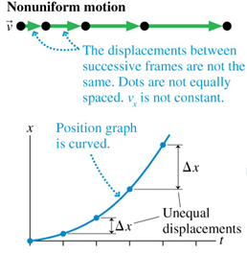
Non-Uniform Motion
Motion on a curve, and
Occur when successive displacements/distances are not equal at equal time intervals
Example- falling objects
Can be represented graphically

Slide 21



Acceleration
Rate of change of velocity.
S.I unit of acceleration is m/sec²

Slide 22
Acceleration due to gravity

Slide 23
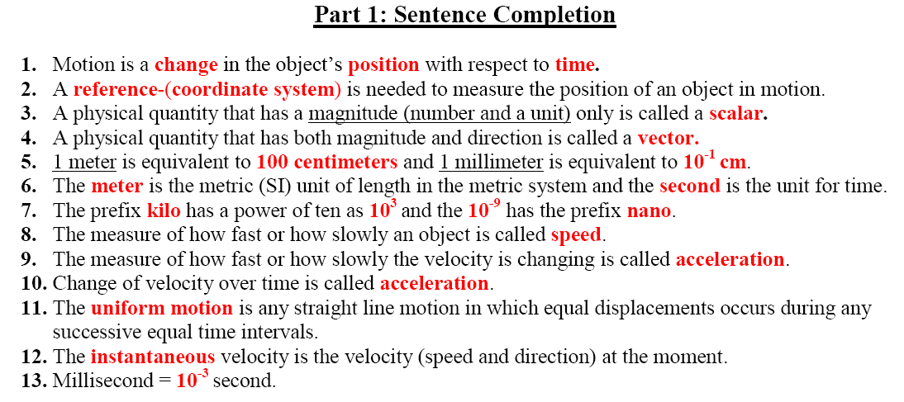

Slide 24
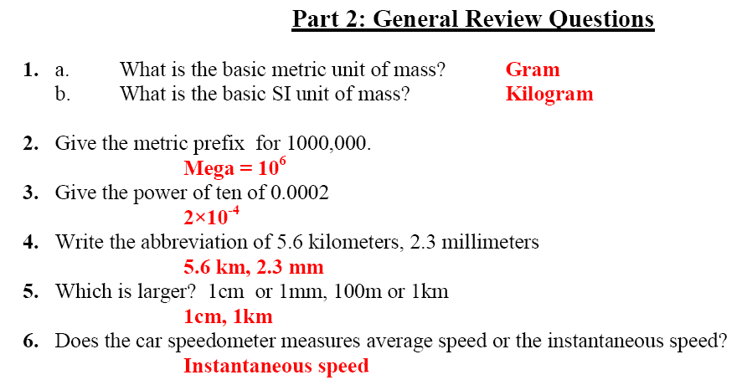

Slide 25
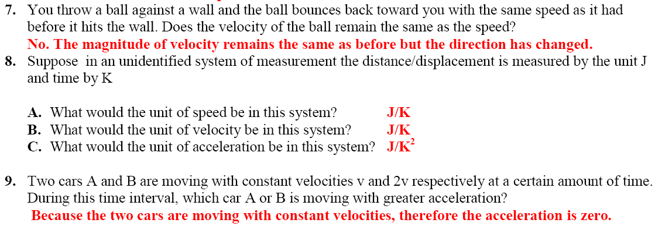

Slide 26
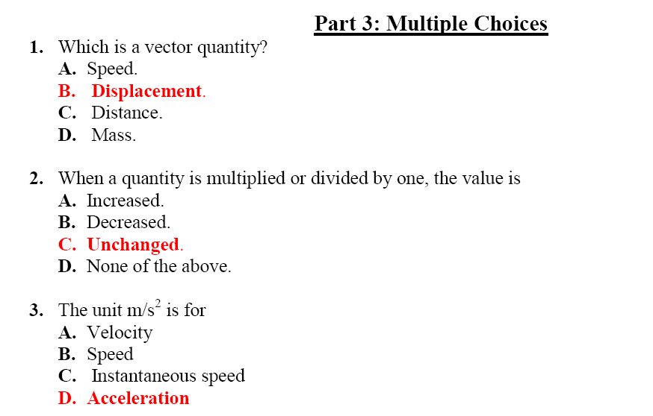

Slide 27
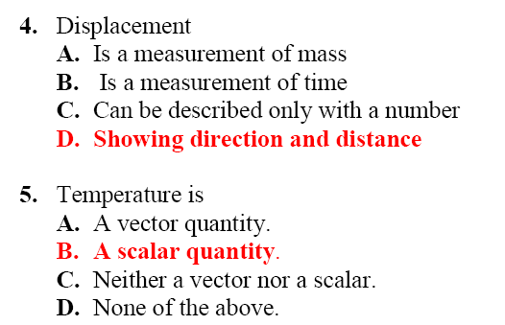

Slide 28
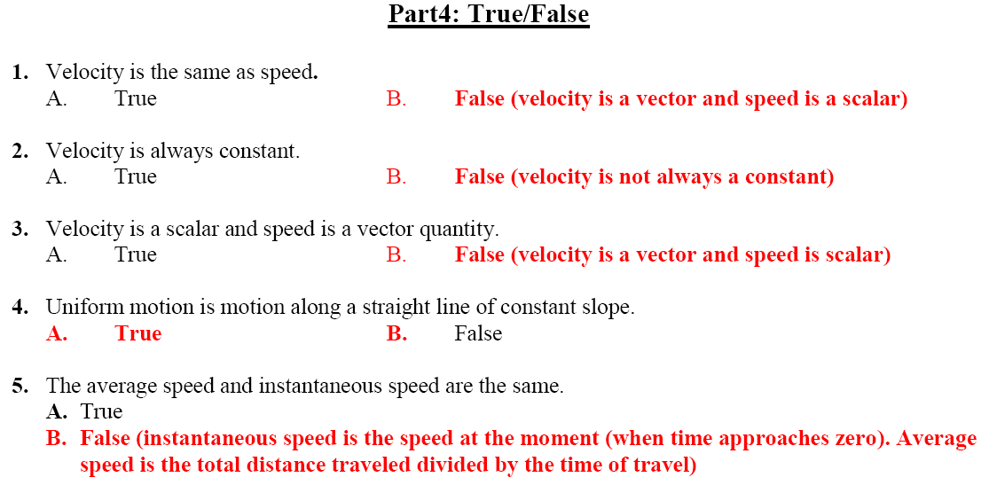

Slide 29
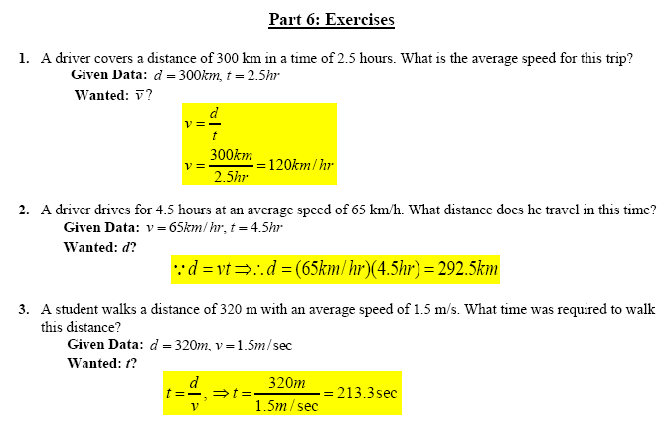

Slide 30
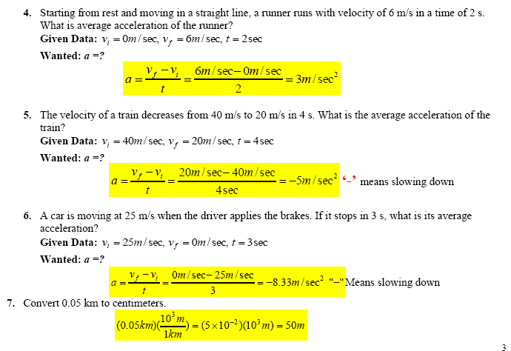

Slide 31
