Slide 1

Rational and Irrational Numbers

Slide 2
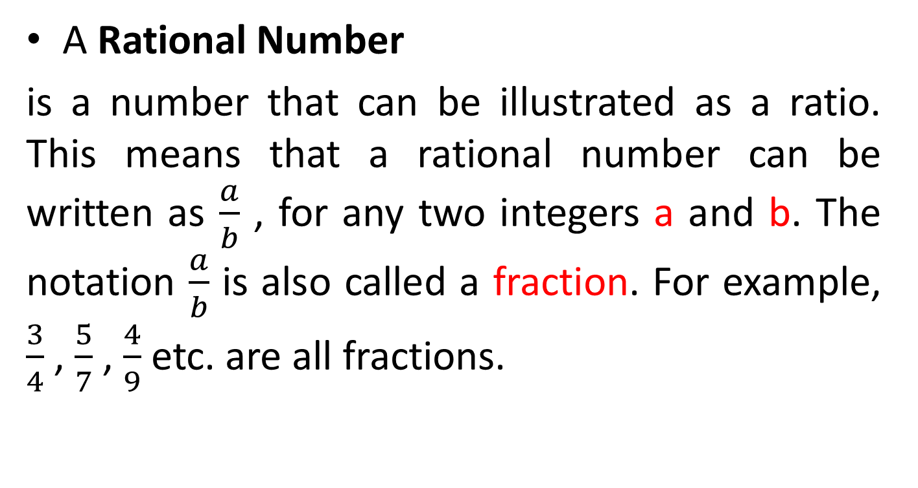
Rational Number
A Rational Number
is a number that can be illustrated as a ratio. This means that a rational number can be written as $\frac{a}{b}$ , for any two integers a and b. The notation $\frac{a}{b}$ is also called a fraction. For example, $\frac{3}{4}$ , $\frac{5}{7}$ , $\frac{4}{9}$ etc. are all fractions.

Slide 3
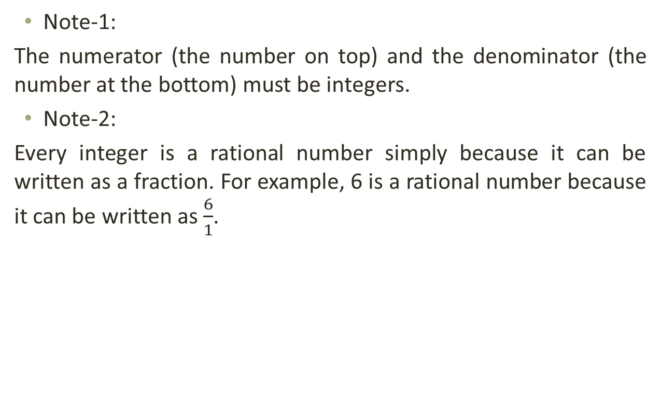
Rational Number
Note-1:
The numerator (the number on top) and the denominator (the number at the bottom) must be integers.
Note-2:
Every integer is a rational number simply because it can be written as a fraction. For example, 6 is a rational number because it can be written as $\frac{6}{1}$.

Slide 4
Rational Number
Rational numbers are numbers which are either repeated, or terminated.
Like 0.7645 and 0.232323..... are both rational numbers.

Slide 5
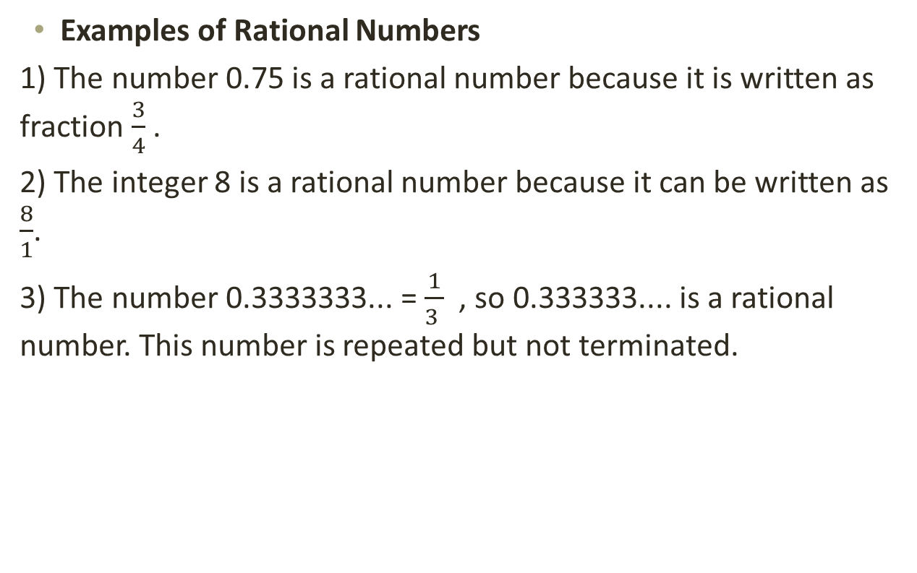
Rational Number
Examples of Rational Numbers
1) The number 0.75 is a rational number because it is written as fraction $\frac{3}{4}$ .
2) The integer 8 is a rational number because it can be written as $\frac{8}{1}$.
3) The number 0.3333333... = $\frac{1}{3 }$ , so 0.333333.... is a rational number. This number is repeated but not terminated.

Slide 6
Irrational Number
An Irrational Number is basically a non-rational number; it consists of numbers that are not whole numbers. Irrational numbers can be written as decimals, but not as fractions. Irrational Numbers are non-repeating and non-ending. For example, the mathematical constant Pi = π = 3.14159… has a decimal representation which consists of an infinite number of non-repeating digits.

Slide 7

Irrational Number
The value of pi to 100 significant figures is
3.141592653589793238462643383279502884197169399375105820974944592307816406286208998628034825342117067...
Note:
Rational and Irrational numbers both exist on the number line.

Slide 8
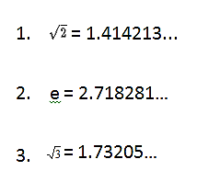
Irrational Number
Examples of Irrational Numbers

Slide 9
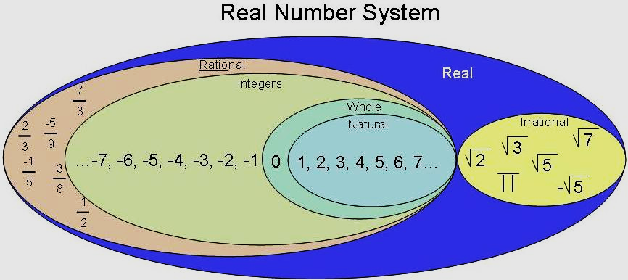
Real Number System

Slide 10
Real Number
Real numbers consist of all the rational and irrational numbers.
The real number system has many subsets:
  Natural Numbers
  Whole Numbers
  Integers

Slide 11
Natural numbers are the set of counting numbers.
{1, 2, 3,4,5,6,…}
Whole numbers are the set of numbers that include 0 plus the set of natural numbers.
{0, 1, 2, 3, 4, 5,…}
Integers are the set of whole numbers and their opposites.
{…,-3, -2, -1, 0, 1, 2, 3,…}

Slide 12
Prime Number
A Prime Number is a positive integer which is only divisible by 1 and the number itself. For example, 7 is a prime number because it is only divisible by 1 and 7.
The number 6 is not a prime as it can be divided by 2 and 3.
Note: A prime number is a whole number greater than 1.
Some examples of Prime Numbers are 2, 3, 5, 7, 11, 13, 17, 19, 23,...

Slide 13
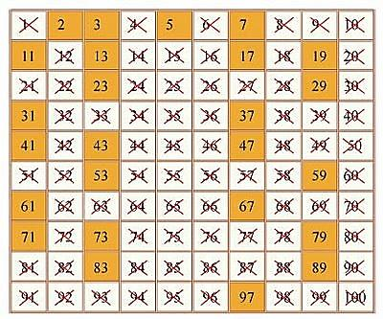
Prime Number

Slide 14
Composite Number
A Composite Number can be properly divided by numbers other than 1 or itself.
For example, 6 is a composite number because it can be divided by 1, 2, 3, and 6. It can be divided by more numbers (2 and 3) than just by 1 or itself.
The numbers 0 and 1 are neither prime nor composite.

Slide 15
Example
Determine whether each number is a prime or Composite numbers:
0, 2, 4, 11, 37,78,79, 90, 1.
Prime numbers:
Composite numbers:

Slide 16
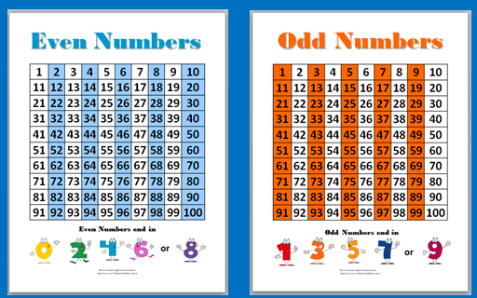
Even and Odd integers

Slide 17
Even numbers Even numbers are integers that can be completely divided by 2.
-Even numbers can be illustrated as
{…-10,-8,-6, -4, -2, 0, 2, 4, 6, 8, 10…}
-Zero is considered an even number.

Slide 18
Odd numbers
Odd numbers are integers that cannot be totally divided by 2.
-Odd numbers can be illustrated as {…-9,-7,-5, -3, -1, 1, 3, 5, 7, 9…}
The collection of all even and odd numbers form the set of integers.

Slide 19
Note:
To determine whether a number is even or odd, notice the number at the ones place. Like to check if the numbers 12, 15, 36, 43, 69, 88, 101, 204 are even or odd, check the ones digit.
An even number ends in 0, 2, 4, 6, or 8.
An odd number ends in 1, 3, 5, 7, or 9

Slide 20
Even | Odd
8 | 3
12 | 15
322 | 123
8234 | 1765
23432 | 93249

Slide 21
Rules of ASM
Adding Evens and Odds
even + even = even 2 + 4 = 6
even + odd = odd 4 + 1 = 5
odd + odd = even 3 + 3 = 6
Subtracting Evens and Odds
even - even = even 8 – 6 = 2
even - odd = odd 10 – 9 = 1
odd - odd = even 5 – 3 = 2
Multiplying Evens and Odds
even x even = even 4 x 2 = 8
even x odd = even 5 x 2 = 10
odd x odd = odd 5 x 5 = 25

Slide 22
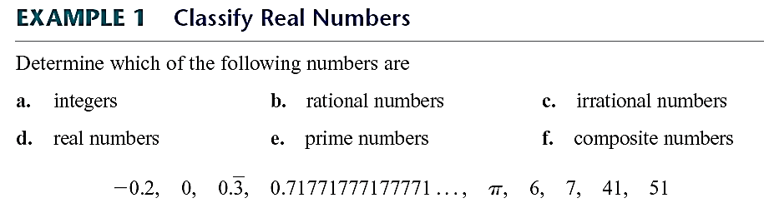
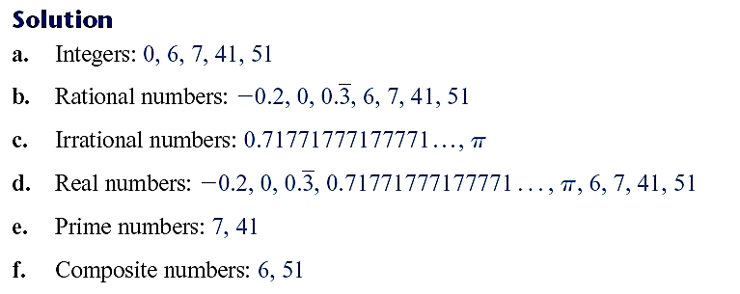

Slide 23

Real Number System
Real Number System:
The collection of all rational and irrational numbers form the set of real numbers, usually denoted by R.

Slide 24

Activity
Tell whether the following are rational or irrational numbers:
$\frac{1}{2}$=
$\frac{3}{4}$=
0.2345234… =
$\sqrt{3}$=
$\sqrt{2}$=
0. 315315315..... =

