Slide 1
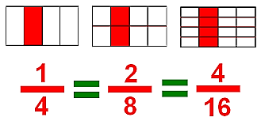
Fractions

Slide 2
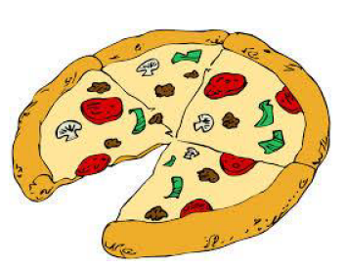
A fraction is basically a part of an entire thing. It is not a
whole number, but a part of something.

Slide 3
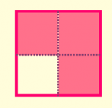
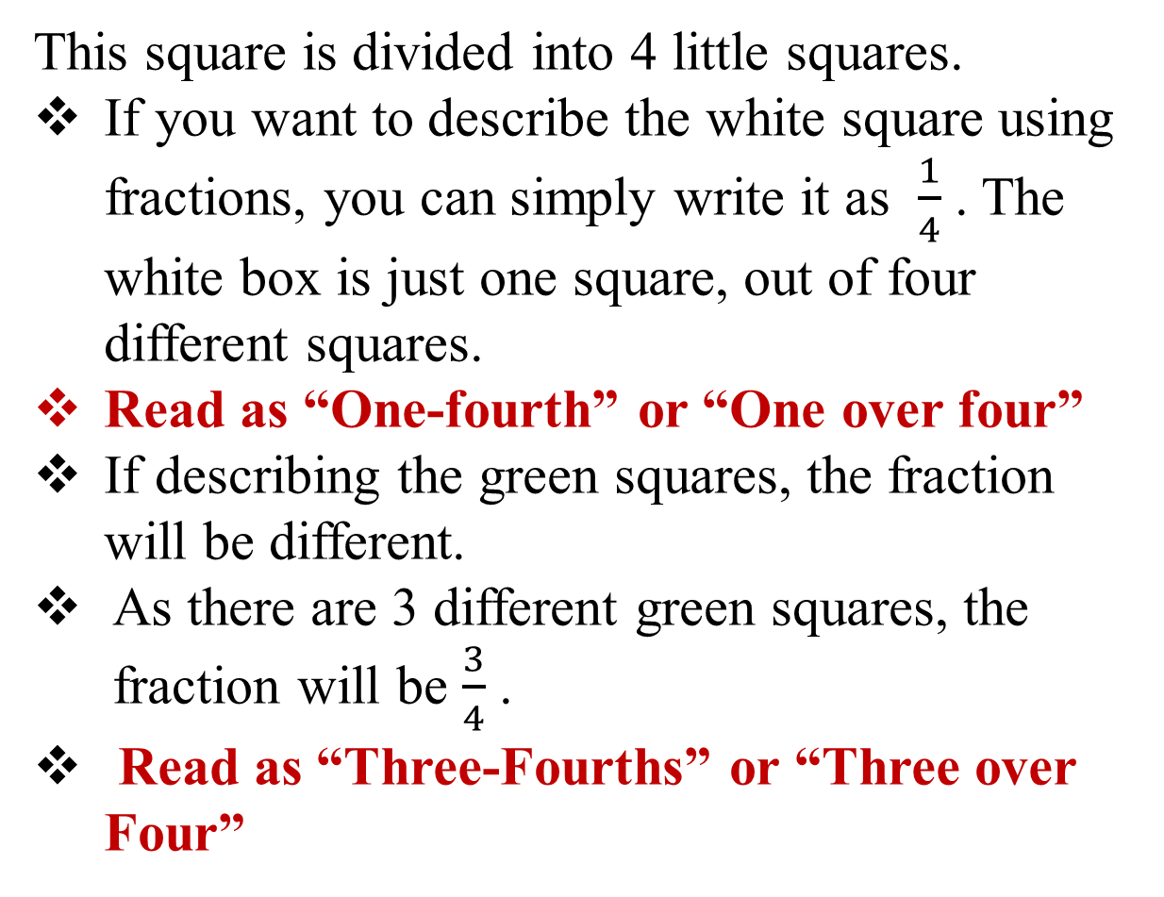
This square is divided into 4 little squares.
If you want to describe the white square using fractions, you can simply write it as $\frac{1}{4}$ . The white box is just one square, out of four different squares.
Read as “One-fourth” or “One over four”
If describing the green squares, the fraction will be different.
As there are 3 different green squares, the fraction will be $\frac{3}{4}$ .
Read as “Three-Fourths” or “Three over Four”

Slide 4
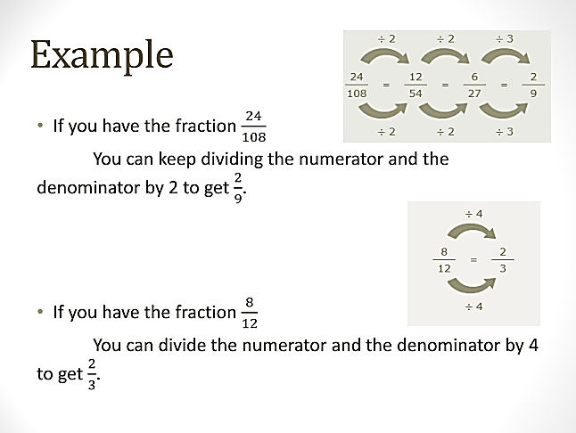

Slide 5
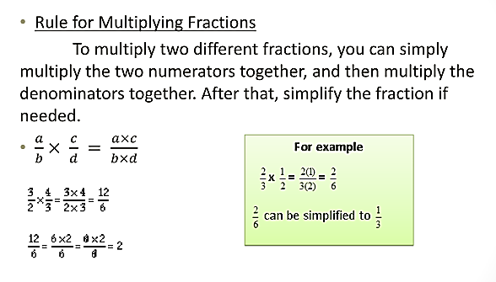

Slide 6
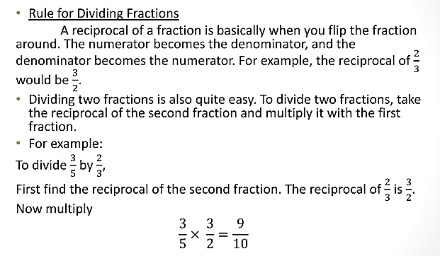

Slide 7
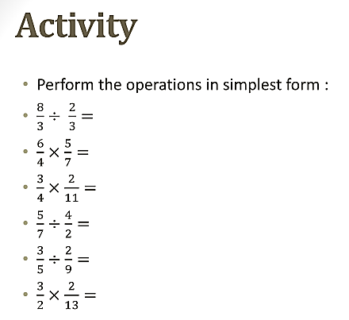

Slide 8




Addition of Fractions

Slide 9

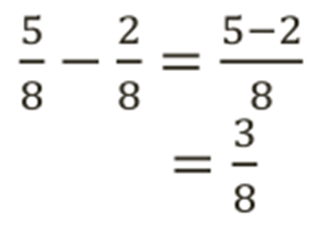


Subtraction of Fractions

Slide 10
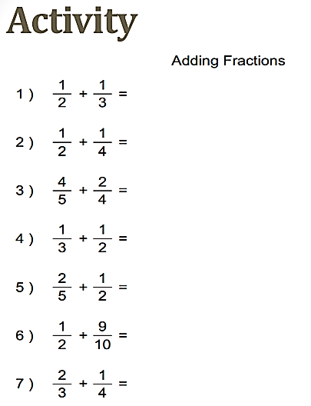

Slide 11
