Slide 1
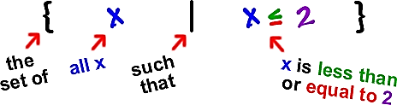
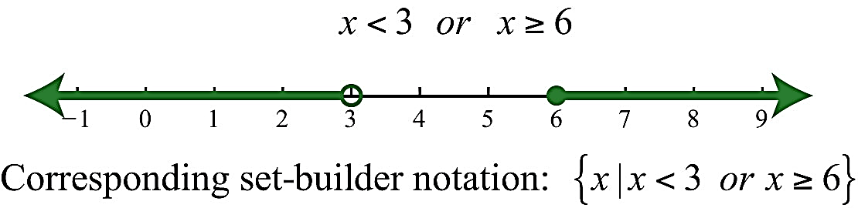
Set-Builder Notation

Slide 2
Sets
A set is a collection of objects called the elements or members of the set. Set braces { } are usually used to enclose the elements.
Example 1: 3 is an element of the set {1,2,3}
Note: This is referred to as a Finite Set since we can count the elements of the set.
Example 2: A set containing no numbers is shown as { } .
This is referred to as the Null Set or Empty Set.

Slide 3
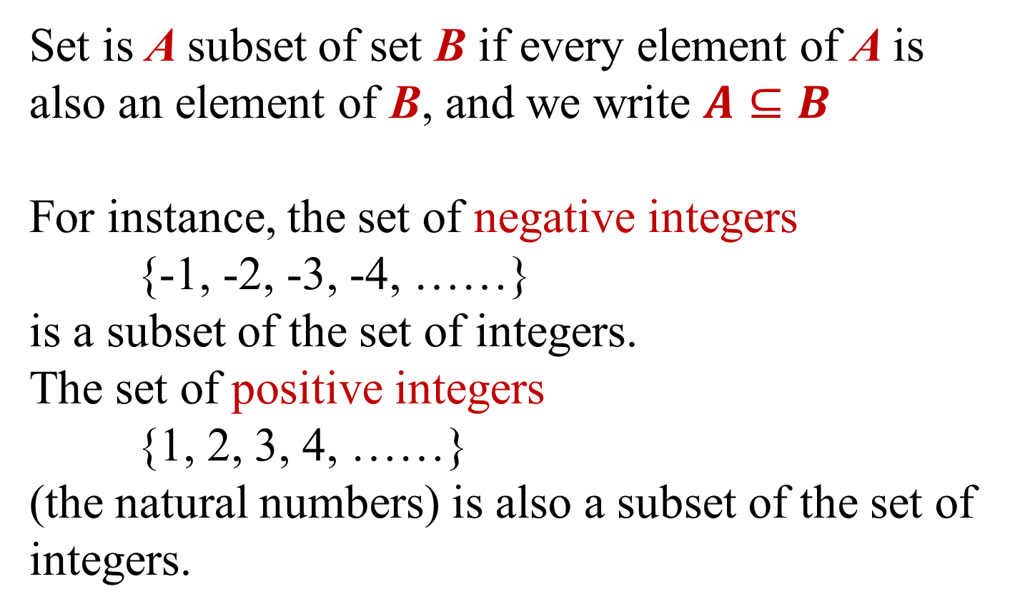
Set is A subset of set B if every element of A is also an element of B, and we write $A⊆B$
For instance, the set of negative integers
{-1, -2, -3, -4, ……}
is a subset of the set of integers.
The set of positive integers
{1, 2, 3, 4, ……}
(the natural numbers) is also a subset of the set of integers.

Slide 4
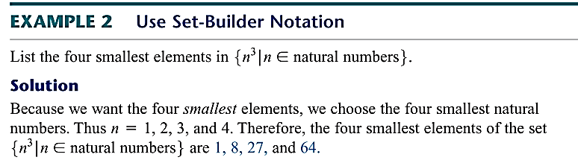
Set Builder Notation P/4:
The notation {x|x has property P} is an example of “Set Builder Notation” and is read as:
{x | x has property P}
the set of all elements x such that x has property P
Example : {x|x is a whole number less than 6}
Solution: {0,1,2,3,4,5}

Slide 5
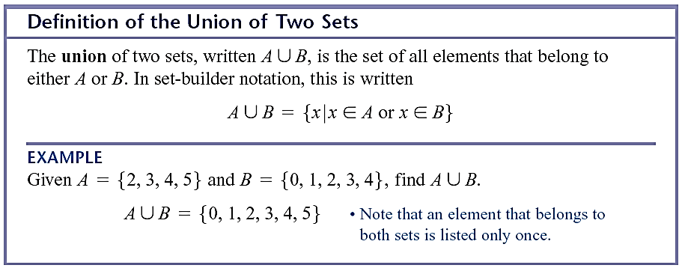
Set operations:
Union P/5
Formal definition for the union of two sets:
A U B = { x | x ∈ A or x ∈ B }
Further examples
  {1, 2, 3} U {3, 4, 5} = {1, 2, 3, 4, 5}
  {0,2,4,6,8,10,12} U {0,3,6,12,15}
  = { 0,2,3,4,6,8,10,12,15}

Slide 6
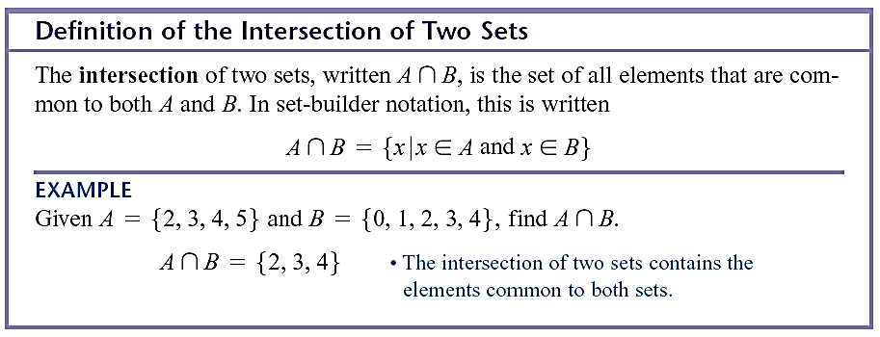
Set operations:
Intersection
Formal definition for the intersection of two sets:
A ∩ B = { x | x ∈ A and x ∈ B }
Further examples
  {1, 2, 3} ∩ {3, 4, 5} = {3}
  {0,2,4,6,8,10,12} ∩ {0,3,6,12,15} = { 0,6,12}

Slide 7
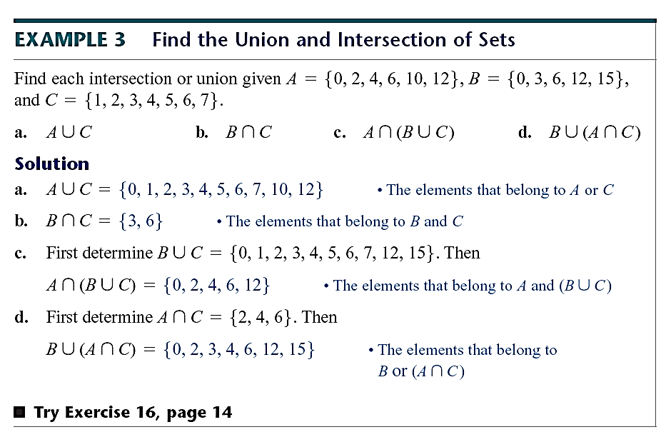

Slide 8
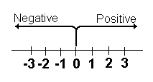
Numbers to the left of zero
are less than zero.
Numbers to the right of zero are more than zero.
The numbers –1, -2, -3,… are called negative integers. The number negative 3 is written –3.
Zero is neither negative nor positive.
The numbers 1, 2, 3, … are called positive integers. The number positive 4 is written +4 or 4.

Slide 9
Using a number line
-2 -1 0 1 2 3 4 5
One way to visualize a set a numbers is to use a “Number Line”.
Example 1: The set of numbers shown above includes positive numbers, negative numbers and 0. This set is part of the set of “Integers” and is written:
I = {…, -2, -1, 0, 1, 2, …}

Slide 10
Using Inequality Symbols
Equality/Inequality Symbols:
Caution: With the symbol ≤ , if either the < or
the = part is true, then the inequality is true. This is also
the case for the ≥ symbol.

Slide 11
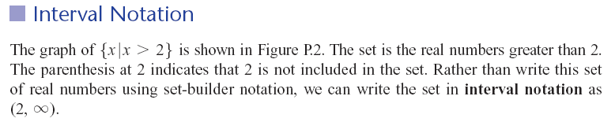
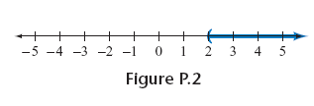

Slide 12

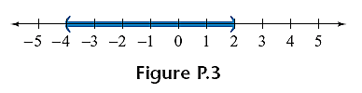
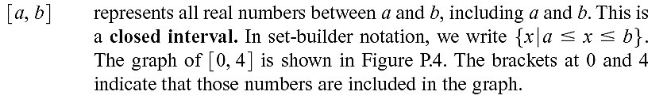


Slide 13
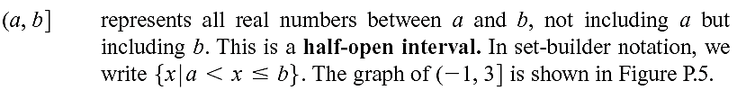
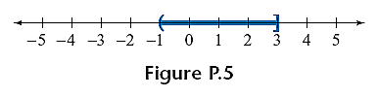
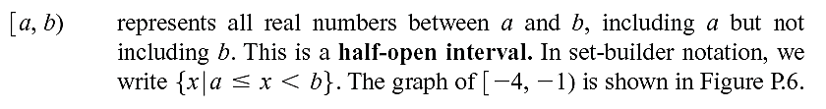


Slide 14
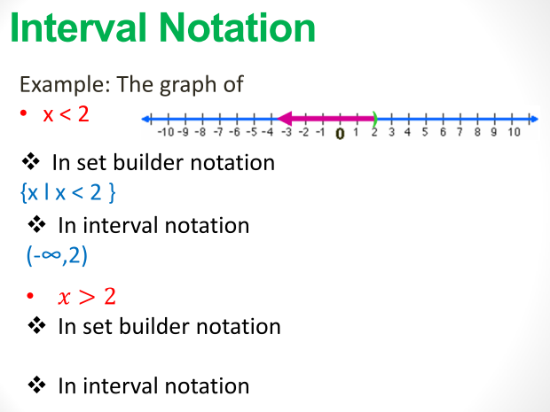

Slide 15
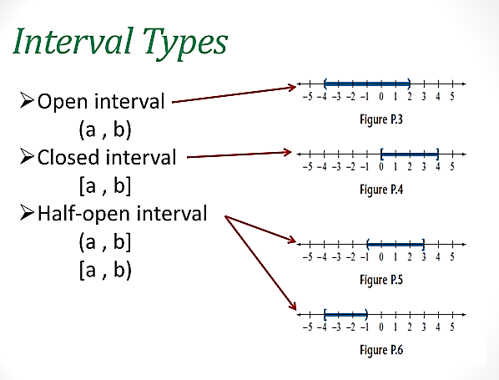

Slide 16
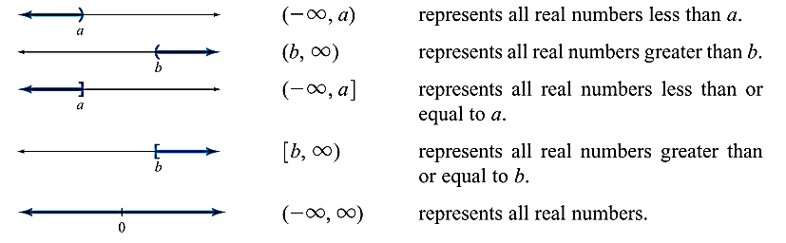

Slide 17
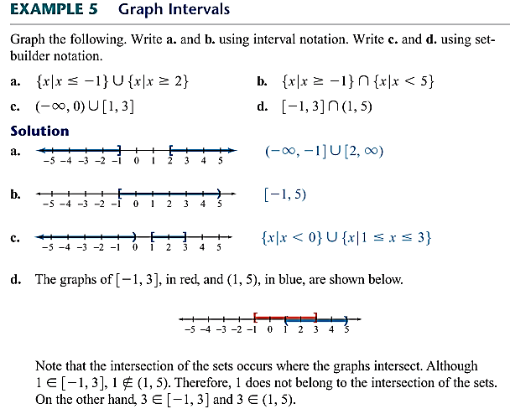

Slide 18
