Slide 1

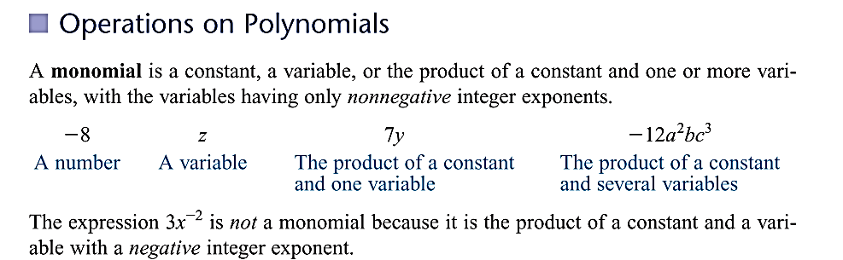

Slide 2
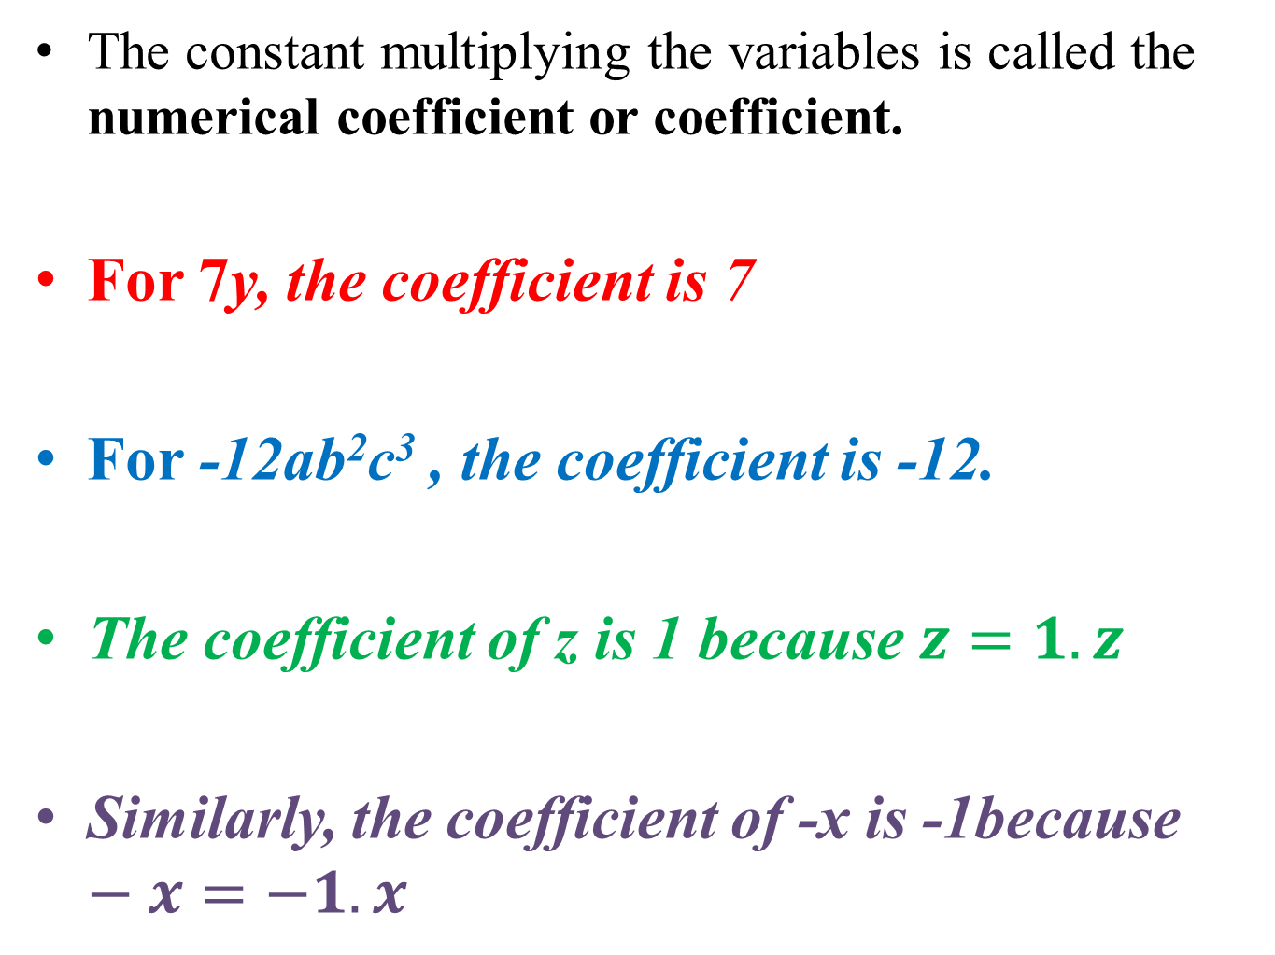
The constant multiplying the variables is called the numerical coefficient or coefficient.
For 7y, the coefficient is 7
For -12ab²c³ , the coefficient is -12.
The coefficient of z is 1 because $z=1.z$
Similarly, the coefficient of -x is -1because $−x=−1.x$

Slide 3
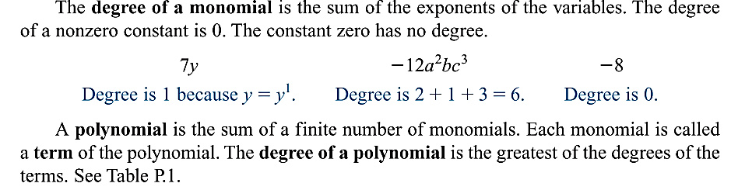
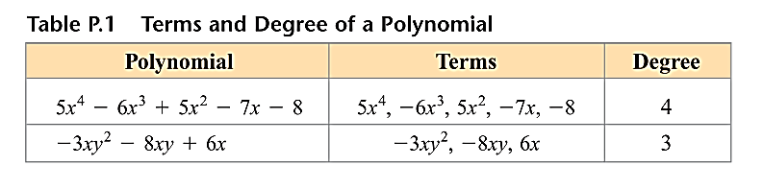

Slide 4
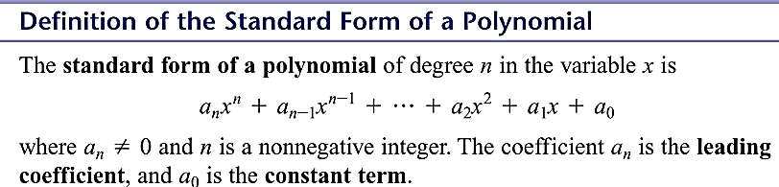
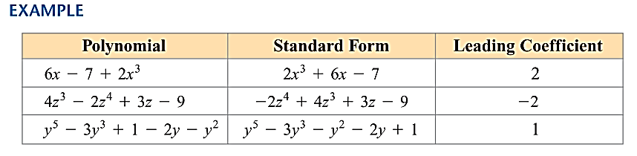

Slide 5

standard form | degree | coefficients | leading coefficient, | terms

Slide 6





standard form | degree | coefficients | leading coefficient, | terms

Slide 7
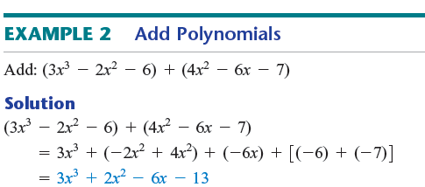
To add polynomials, add the coefficients of the like terms.

Slide 8


To subtract a polynomial, we add its additive inverse.

Slide 14
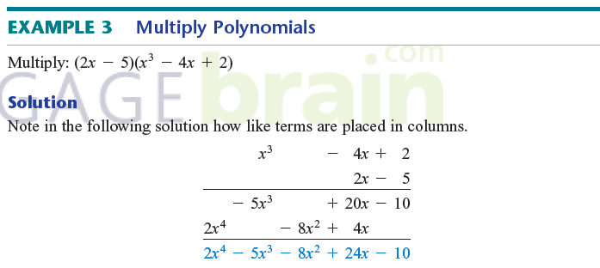
Multiply Polynomials

Slide 15
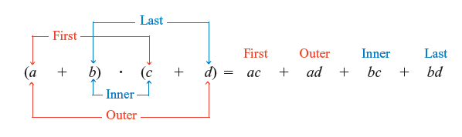
FOIL method
If the terms of the binomials (a + b) and (c + d) are labeled as shown below, then the product of the two binomials can be computed mentally by the FOIL method.

Slide 17
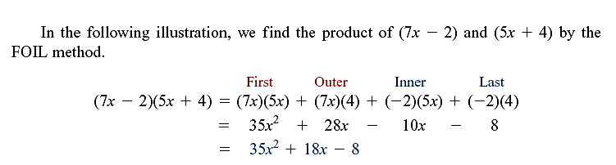
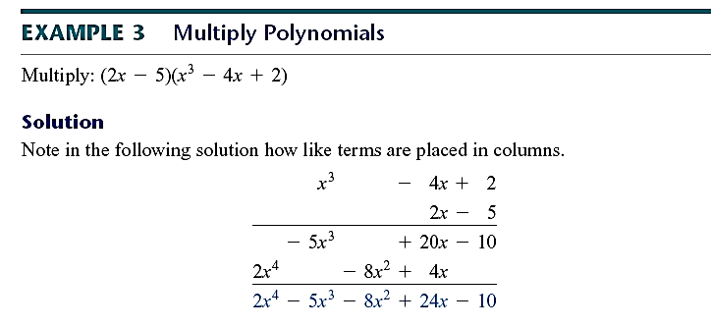

Slide 18
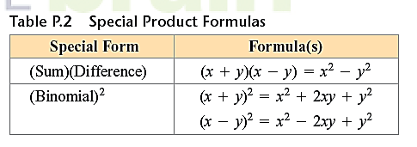
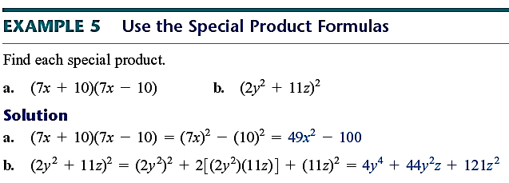

Slide 20

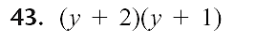

Slide 21


