Slide 1
Chapter 1
Measurement
In this chapter we will explore the following concepts:
1. Measurement of a physical parameter
2. Units, systems of units
3. Basic units in mechanics
4. Changing units

Slide 2
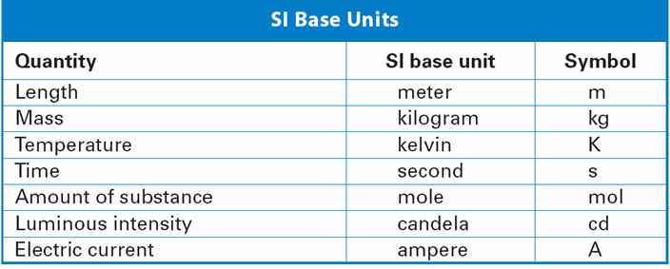

Slide 3
International System of Units:
These parameters are length, mass, and time.
They are known as basic quantities.
In this book we use the International System of Units (SI).
In this system the units for the base quantities are:
Parameter | Unit Name | Symbol
Length | meter | m
Mass | kilogram | kg
Time | second | sec or s

Slide 4
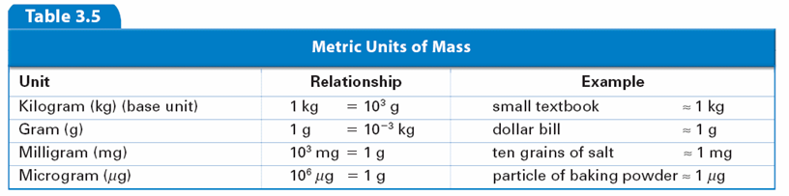
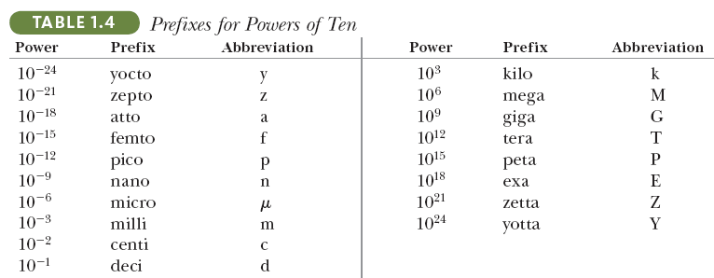

Slide 5
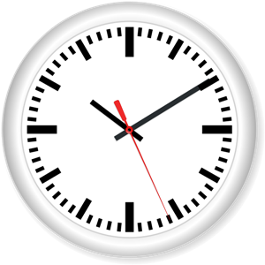


Changing Units

Slide 6
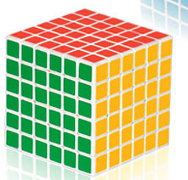
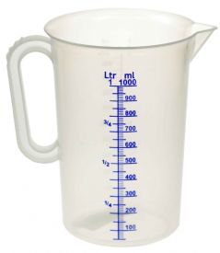
  Units of Volume:
The SI unit of volume is the cubic meter (m)³.
A more convenient unit of volume for everyday use is the liter, a non-SI unit.
A liter (L) is the volume of a cube that is 10 centimeters (10 cm) along each edge.
10 cm × 10 cm × 10 cm = 1000 cm³ = 1 L

Slide 7
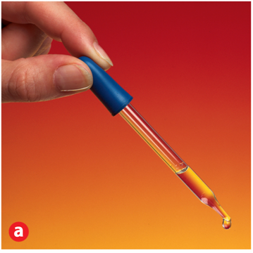
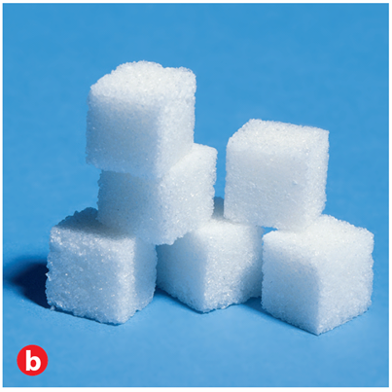
Units and Quantities
3.2
    The volume of 20 drops of liquid from a medicine dropper is approximately 1 ml.
    A sugar cube has a volume of 1 cm³. 1 ml is the same as 1 cm³.
Notes:
These photographs above give you some idea of the relative sizes of some different units of volume. a) The volume of 20 drops of liquid from a medicine dropper is approximately 1 mL. b) A sugar cube is 1 cm on each edge and has a volume of 1 cm³. Note that 1 mL is the same as 1 cm³. c) A gallon of milk has about twice the volume of a 2-L bottle of soda. Calculating How many cubic centimeters are in 2 liters?

Slide 8
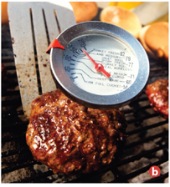
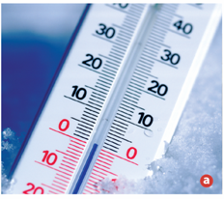
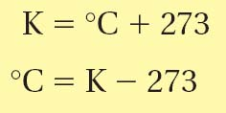
Units and Quantities
3.2
  Units of Temperature
Scientists commonly use two equivalent units of temperature, the degree Celsius and the kelvin.
Notes:
Thermometers are used to measure temperature. a) A liquid-in-glass thermometer contains alcohol or mineral spirits. b) A dial thermometer contains a coiled bimetallic strip. c) A Galileo thermometer contains several glass bulbs that are calibrated to sink or float depending on the temperature. The Galileo thermometer shown uses the Fahrenheit scale, which sets the freezing point of water at 32°F and the boiling point of water at 212°F.

Slide 9

Units and Quantities
3.2
    The joule (J) is the SI unit of energy.
    One calorie (cal) is the quantity of heat that raises the temperature of 1 g of pure water by 1°C.

Slide 10
THE END

