Slide 1
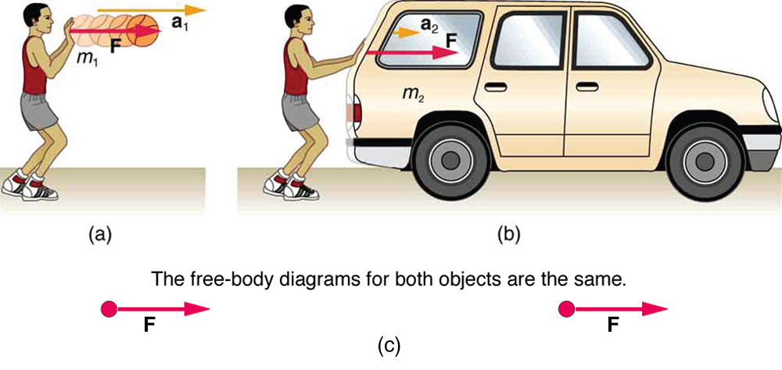
Chapter 2
Motion in one dimension

Slide 2

Position and Displacement
If an object moves from position x₁ to position x₂ , the change in position is described by the displacement
For example if x₁ = 5 m and x₂ = 12 m then Δx = 12 – 5 = 7 m. The positive sign of Δx indicates that the motion is along the positive x-direction.
If instead the object moves from x₁ = 5 m and x₂ = 1 m then Δx = 1 – 5 = -4 m. The negative sign of Δx indicates that the motion is along the negative x-direction.
Displacement is a vector quantity that has both magnitude and direction.
.
.
.
O
x_{i}
x_{f}
x-axis
Δx
motion

Slide 3
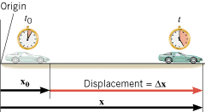
Displacement
DISPLACEMENT is defined as the change of an object's position that occurs during a period of time.
The displacement is a vector that points from an object’s initial position to its final position and has a magnitude that equals the shortest distance between the two positions.
SI Unit of Displacement: meter (m)

Slide 4
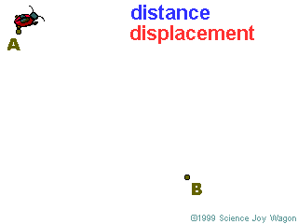

Slide 5



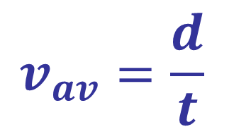
AVERAGE SPEED and AVERAGE VELOCITY
$$v_{av}=\frac{d}{t}$$
The speed of an object in a certain direction is velocity.
The unit of v_{av} is m/s.

Slide 6
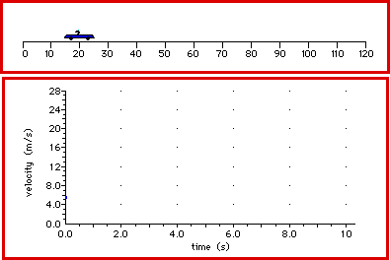

Slide 7
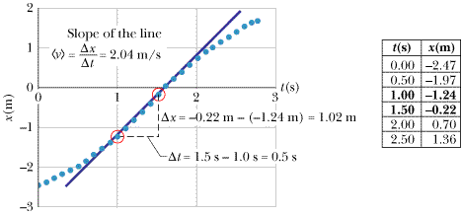
Example 5: find the average velocity for the student motion represented by the graph shown in Fig. 2-9 between the times t₁ = 1.0 s and t₂ = 1.5 s.

Slide 8
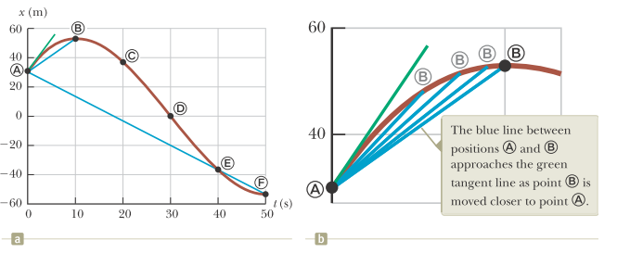
Instantaneous Velocity:
Instantaneous velocity is defined as the limit of the average velocity determined for a time interval Δt as we let Δt → 0.

Slide 9
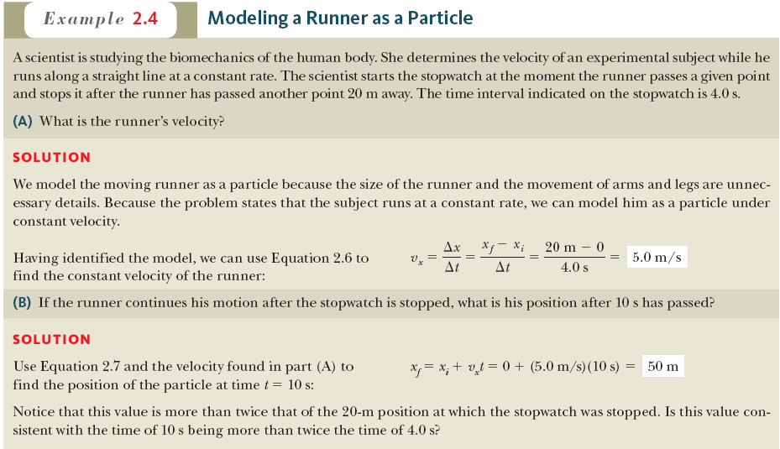

Slide 10

Acceleration is how quickly velocity changes over time.
0
Speed
3
1
2
Meters/second

Slide 11
Acceleration
how quickly velocity changes over time.
a = CHANGE IN VELOCITY/TIME
(V_{final} - V_{initial})
a =
___________
time

Slide 12


Average Acceleration
We define the average acceleration a_{avg} between t₁ and t₂ as
Units: m/s²
Instantaneous Acceleration
If we take the limit of a_{avg} as Δt → 0 we get the instantaneous acceleration a, which describes how fast the velocity is changing at any time t.
The acceleration is the slope of the v versus t plot.
Note: The human body does not react to velocity but it does react to acceleration.

Slide 13



Motion with Constant Acceleration
Motion with a = 0 is a special case but it is rather common, so we will develop the equations that describe it.

Slide 14
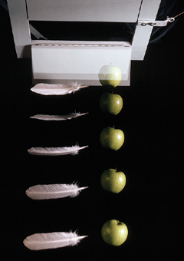
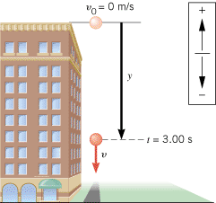
Free Fall

Slide 15
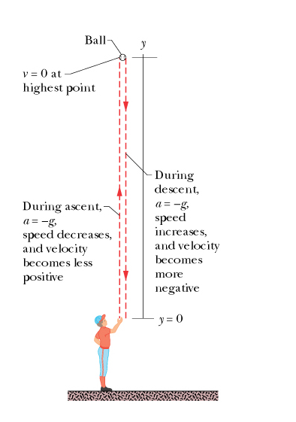
Free Fall:
If we take the y-axis to point upward then the acceleration of an object in free fall a = -g and the equations for free fall take the form:
Note:
Even though with this choice of axes a < 0, the velocity can be positive (upward motion from point A to point B).
It is momentarily zero at point B.
The velocity becomes negative on the downward motion from point B to point A.
a
y
B
A

