Slide 1
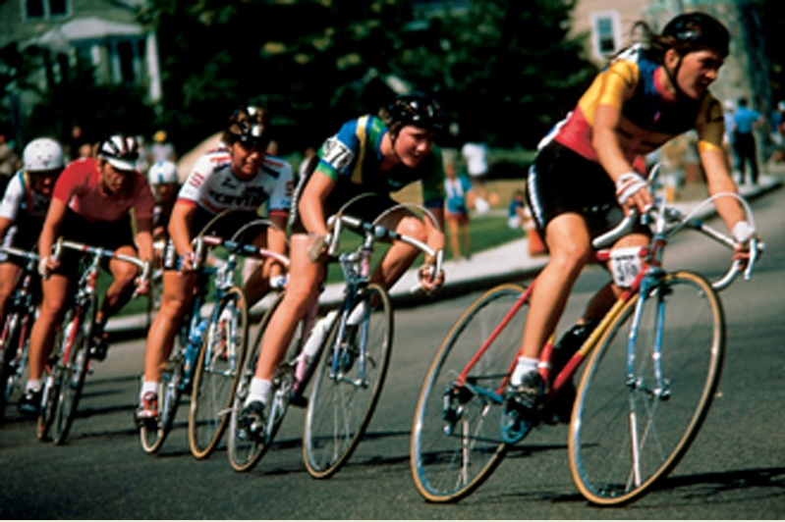
Force and Motion
Chapter 2

Slide 2
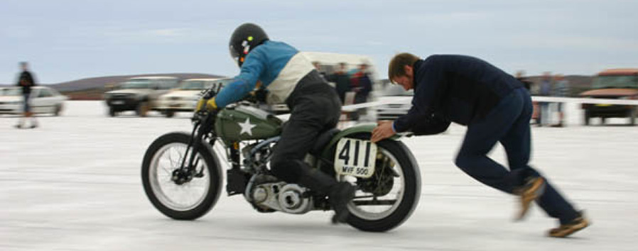
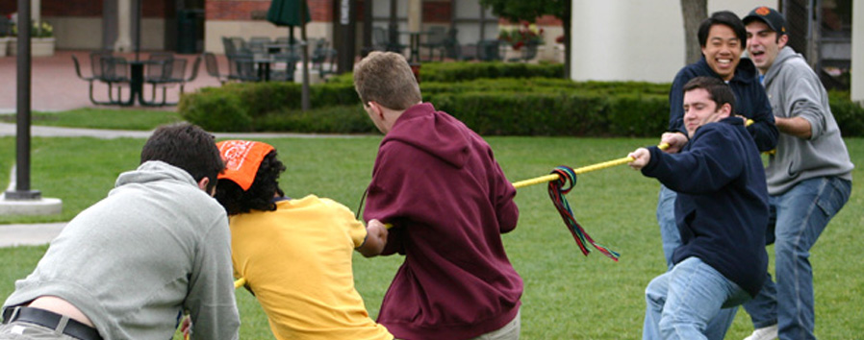
What is a Force?
A force is a push or pull on an object by another object and measured in newton (N).
Forces are vectors
Force is a push
Force is a pull

Slide 3
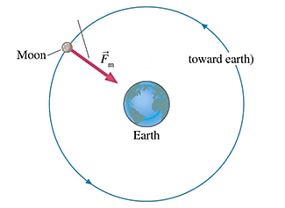
Non-contact forces (action at a distance)

Slide 4
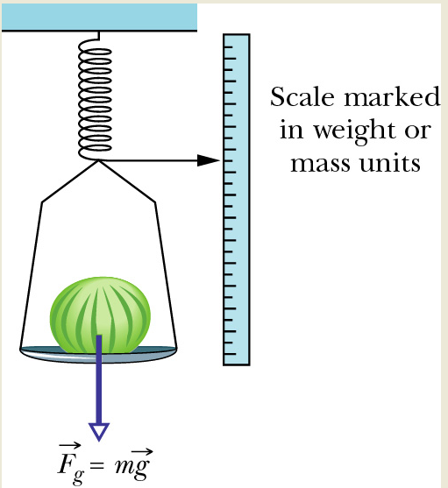
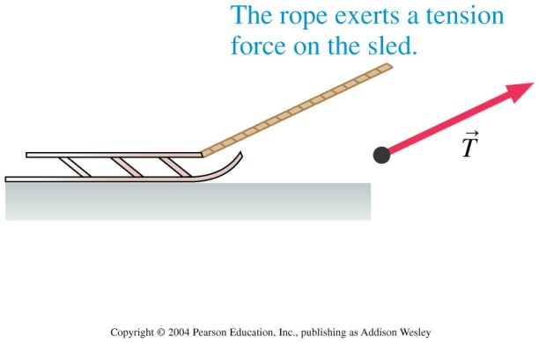
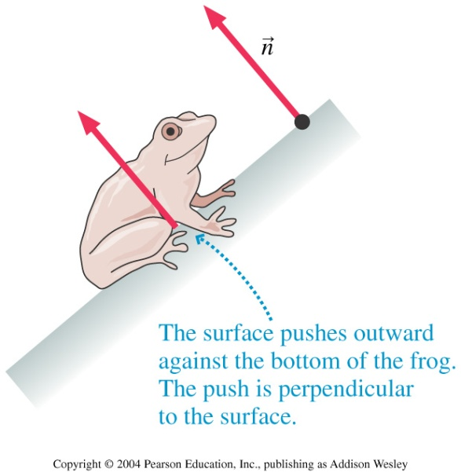
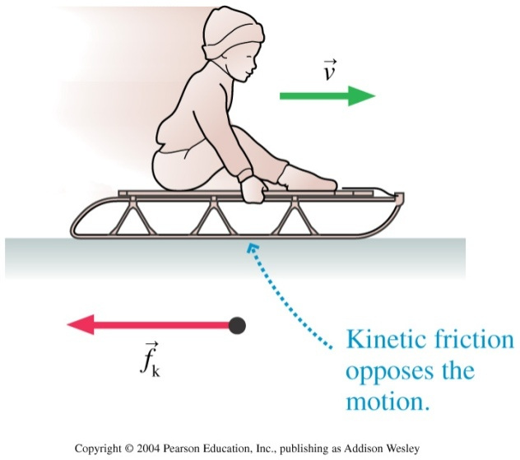
Some Common Forces
Weight (W) is the force of gravity on an object.
Tension Force (T) is the force provided by a string or rope.
Normal force (N) is the force provided by a surface perpendicularly.
Friction force (f) is a resistance to any attempt to move an object along a surface in contact

Slide 5
Some Common Forces
Weight is a vector, downward always
Weight equals mass times the acceleration of gravity
m is mass and g = 9.8 m/sec² is acceleration of gravity.
On moon g = 1.6 m/sec²
Weight changes with location
Mass dose not.
Your mass is 70 kg, then on earth your weight is about 700 N, but on moon it is 182 N. How?

Slide 6
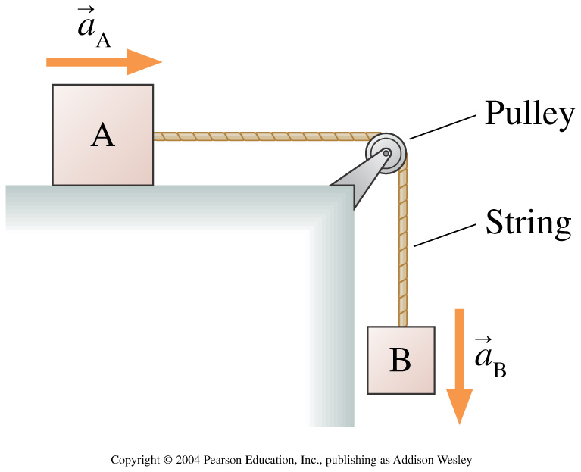
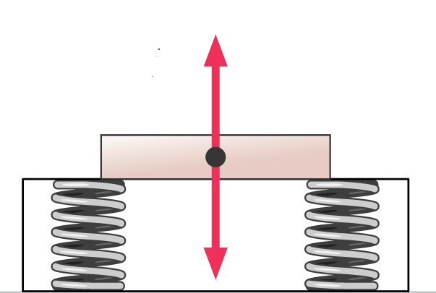
Examples
Identify the forces acting on the object shown in the following diagram

Slide 7
What is Mass?
Mass is the amount of matter inside an object
Mass is measured in gm or kg. Mass is not weight.
Mass equals weight divided by acceleration of gravity
Example: an object has weight of 300N on earth. How much is its mass?
Mass and inertia are related.
More mass means more inertia.
A GMC car has more inertia than a bike.

Slide 8
MASS | WEIGHT
Mass is a measure of how much matter an object has. | Weight is a measure of how strongly gravity pulls on that matter
Mass is scalar quantity | Weight is a vector quantity
The unit of mass is kg | The unit of weight is newton (N)
Mass does not change on different places. | Weight changes on different places.

Slide 9

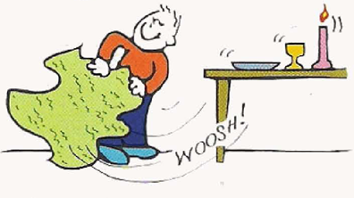
Inertia:
“The property of objects to resist changes in motion.”

Slide 10
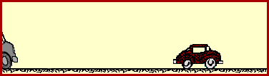
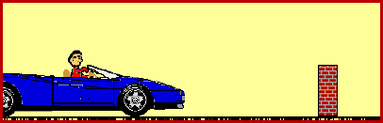
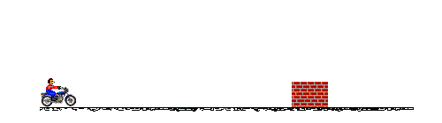

Slide 11
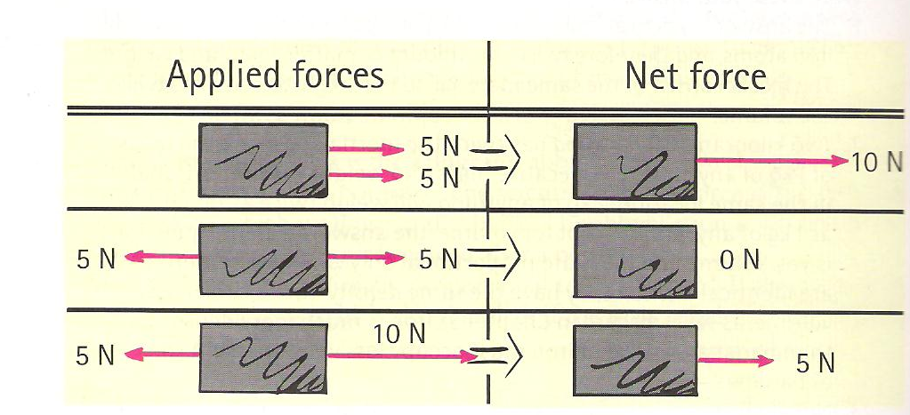
NET FORCE

Slide 12

Example
Find the net (resultant) force acting on the object as shown in the drawing below
Solution
Given
Note: The direction of the net force is always in the direction of the bigger force

Slide 13
Newton's First Law of Motion:
Newton’s first law of motion, usually called
‘LAW OF INERTIA’
It is the restatement of Galileo’s Idea.
If the net force acting on an object is zero, then the object remains at rest or moving continuously with constant velocity along straight line

Slide 14
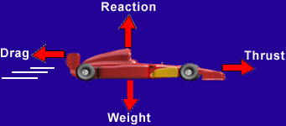
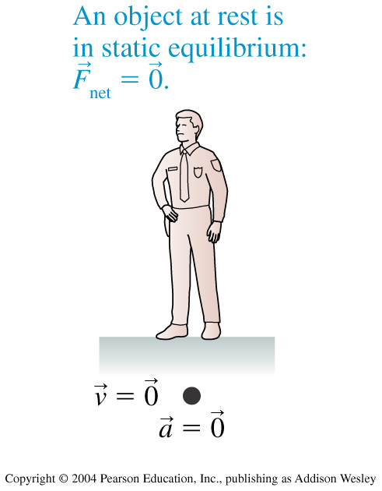
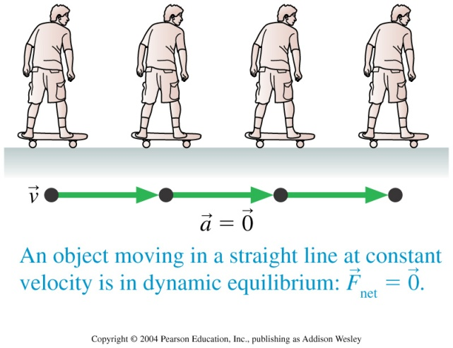
Mechanical Equilibrium
An object on which = 0 is said to be in mechanical equilibrium. By Newton’s first law, there are two kinds of mechanical equilibrium:
Static equilibrium. The object is at rest.
Dynamic equilibrium. The object is moving with constant velocity along straight line.

Slide 15
Example
A box is suspended by a rope and it is at rest. The mass of the box is 20kg
Find
The box’s weight
Apply the mechanical equilibrium condition and
Find the tension in the rope

Slide 16
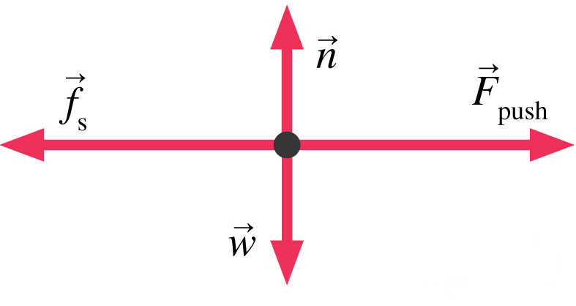
Example
The object shown as a dark dot is under the action of four forces. The object will
Move to the right
Move to the left
Move upward
Move downward
Not move because it is under mechanical equilibrium
Hint: consider the length of each vector

Slide 17



Newton’s Second Law of Motion:
“The acceleration produced by a net force on an object is directly proportional to the net force, is in the same direction as the net force, and is inversely proportional to the mass of the object.”
In equation form we can write,

Slide 18
Example
Two forces of 40 N and 28 N acting on an object of mass 3 kg s shown below. Does the object have acceleration? If it does then find its magnitude and its direction
F₂ = 28 N
F₁ = 40 N
m= 3kg
F_{net}

Slide 19
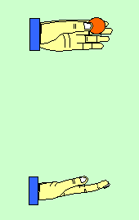
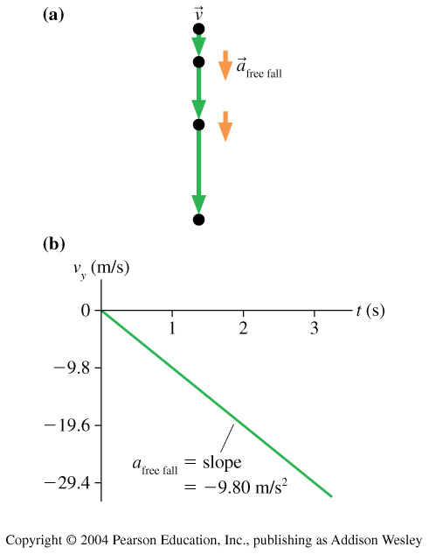
When a = g: Free fall Motion

Slide 20
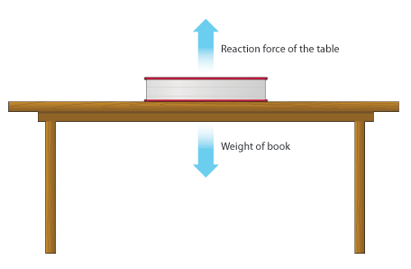
Newton’s Third Law of Motion:
“ Whenever one object exerts a force on a second object, the second object exerts an equal and opposite force on the first.”
We can call one force the ‘action force’, and the other the ‘reaction force’.
we can express Newton's third law in the following form:
“For every action there is always an opposed equal reaction.”

Slide 21
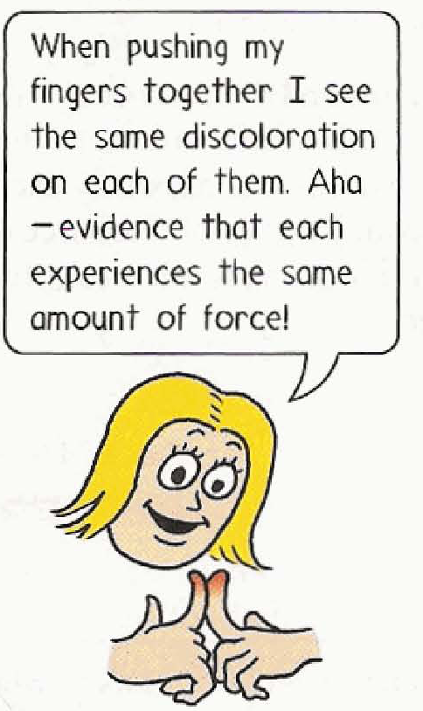
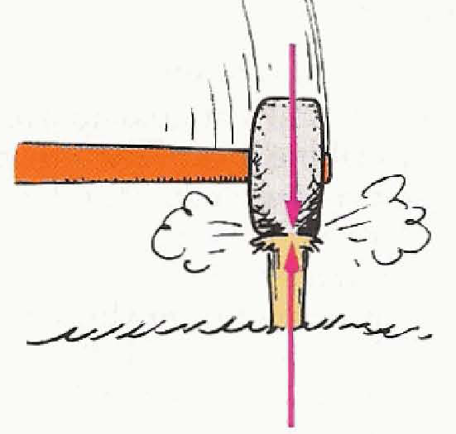
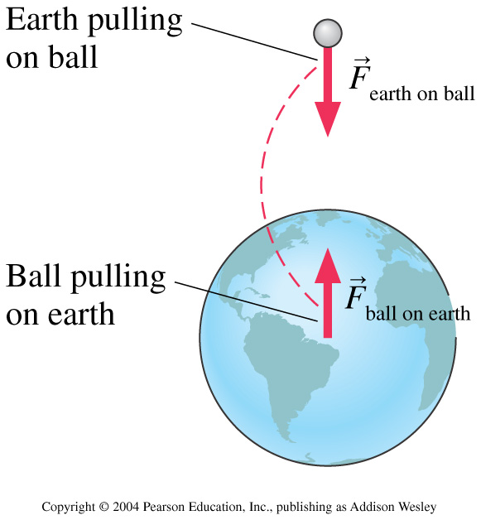

Slide 22
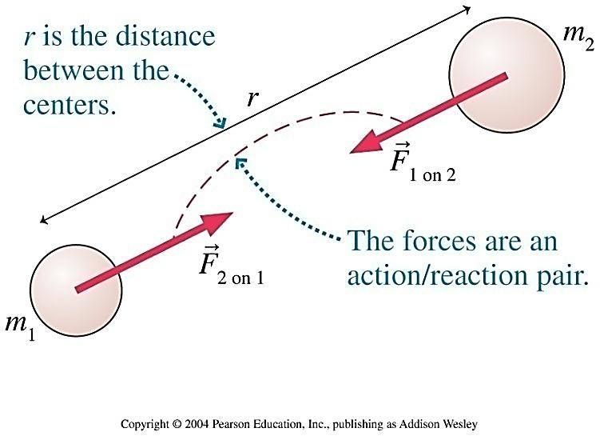
Newton’s Law of Universal Gravitation
Any two objects in the universe attract each other with a force that is
Proportional to the product of their masses , and
Inversely proportional to the square of the distance between them

