Slide 1

Chapter 3
Work and Energy

Slide 2
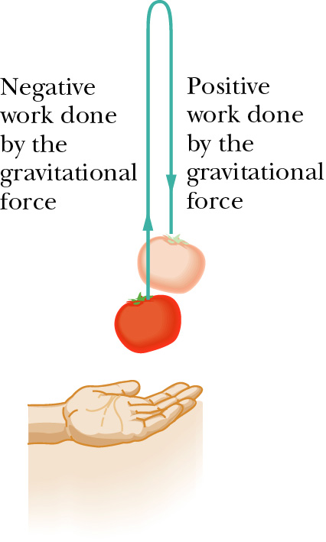
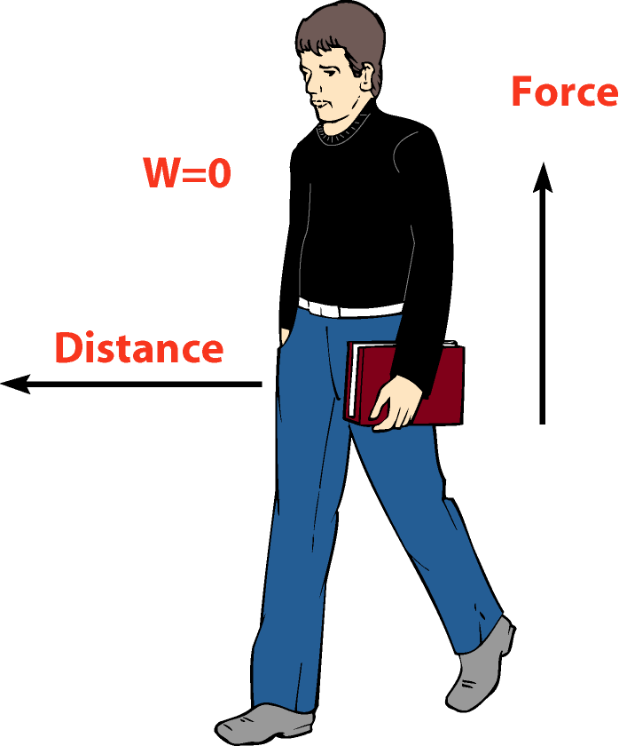
Work:
“Work is the product of force and distance.’’
Work = Force × Distance
or in shorthand notation,
W = F d
S.I Unit of Work:
joules

Slide 3
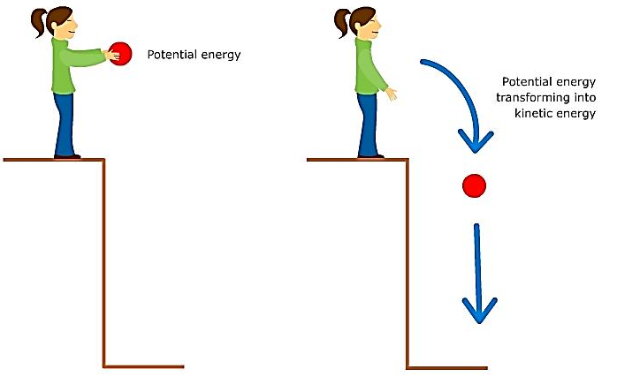
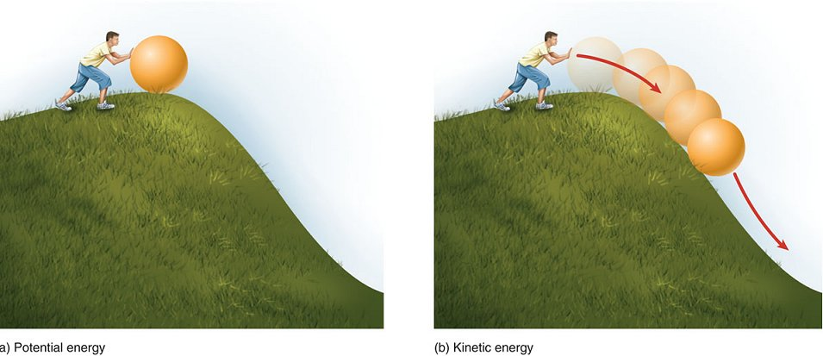
Energy:
“The ability of a body to do work is called Energy’’
S.I Unit of Energy:
joules
Potential Energy:
“The Energy stored by an object by virtue of its position is called Potential Energy (P.E)”
or in shorthand notation,
P.E = mgh
S.I Unit of P.E:
joules

Slide 4


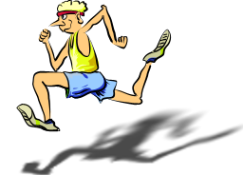
Kinetic Energy:
“The Energy of motion is called Kinetic Energy (K.E)” or in shorthand notation,
S.I Unit of K.E:
joules

Slide 5
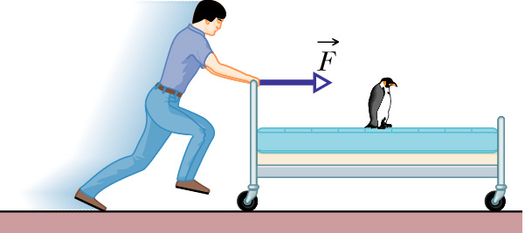
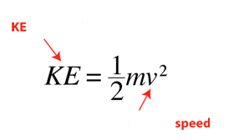
2. Kinetic Energy KE
Is the energy of motion
If speed doubled, KE increases by 4 times

Slide 6
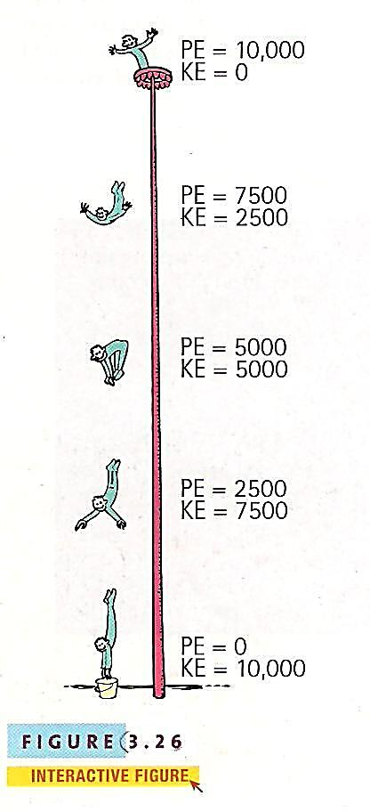
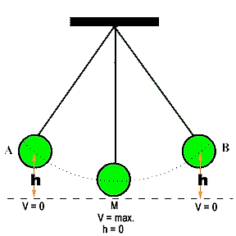
Conservation of Energy:
“The energy cannot be created or destroyed; it may be transformed from one form into another, but the total amount of energy never changes.”

Slide 7
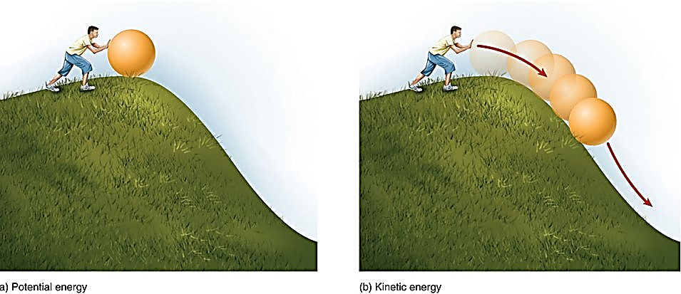
Conservation of Energy

Slide 8
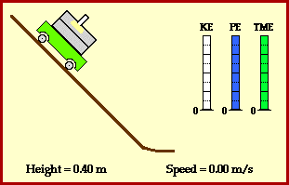
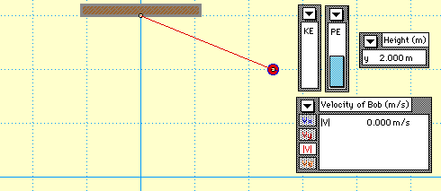

Slide 9
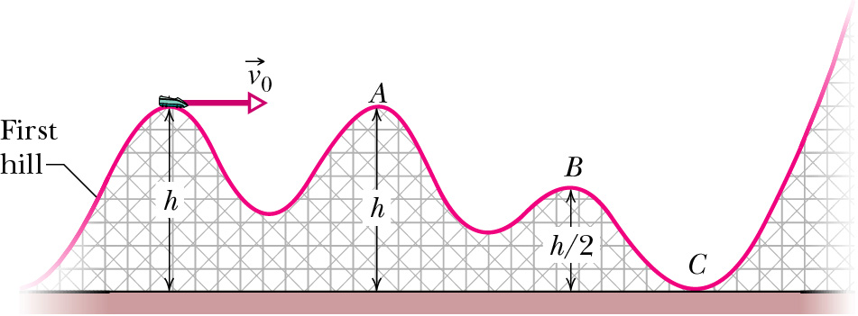
At which height relative to the ground, the object has the lowest GPE
A
B or
C

Slide 10
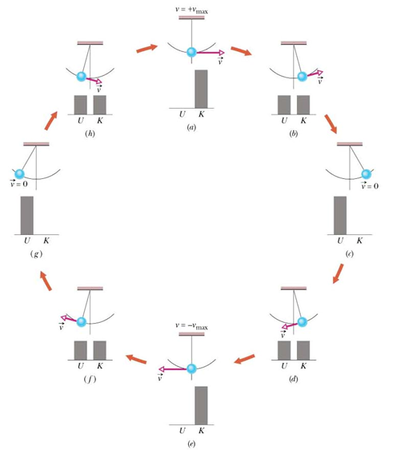
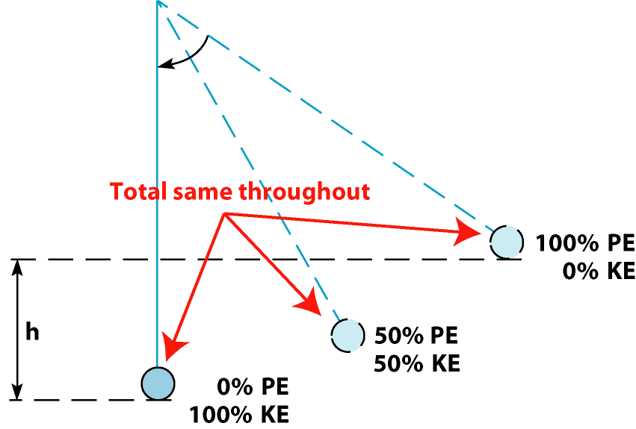
Energy Conversion
Pendulum

Slide 11
Energy Conversion
A stone is dropped from a height h above the ground

Slide 12
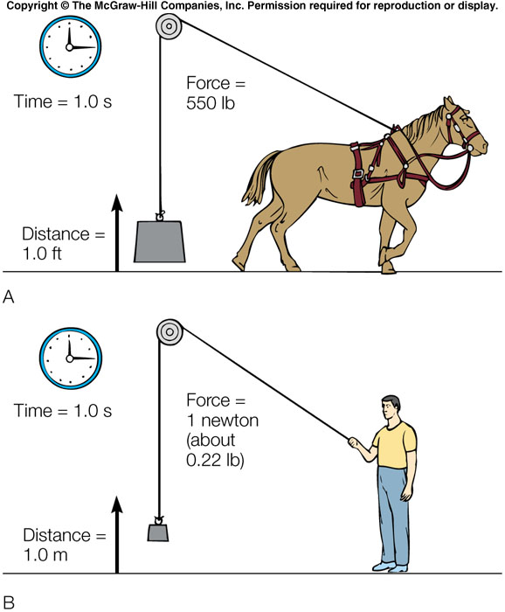
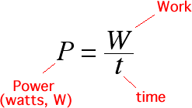
Power P
Power P is work per unit time
Unit- Watt= Joule/sec
Horse power (hp) English system
1hp= 746 Watt

Slide 13
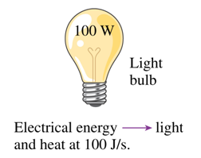
Examples
An elevator with a person inside weighs 5000 N. If it is raised to a height of 15 m in 10 sec. Find
(a)The work done on the elevator by the motor.
(b)The power
100 Watt lamp

Slide 14
Simple Machines
A simple machine is a mechanical device that multiplies an applied force or it makes it bigger
The applied force to the machine is called effort
The force that the machine is to overcome is called the resistance
Examples of Simple Machines
- Lever
- Pulley

Slide 15
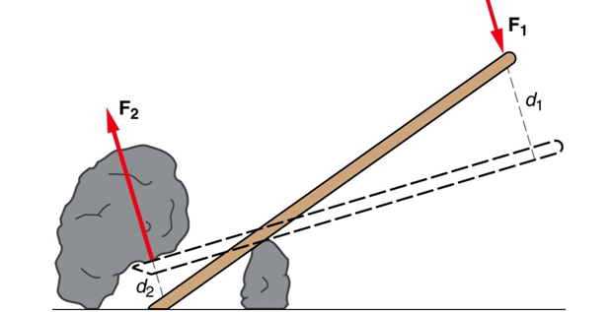
The Lever
F₁ = F_{e} effort
F₂ = F_{r} resistance (load)
d₁=d_{e} =effort distance from fulcrum
d₂ =d_{r} =resistance distance from fulcrum
Always d₁> d₂ why?
fulcrum
All distances are measured from a fixed point (fulcrum)
Mechanical Advantage

Slide 16
Example
A person applies 30 N force on the car jack (a lever) and the machine produce 600 N lifting force on the car. What is the jack’s mechanical advantage?

Slide 17
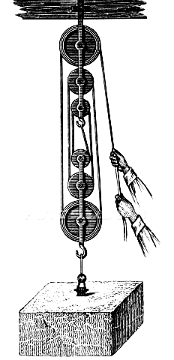
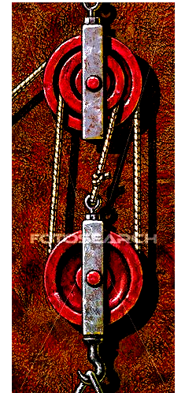
The pulley
A pulley is a grooved wheel that turns on an axle and is supported on a frame
Single pulley has no MA
MA for system of pulleys
equals number of ropes
That support movable
pulley
Fixed triple
Movable triple
F_{e}
MA=3
F_{r}
MA=6 how?

Slide 18
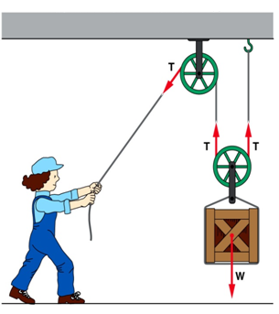
Double pulley system consists of a fixed (not movable) pulley and a movable pulley attached to the load to be lifted. Notice how easy for the operator to move the load.

Slide 19
Quiz
1. Joule is unit of
Work
Energy
Power
Energy and work
2. Energy of position is
KE
GPE
Power
Work
3. Energy of motion is
KE
GPE
Power
Work
Work changes
KE
GPE
Power
Both KE and GPE
5. Work done by friction is
Zero
positive
Negative
Infinity
6. Work done by gravity on vertically thrown object is positive
True
False

Slide 20
7. Work done by force of gravity on a falling object is negative.
True
False
8. Energy can be converted from KE to GPE and vice versa.
True
False
9. Power is the work done per unit time.
True
False
10. Simple machines are used to multiply distances.
True
False
11. A single pulley has mechanical advantage 1.
True
False
12. Mechanical advantage can be less than 1.
True
False

