Slide 1
Impulse and Momentum
Chapter 4

Slide 2
Momentum:
By Momentum, we mean “Inertia in Motion” or more specifically, the mass of an object multiplied by its velocity.
Momentum = mass × velocity
or in shorthand notation,
Momentum = m × v
P = m × v
When direction is not an important factor, we can say
Momentum = mass × speed
S.I Unit of Momentum :
Kg-m/sec or N-sec

Slide 3
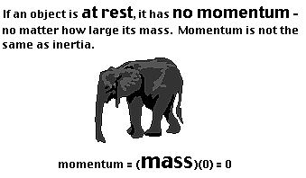
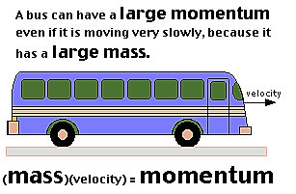

Slide 4
P_{1(initial)} + P_{2(initial)} = P_{1(final)} +P_{2(final)}
Law of Conservation of Momentum
If no net external force acts on a system, the total linear momentum of the system cannot change.
Or It can be stated that
The sum of a system's initial momentum is equal to the sum of a system's final momentum.
The law of conservation of momentum can be mathematically expressed as
Total momentum before collision = Total momentum after collision

Slide 5
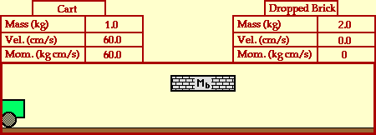

Slide 6
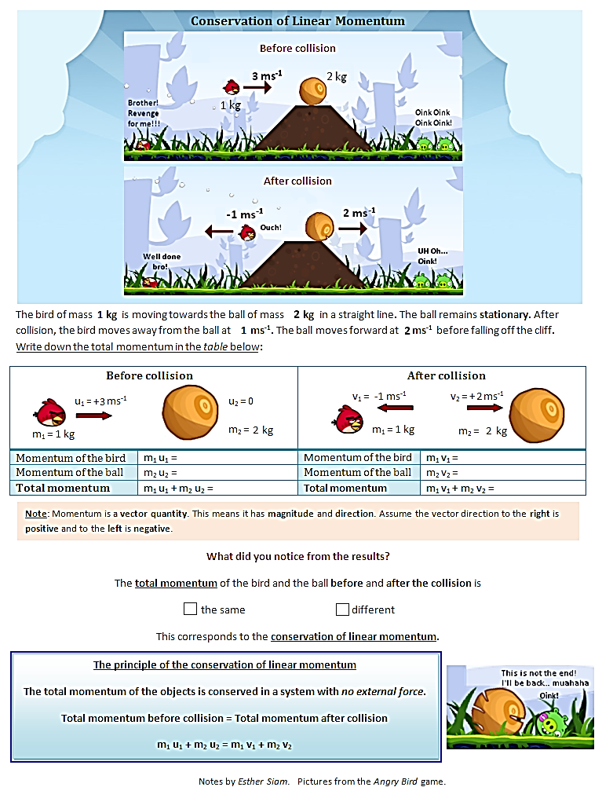

Slide 8
Impulse Changes Momentum:
The greater the impulse exerted on some thing, the greater the change in momentum. The exact relationship is,
Impulse = Change in Momentum
or in shorthand notation,
Ft = Δ(mv)
Where Δ is the symbol for “change in”

Slide 9
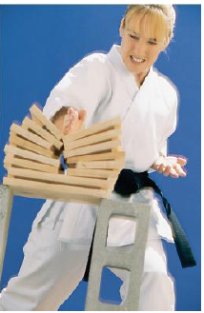
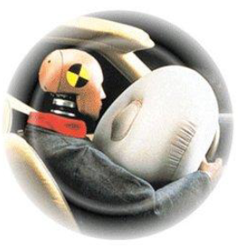

Slide 10
Example
An average force of 300 N acts for a time of 0.05 s on a golf ball. What is the magnitude of the impulse acting on the ball?
Solution
Given data:

Slide 11
Example
A bowling ball of mass 5kg travels at 2m/s and a tennis ball with mass of 150g. Can both balls have the same momentum? If yes at what speed must the tennis ball travel to have same momentum?
solution
V =2m/s
Given data:
m = 150g M = 5kg

Slide 12
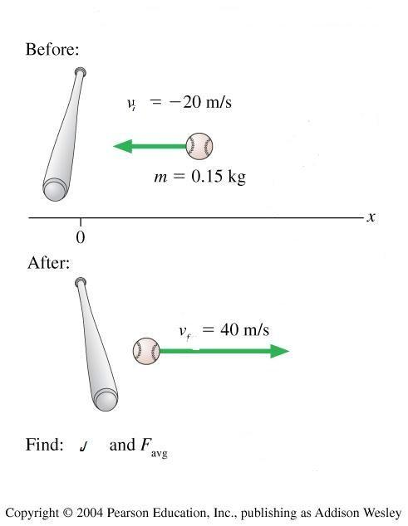
Example
A baseball of mass 0.15 kg has an initial velocity 0f -20 m/s (moving to the left) as it approaches a bat. It is hit straight back to the right and leaves the bat with a final velocity of +40 m/s. (a) Determine the impulse applied to the ball by the bat. (b) Assume that the time of contact is , find the average force exerted on the ball by the bat. (c) How much is the impulse exerted by the ball on the bat?

Slide 13
Solution
(1) Apply the impulse-momentum theorem
(2) Apply the equation that defines impulse
(3) Apply Newton’s third law of action and reaction and get
Impulse exerted on the bat by the ball equals -9 kg m/s. The negative sign indicates a direction to the left of the origin of coordinate system.

Slide 14
Applications
Recoil of a gun: why a rifle recoils when a bullet is fired?
A 10 g bullet is fired from a 3 kg rifle with speed of 500 m/s. What is (a) the initial momentum of the system (bullet and rifle)? And (b) the recoil speed of the rifle?
b=bullet
r=rifle
i=initial
f=final

Slide 15
m₁ = 3 kg m₂ = 10 gm = 0.01 kg v_{1i} = 0 m/sec (before firing) v_{2i} = 0 m/sec (before firing) v_{2f} = 500 m/sec (after firing)
P = ? v_{1f} = ? (after firing)
A 10 g bullet is fired from a 3 kg rifle with speed of 500 m/s. What is (a) the initial momentum of the system (bullet and rifle)? And (b) the recoil speed of the rifle?

Slide 16
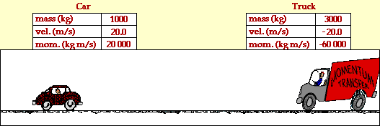
Collision
Elastic Collision
Is a collision in which the total kinetic energy of the collided objects after collision equals the total kinetic energy before collision.
P_{1i} + P_{2i} = P_{1f} + P_{2f}
K_{1i} + K_{2i} = K_{1f} + K_{2f}
The collided object bounce a part and return to their original shape without a permanent deformation

Slide 17
Inelastic Collision
- Is one in which the total kinetic energy of the collided objects after collision is not equal to the total kinetic energy before collision. The two object experience a permanent deformation in their original shape
P_{1i} + P_{2i} = P_{1f} + P_{2f}
K_{1i} + K_{2i} ≠ K_{1f} + K_{2f}
- In completely inelastic collision, the two objects coupled and move as a one object after collision
In both collisions, conservation of momentum is applied

Slide 18
Example on Elastic collision
A ball of mass 0.6 kg traveling at 9 m/s to the right collides head on collision with a second ball of mass 0.3 kg traveling at 8 m/s to the left. After the collision, the heavier ball is traveling at 2.33 m/s to the left. What is the velocity of the lighter ball after the collision?
solution
Given Data

Slide 19
Example about completely Inelastic Collision
A kg railroad car traveling at 8 m/s to the east as shown in the drawing below is collided with another car of the same mass and initially at rest and couple with it. What is the velocity of the coupled system of cars after the collision?

