Slide 1
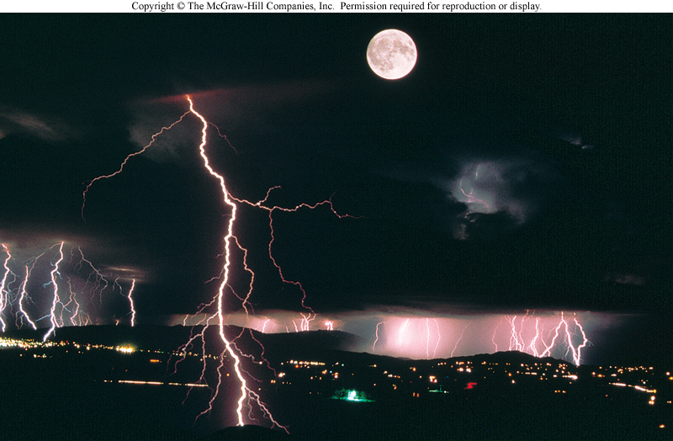
Static and Current Electricity
Chapter 5

Slide 2
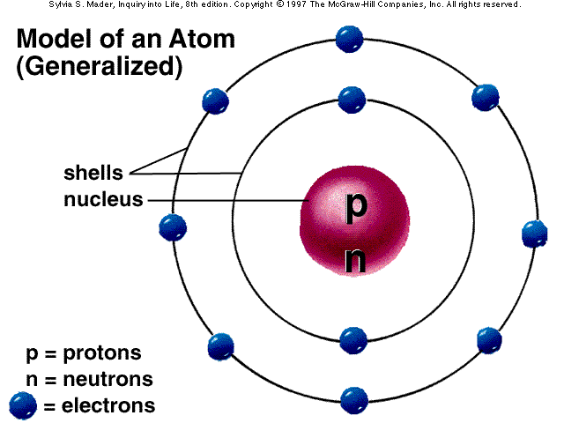
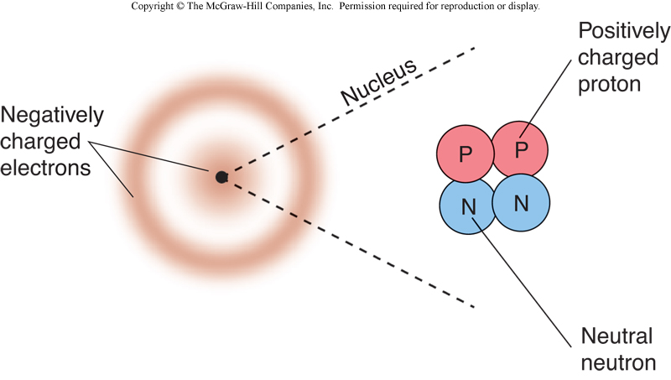
Electric Charge
Atom is made up of electrons and nucleus
Nucleus contains the protons and neutrons
Electrons are outside the nucleus like a cloud surrounding the nucleus

Slide 3
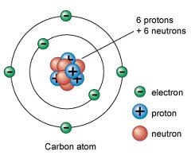
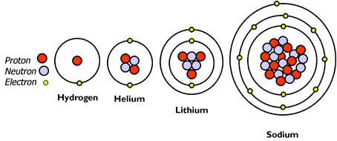
Electric Charge
Charges in matter
Electrons: negative electric charge
Protons: positive electric charge
Charge interaction
Electric force
Like charges repel; unlike charges attract
At normal conditions, atom is neutral (carry no charge.
No. of electrons = No. of protons

Slide 4
electric charge
Unit of charge = coulomb (C)
In one coulomb of charge there are
Electron charge=
Proton charge =
Neutron charge= 0

Slide 5
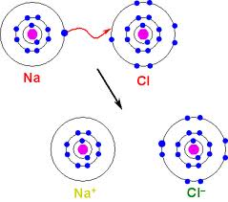
Ions
An ion is a charged object with non-zero net charge because of lose or gain of electrons
A positive ion is an atom that lost electron(s). Example sodium atom that lost one electron becomes a positive ion written as Na¹⁺ . Calcium loses two electrons and becomes Ca²⁺
A negative ion is an atom that gained electron(s). For example, Chlorine gains sodium’s donated electron and becomes a negative ion, or Cl¹⁻ .

Slide 6
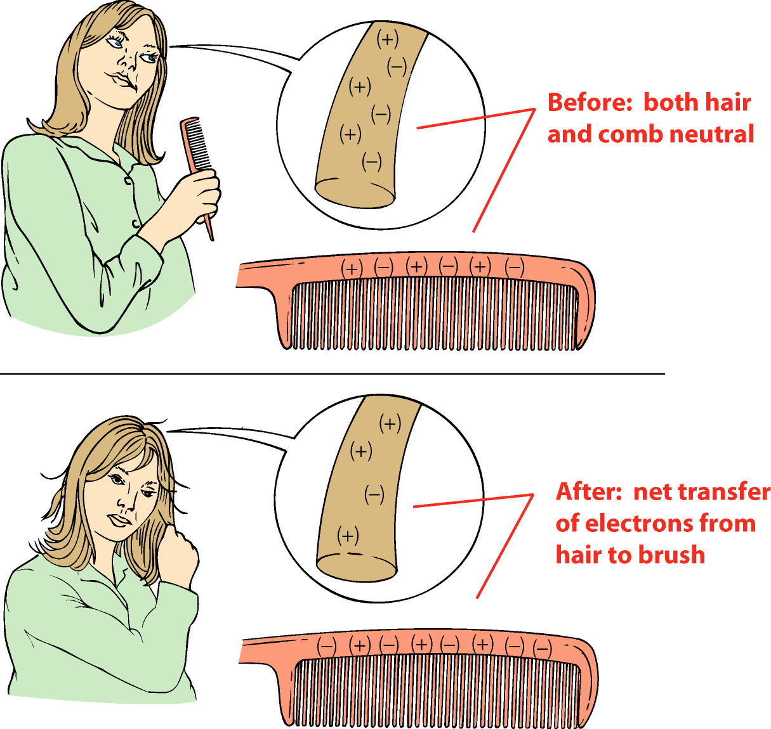
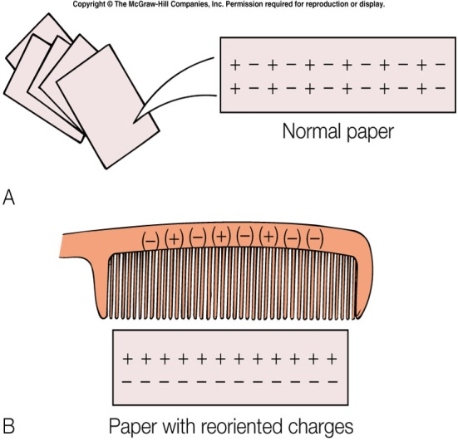
Static Charge
Static charge=Charge at rest on an object as a result of
  Friction or rubbing
  Contact with a charged object (charge by induction
  Examples: combing hair, rubbing a rod of rubber with fur. Rod becomes negatively charged object
Comb attracts pieces of paper

Slide 7
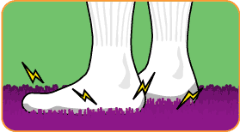
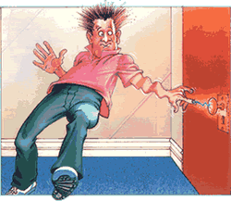
Example of Static Electricity
When your rubber or plastic soled shoes drag across a rug or carpeted room, they pick up electrons from the rug due to friction/rubbing. Are you negatively or positively charged?
Why do you get a slight shock when you touch the doorknob after that
You have same experience when you leave your car and touch the car’s doorknob.

Slide 8
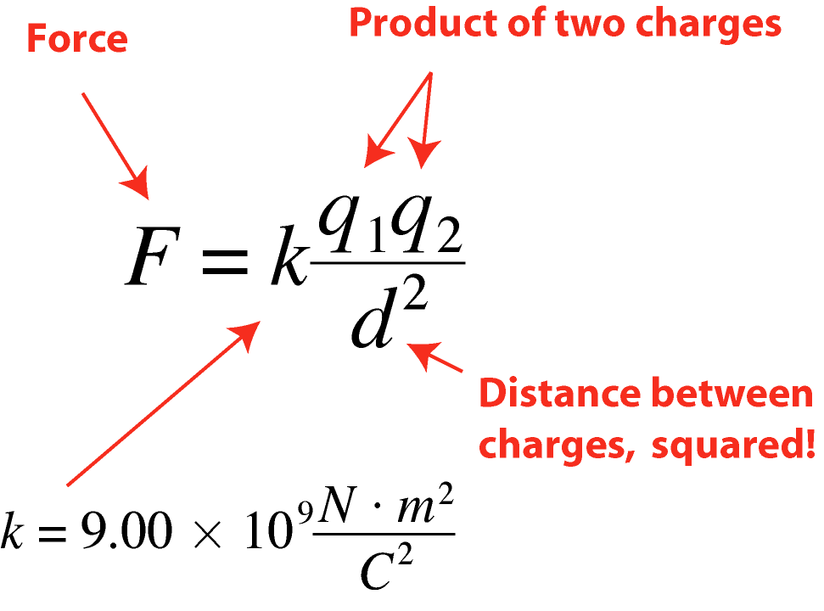
Coulomb’s Law
Coulomb’s law
Relationship giving force between two charges
Force between two charged objects:
  repulsive if q₁ and q₂ are same
  attractive if q₁ q₂ different
Both objects feel same force
Distance between objects increases: strength of force decreases
  Double distance, force reduced by 1/4

Slide 9
Example
What happens to the force between two charges if the distance between them becomes three times bigger?
What happens to the electrical force between two charges when the distance between them is reduced to 1/3 of its original value?

Slide 10
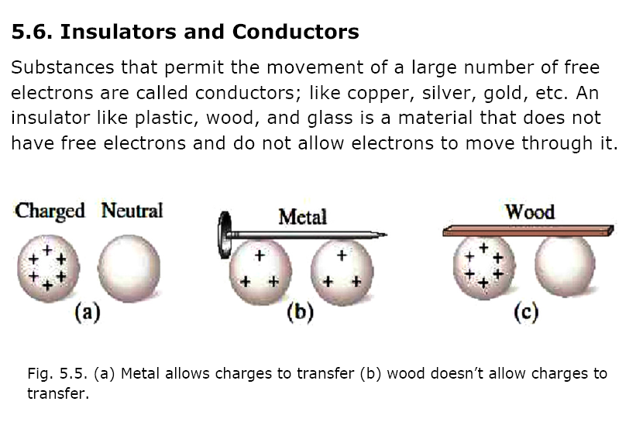

Slide 11
Electric potential
Electric potential = electric potential difference = voltage (all the same)
Lifting a box upward against gravity requires work. This work appears as a gravitational potential energy GPE = mgh and stored in the object.
In electricity, if we push a negative charge q towards another negative charge requires work. This work appears and stored in the charge as an electric potential energy U (in Joules)
Electric potential (voltage)
12 V= 12 J/1C

Slide 12
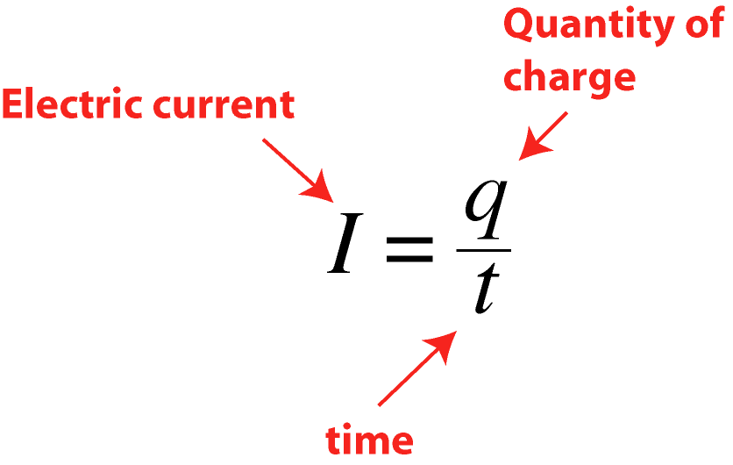
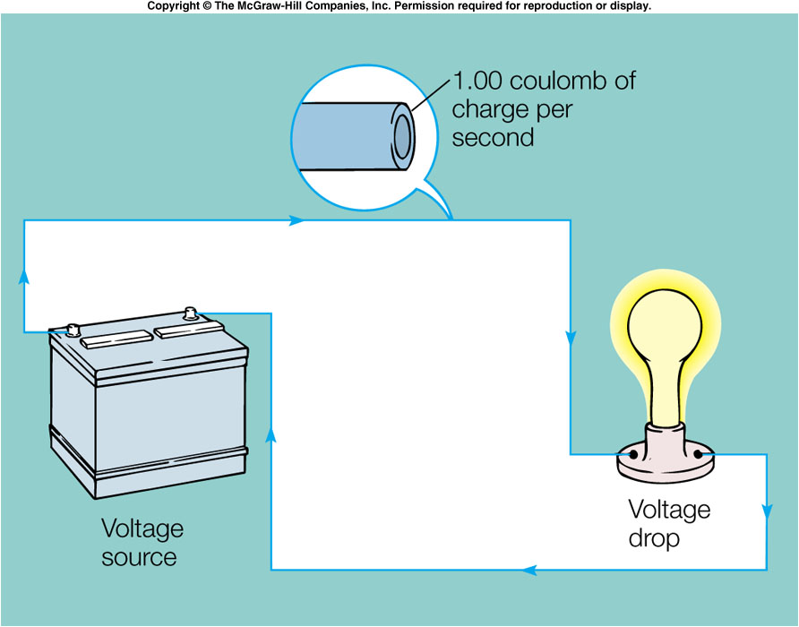
Electric Current
Electric current “I” is the flow of electric charge (electrons) that transports energy from one place to another.
Current = charge per unit time
Units = ampere, amps (A)
Direct current (DC)
  Charges move in one direction
  Electronic devices, batteries, solar cells
Alternating current (AC)
  Current flows one way then the other

Slide 13
Example
An electric iron takes 9 A of current. Show that the number of coulombs (charge) that flow through it in 1 min is 450 C?

Slide 14
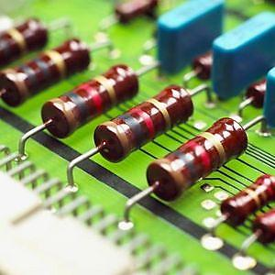
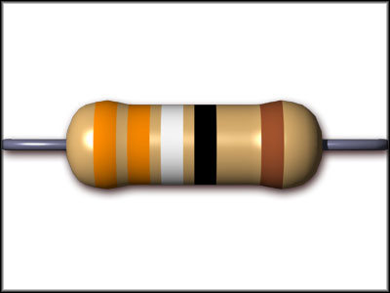
Electric Resistance R
Resistance is to resists electron flow (I). Electrons Loss current energy
Two sources of resistance
  Collisions with other electrons in current
  Collisions with other charges in material
Unit of R = Ohm or Ω

Slide 15
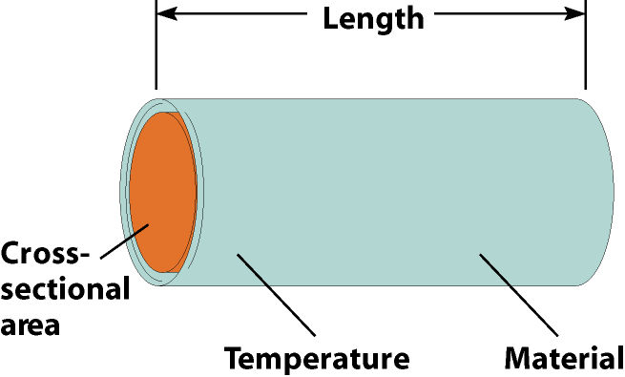
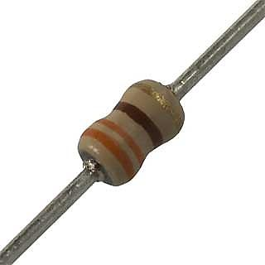
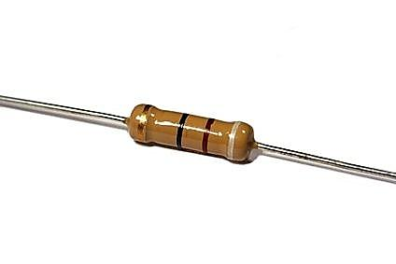
Resistance factors
  Type of material
    Conductors have less electrical resistance, insulators have more
  Length
    Longer the wire, more resistance
  Cross sectional area
    Thinner the wire, the more resistance
  Temperature
    Resistance increases with increasing temperature

Slide 16
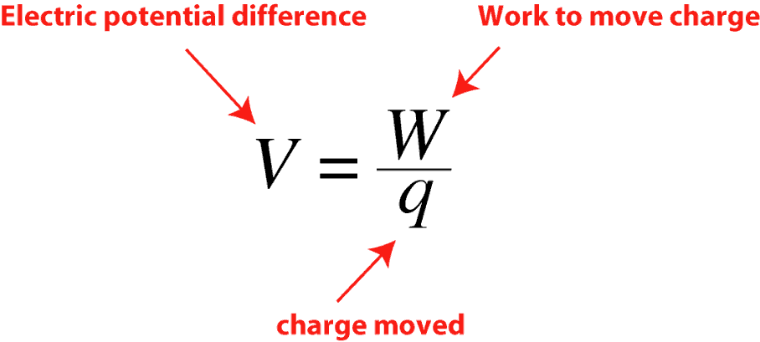
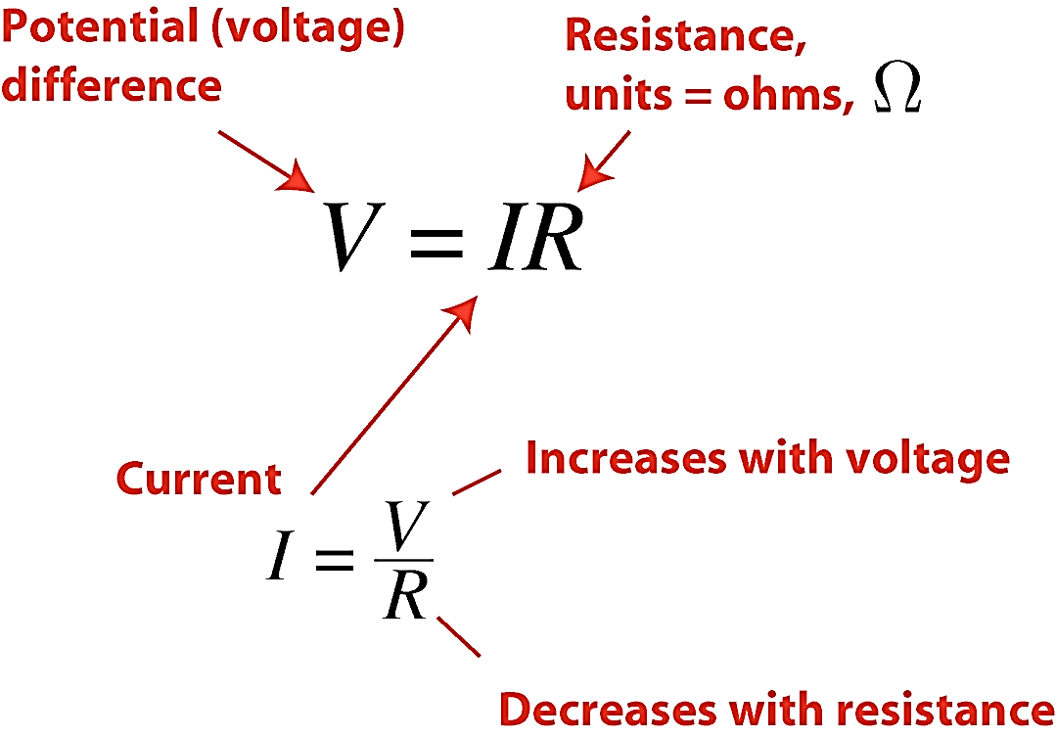
Ohm’s Law
Relationship between voltage V, current I, and resistance R
Voltage or electric potential difference is the electric potential energy or work divided by charge. Measured in volts
Ohm’s law can be written as:

Slide 17
Example
A light bulb in a 120 V circuit. A current of 0.50 A flows through the filament. What is resistance of the bulb

Slide 18
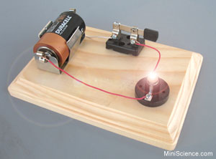
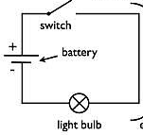
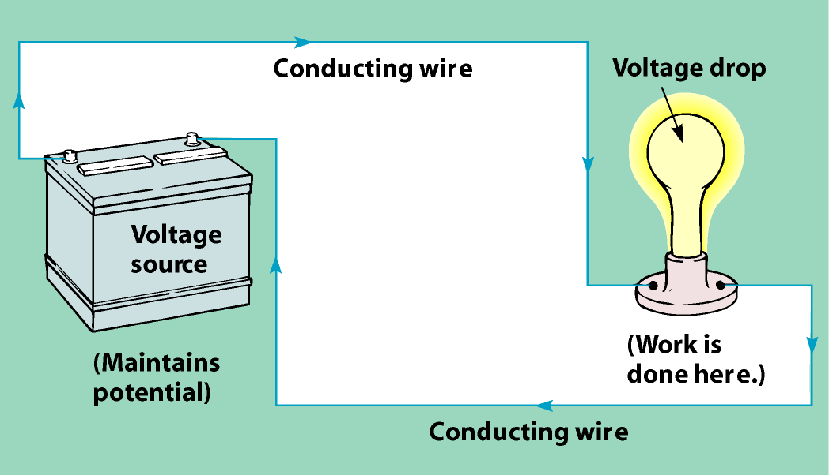
Electric Circuit
Energy source (battery, generator)
  Necessary for continuing flow
  Charge moves out one terminal, through wire and back in the other terminal
Circuit elements
  Charges do work on them
  Examples: Light bulbs, run motors, provide heat

Slide 19
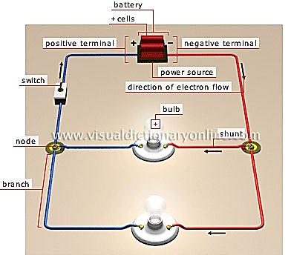
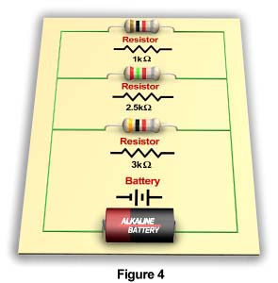

Slide 20
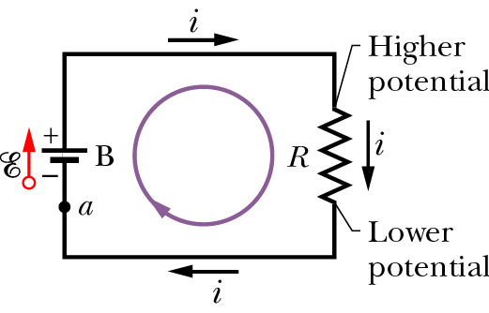
Typical simple electric circuit

Slide 21
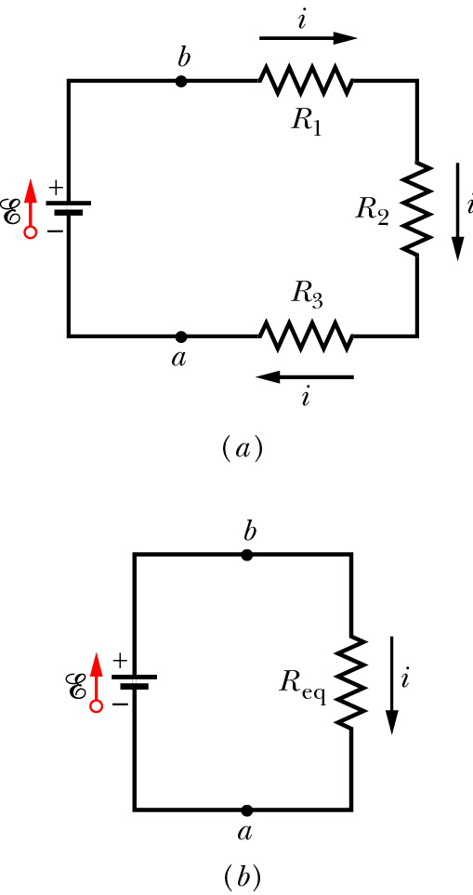
Series and Parallel Circuits
Series Circuit
Assume V=ξ
What is V₁?

Slide 22
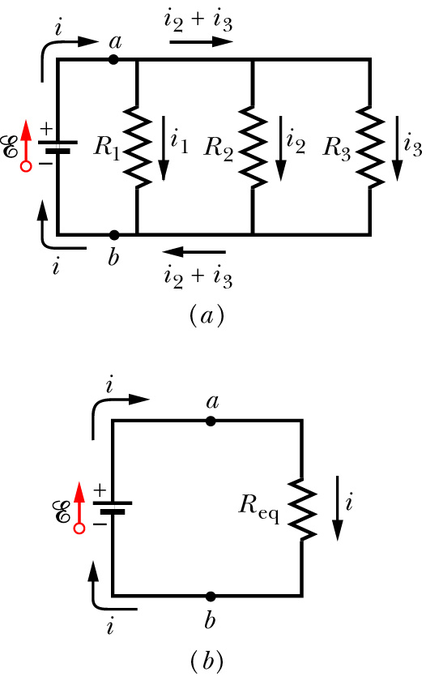
Series and Parallel Circuits
Parallel Circuit

Slide 23
Example
Two resistors 6 and 4 Ohm are connected in series with a 6 V battery (a) find the equivalent resistance, (b) find the current in the circuit, (c) find the voltage a cross 4 Ohm resistor.
Repeat if the two resistors are connected in parallel with the same battery

