Slide 1
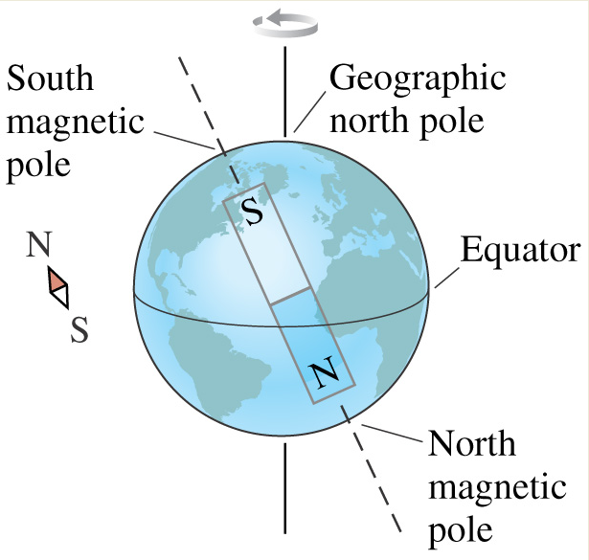
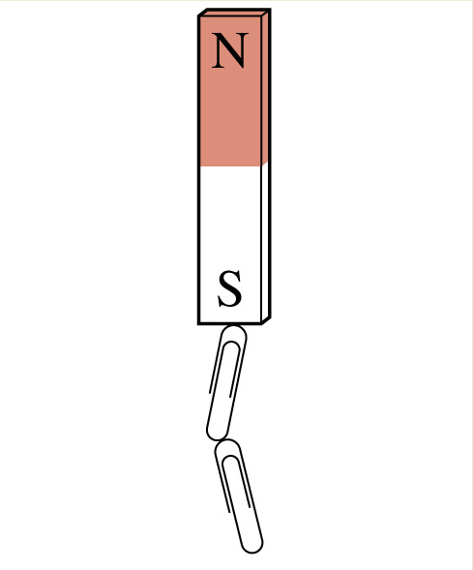
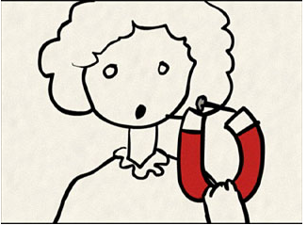
Magnetism
Chapter6

Slide 2
Magnetism
Magnetism was known from long times ago
Ancient Greek and Chinese used stones exist in nature that have “magical” attractive properties later known as lodestone and magnetite (iron oxide Fe₂0₃)
These stones used in navigation
Today we know that iron, cobalt, and nickel are magnetic materials. They are magnets due to special arrangements of their electrons
Other elements like aluminum, silver, gold,… are not magnets (Why?)

Slide 3
Magnetic Materials
A natural magnet is a material made of magnetite
A natural magnet attracts certain materials:
Cobalt
Nickel
Iron
Steel
Alloys of any of the above
These materials are called Magnetic materials

Slide 4
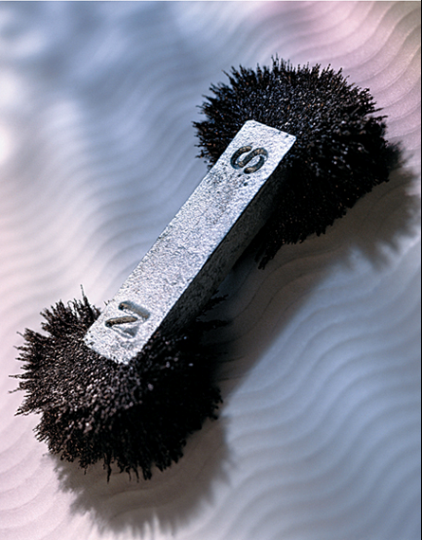
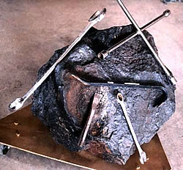
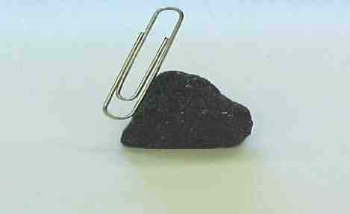
What Does a Magnet Do?
A magnet exert a force of attraction or repulsion on magnetic materials only

Slide 5
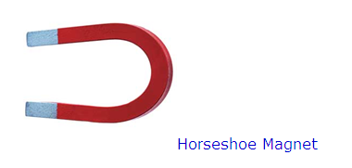
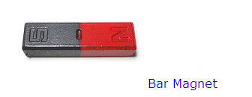
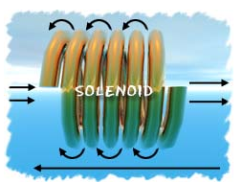
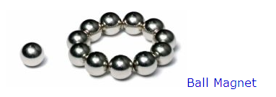
Types of magnets
electromagnet

Slide 6
Properties of Magnets
Magnets have the following properties:
a magnet has 2 magnetic poles
- the North and South seeking poles
If allowed to swing freely, a magnet will come to
rest with one end pointing towards the Earth’s
North pole, the other end pointing towards the
Earth’s South pole
Like poles repel, Unlike poles attract

Slide 7
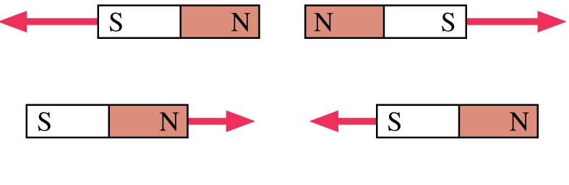
Like poles repel, unlike poles attract

Slide 8
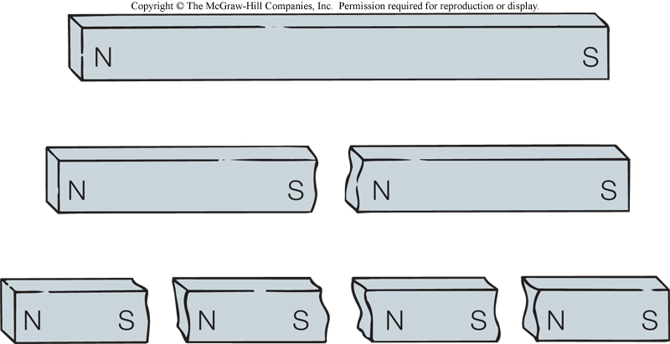
If you cut a magnet into halves, you get two magnets
There is no single poles or monopoles no matter how many times you cut a magnet into halves

Slide 9
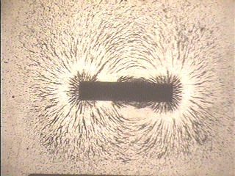
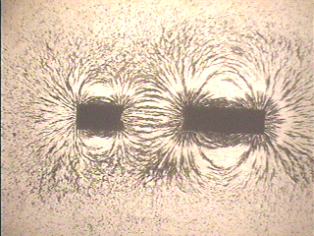
Broken Magnets
Before after

Slide 10
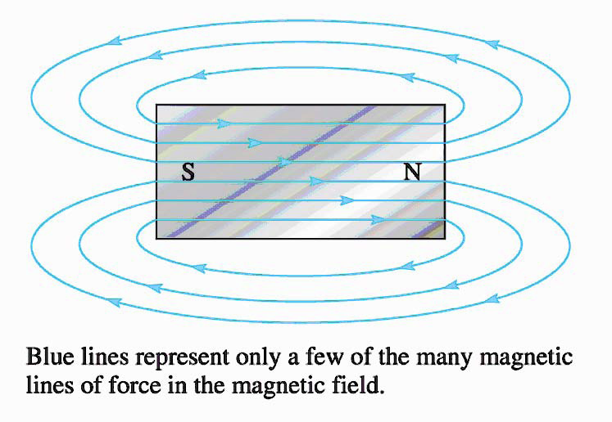
Magnetic Field
Magnetic field is the space surrounding a magnet
Represented by magnetic lines
Magnetic lines leave the N-pole, to air, to S-pole, and inside the magnet
Magnetic lines are loops
Any magnetic materials that enter the field is subject to magnetic force
Magnetic lines never
Intersect
The closer lines, the
Stronger the field

Slide 11
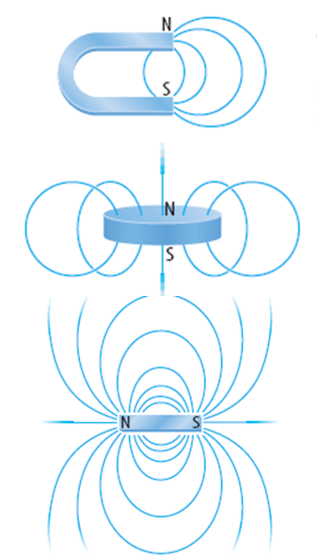

Slide 12
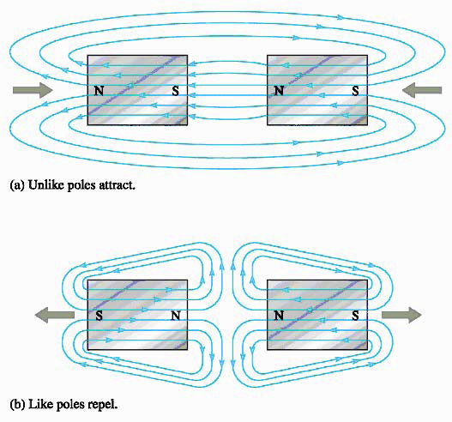

Slide 13
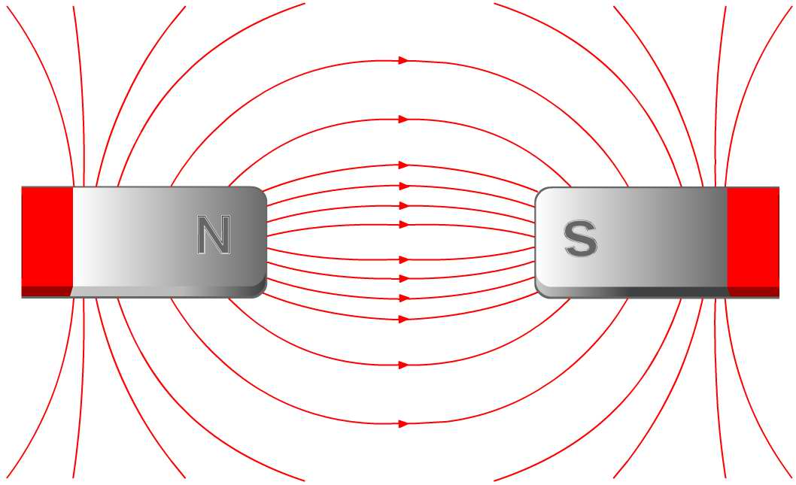
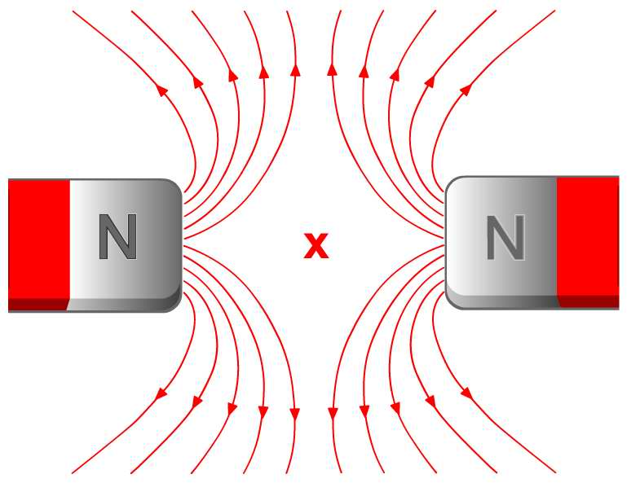

Slide 14
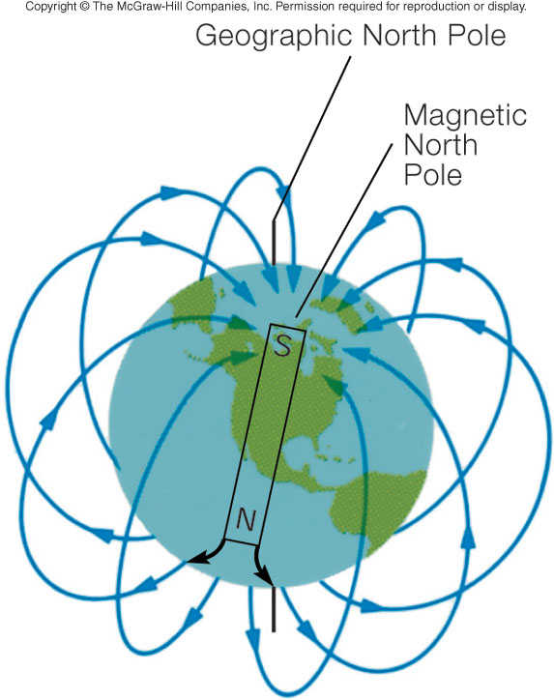
Earth is a Big Magnet
Shaped and oriented as if huge bar magnet were inside
South pole of magnet near geographic north pole
Geographic North Pole and north magnetic pole different
Which is the smallest naturally occurred magnet you think?

Slide 15
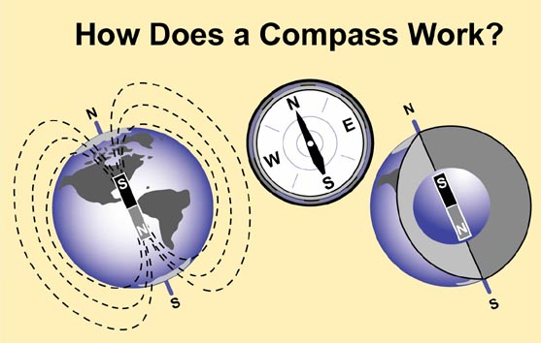
Compasses
Compasses (a magnet)are used to determine direction
Compass needles are magnetized and respond to the magnetic field of the Earth
Compasses point to the magnetic poles of earth

Slide 16
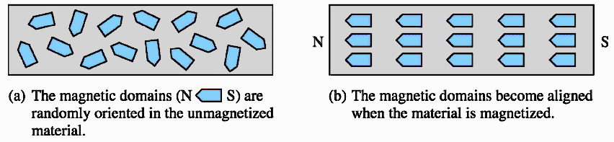
Magnetic Domains
Magnetic domains are atoms with similar magnetic orientations line up with neighboring atoms in groups . These domains are typically composed of billions of atoms

Slide 17
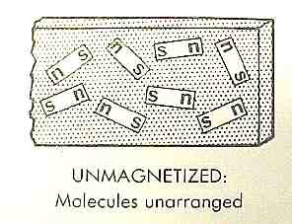
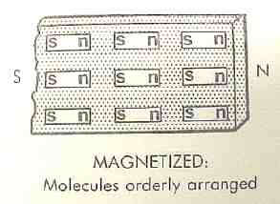

Slide 18
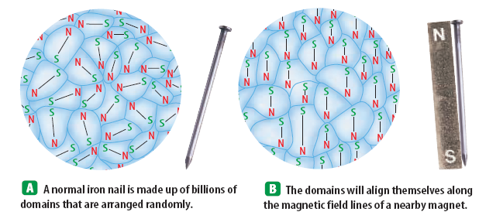
How To magnetize an Iron Nail?
When the permanent magnet is removed, the iron nail loses its magnetization quickly and goes back from B to A

Slide 20
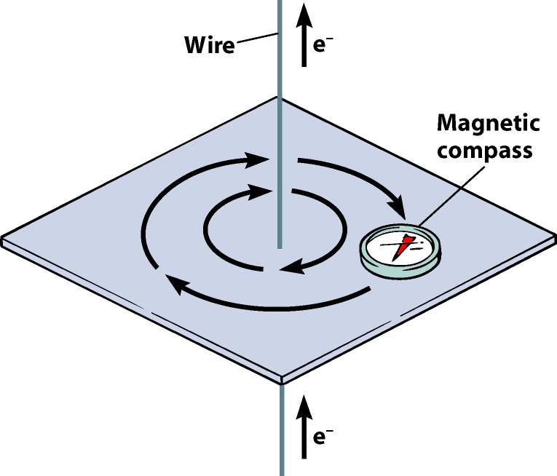
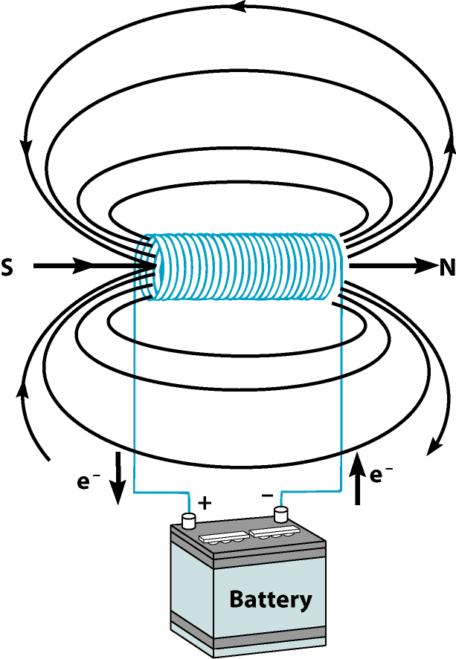
Electric currents produces magnetism
Electromagnetism is the production of magnetism from currents
The shape of the magnetic field is determined by the geometry of current
Straight wire: concentric circles magnetic field
Solenoid: central field

Slide 21
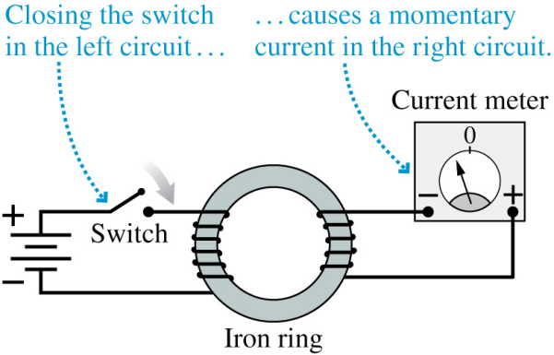
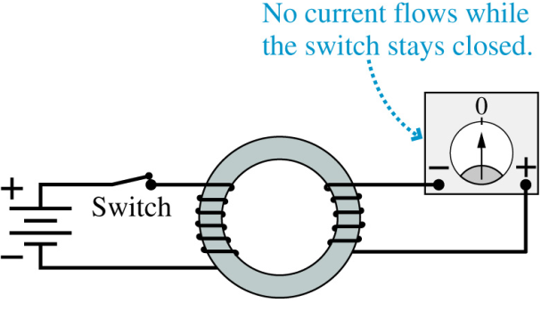
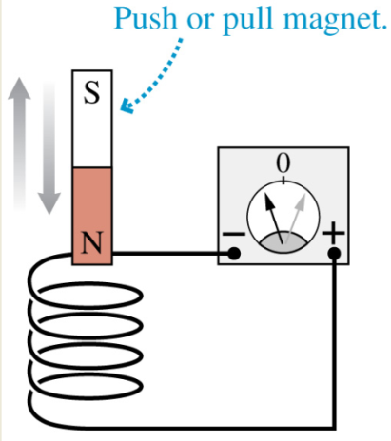
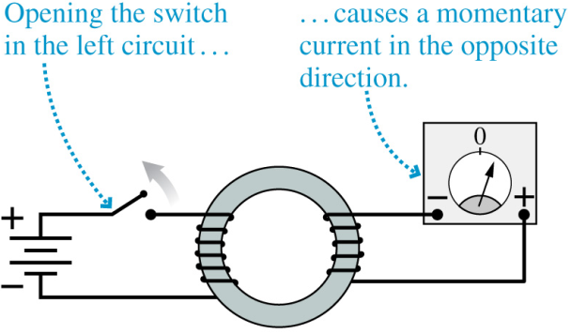
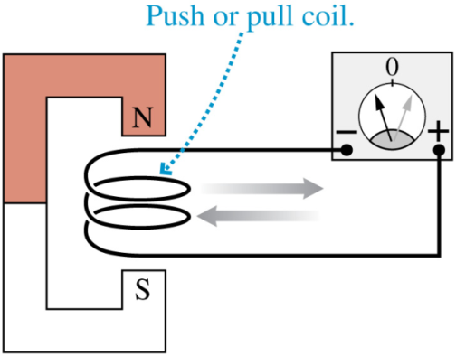
Electromagnetic Induction
Electromagnetic induction: a changing magnetic field produces an electrical current
Different ways to change magnetic field
- turn on the key in a DC circuit
- Move a magnet up or down inside a stationary coil and vice versa
DC changes to a constant value and then remains constant

Slide 22
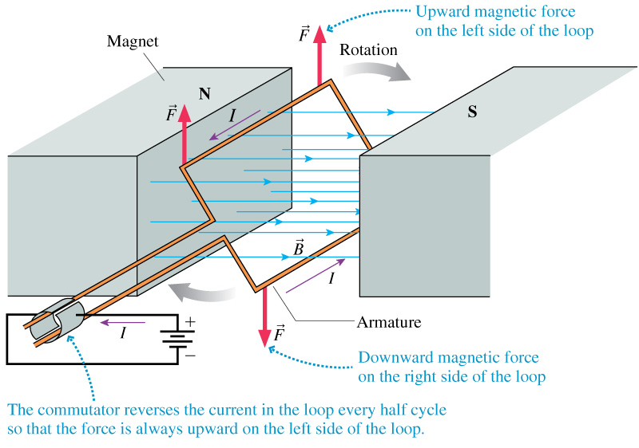
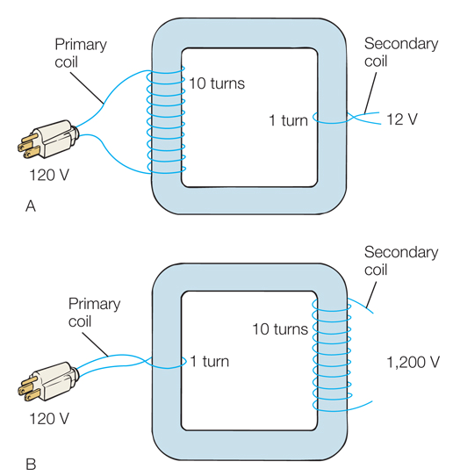
Application of Electromagnetic Induction
Electric generator
Transformer
Transformer electric generator

Slide 23
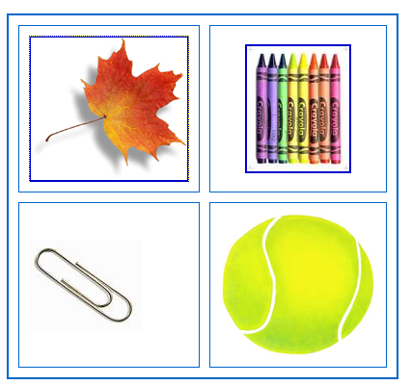
Quiz
Which of these will stick to a magnet?

Slide 24
Aluminium is not magnetic.
True
False
Some magnets also have an east and west pole.
True
False
Magnets attract materials made of iron.
True
False
South poles attract each other.
A. True
False

Slide 25
5. The magnetic field is the area around a magnet where the magnetic force can be felt.
True
False
6. If you break a magnet, you get two smaller magnets.
True
False
The north pole of a magnet is always stronger than the south pole.
A. True
B. False
Some magnets only have a north pole.
A. True
B. False

Slide 26
9. Iron filings can be used to show the shape of the magnetic field.
True
False
10. Magnetic field lines always go out of the north pole.
True
False
11. Magnetic field lines come out of both ends of a magnet.
True
False
12. Magnetic materials placed in the magnetic field will be attracted towards the magnet.
True
False

Slide 27
What is magnetism?
a) a kind of glue
b) an invisible force that pushes or pulls magnetic materials
c) something that an attractive person has.
Which of the following metals can be magnetised?
a) copper
b) aluminium
iron.
All magnets are surrounded by...
a) metal
b) a magnetic field
c) nothing.
If magnetic field lines are close together it means...
a) the magnetic field is very strong
b) the magnetic field is very weak
c) there’s not much space for the field to spread into.

Slide 28
A wire carrying a current...
a) continues to act like a magnet when the current is switched off
b) produces circular magnetic field lines
c) produces no magnetic field.

