Slide 1
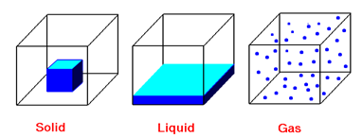
BASIC CHEMISTRY
CHAPTER 7

Slide 2
What is Matter? The Atom Concept
Matter is everything in the universe that has a mass
(weight) and volume
Examples: air, water, bacterium, and human
Atom is the smallest piece of matter.
introduced by Democritus (Greek philosopher)
in 450 B.C
It is Greek word meaning indivisible
The atom concept was restored by the English chemist John Dalton in 1803

Slide 3
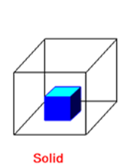
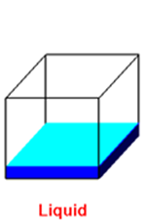
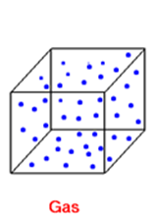
States of matter
States of matter: matter can be solid, liquid, or gas
Solid
Has Fixed volume and shape
Does not take the shape of container
Liquid
Has fixed volume and take the shape of container
Fills the container according to hits volume
Gas
Has no fixed shape and no fixed volume
It takes the shape of container whatever volume it has

Slide 4
What is matter?
Matter is anything that has mass and takes up space.
States of matter
The Three States of Matter
Solid
Liquid
Gas

Slide 5
Properties of Matter
How It Looks (Shiny ,Dull, Color, etc.)
How It Feels (Hard, Soft, Rough , Smooth, etc.)
How It Smells (Sweet, Sharp, Terrible, No Smell, etc.)
How It Sounds (Loud, Soft, Echo, No Sound, etc.)
What It Does (Bounce, Stretch, Tear, Break, Magnetism etc.)

Slide 6
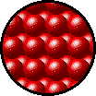

SOLIDS
A solid is matter that has that has definite size and shape.
Particles of solids are tightly packed, vibrating about a fixed position.
Solids have a definite shape and a definite volume.

Slide 7
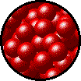

Liquids
A liquid takes the shape of any container.
Particles of liquids are tightly packed, but are far enough apart to slide over one another.
Liquids have an indefinite shape and a definite volume.

Slide 8

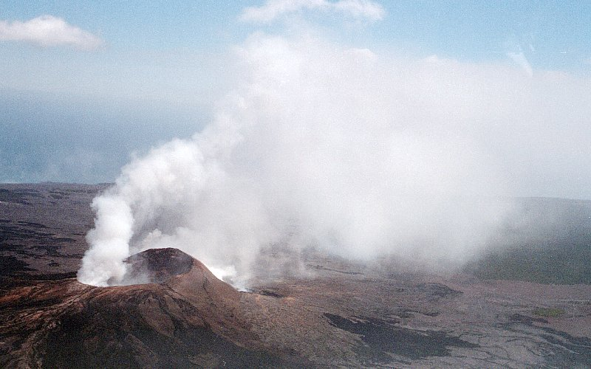
GAS
Gas is matter that has no definite shape. Gases take the shape of whatever container they are in.
Particles of gases are very far apart and move freely.
Gases have an indefinite shape and an indefinite volume.

Slide 9
PHASE CHANGES
Description of Phase Change | Term for Phase Change | Heat Movement During Phase Change
Solid to liquid | Melting | Heat goes into the solid as it melts.
Liquid to solid | Freezing | Heat leaves the liquid as it freezes.

Slide 10
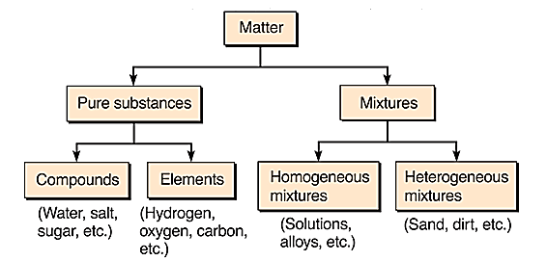

Slide 11
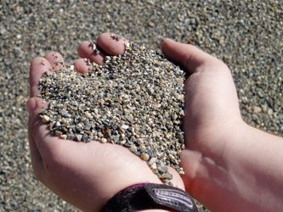


Classification of Matter Continue
mixture is a group of two or more elements or compounds combined by physical (not chemical) means
Examples: Milk, blood, sand, pizza, and wood
Homogeneous mixture is one that has constant matter in all the sample
- example: a well stirred sample of sugar and tea
Heterogeneous mixture is one that has not constant matter in the all the sample
- example: Milk, blood are good examples
Mixtures can be separated by physical means only like filtration

Slide 12
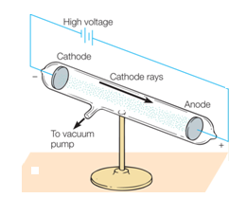
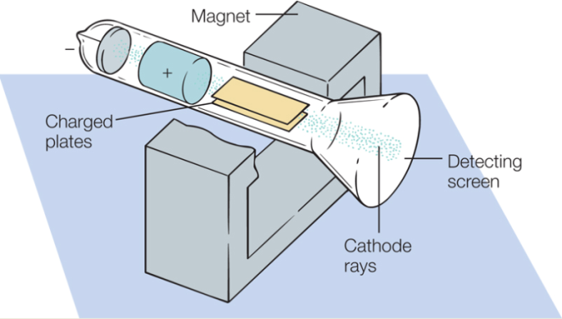
The discovery of Parts of Atom
1. The electron discovered in 1897 by the J.J. Thompson using cathode ray vacuum tube
electron has a charge of Coulomb
electron has a mass

Slide 13
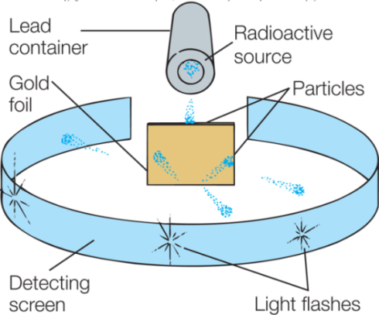
The discovery of Parts of Atom Continue
2. The nucleus (proton) discovered by Ernest Rutherford in 1907
Rutherford conclusion
The atom is mostly empty space, has a central part called a nucleus surrounded by electrons
The nucleus is small, dense concentration of mass and contains a positive charge
Any positive charge projected into the nucleus would be deflected due to a repulsive force

Slide 14
In 1919, Rutherford concluded that the hydrogen nucleus is indeed a positively charged particle he called the proton that is present in all nuclei.
Scientist realized that the proton is about 2000 times heaver that the electron and the magnitude of its charge is the same as that of the electron, but with a positive sign, +1.6 10⁻¹⁹ C.

Slide 15
The discovery of Parts of Atom Continue
3. The neutron discovered by James Chadwick in 1932
Chadwick conclusion
The neutron is uncharged particle
Its mass is approximately equal to that of the proton

Slide 16
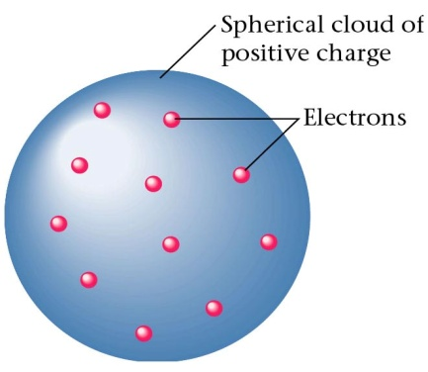
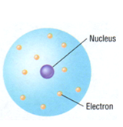
Models of the Atoms
A model is a picture of atom. Two models
Thomson’s model 1889: The plum pudding model
- atom is a sphere with positive charge like ”pudding”
electrons distributed equally like a “plum”
- atom mass distributed all over the atom
Rutherford’s model 1911: The planetary model
- the nucleus (like the sun) at the centre of the atom surrounded by a cloud of orbiting electrons (like the planets).
- Most the atomic mass is concentrated in its nucleus (why?).
- The Coulomb force is responsible of keeping
the electrons orbiting the nucleus.

Slide 17
Quantization of energy
Max Plank in 1900: the energy emitted by hot objects (solid, liquid, and gas) is emitted in a discrete units or bundles he called quanta plural of a quantum and is related to the frequency f of the emitted quantum hf by some whole number multiple of or
Plank’s constant
Albert Einstein (1905) applied Plank’s quantum concept to light.
- light consists of discrete units or bundles of energy called photons
- The energy of a photon is directly proportional to its frequency.

Slide 18
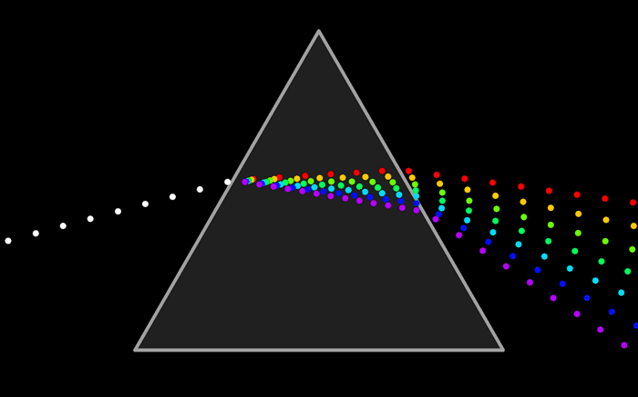
Light From Atom
Why does an atom emits (gives off) light of different colors
(spectrum)?
Light from hydrogen gas in a bulb
Separated 4 lines of colors.
Only hydrogen has these colors
Each color represents a frequency
Other gases have different set of colors

Slide 19
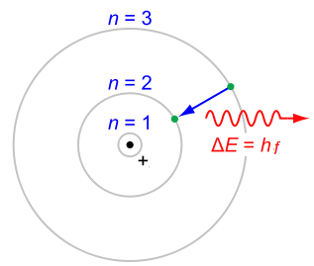
What caused the emission of light? Bohr model of the atom (1913)
The electron orbits the proton in allowed circular orbits identified by numbers: with n=1 is the orbit with the lowest energy (ground state).
The orbits are separated from one another by empty space where the electrons cannot exist
The electron in an allowed orbit does not emit light as long as it remains in that orbit
Electrons can move from one orbit to the next by gaining or losing energy
when electron gains energy. it jumps from an allowed lower to an allowed higher orbit (2-3). Once in a high energy orbit, the electron immediately jumps back to its initial orbit and emits light (photon)
The photon represents a certain frequency f (color) , and carries energy given by

Slide 20
Atomic Mass:
The total mass of an atom is called its Atomic Mass.
It is the sum of the masses of all the atom’s components (electron, proton and neutrons).
Atomic Number:
The number of protons in the nucleus of an atom determines an element's atomic number.
In other words, each element has a unique number that identifies how many protons are in one atom of that element. 8.

Slide 21
For example,
The hydrogen atom contains one proton and have an atomic number of 1.
The carbon atom contains six protons and have an atomic number of 6.
The Oxygen atoms contain eight protons and have an atomic number of 8.

Slide 22
Mass Number:
The mass number (A), also called atomic mass number or nucleon number, is the total number of protons and neutrons (together known as nucleons) in an atomic nucleus.
All atoms have a mass number which is derived as follows.
Number of neutrons
Number of Protons

Slide 23
Chemical identification of an atom
An atom (element) is identified by a symbol (letter) with its Z and A-numbers written at the lower and upper left of the symbol. Example, carbon and silver are identified as
Example
For each of the following atoms, determine (a) A, (b) Z, and (c) N numbers.
Find also the number of electrons. Assume the atoms are at normal
conditions:

Slide 24
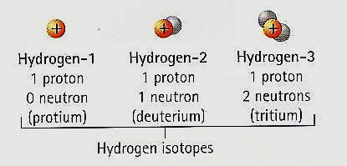
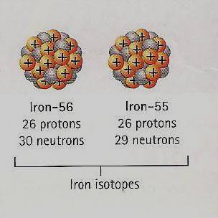
Isotopes:
One of two or more atoms with the same atomic number but with different numbers of neutrons.
Or
One of two or more atoms having the same atomic number but different mass numbers.
Examples of Isotopes:

Slide 25
Periodic Table:
A tabular arrangement of the elements according to their atomic numbers so that elements with similar properties are in the same column.
Two other important ways in which the elements are organized in the periodic table are by horizontal rows and vertical column.
Each horizontal row is called a Period and each vertical column is called a Group (or some times a family).
There are 7 periods and 18 groups.

Slide 26
