Slide 1
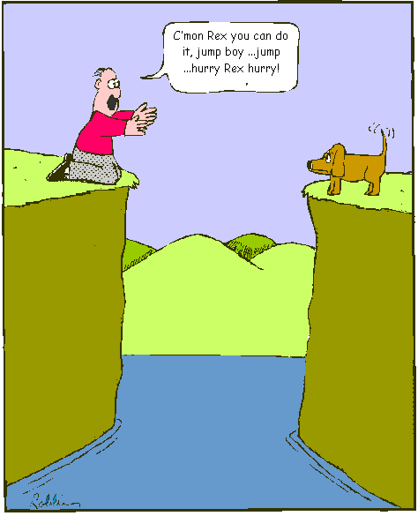
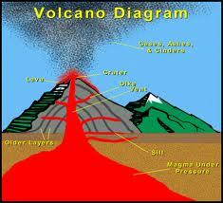
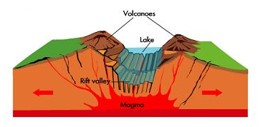
Earthquakes and Volcanoes
Chapter 9

Slide 2
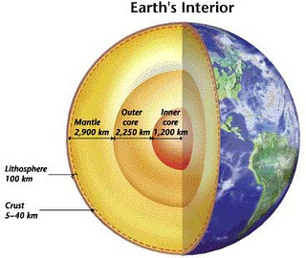
Earth’s Internal Structure
Three regions
Crust : thin outer shell
- Continental part
- Oceanic part (denser than continental crust)
Both part called lithosphere
Mantle : thicker than crust
- upper part: solid rocks
- lower part: thick fluid-like that flows called asthenosphere
Core : central region
- outer part fluid Fe & Mg
- inner part : solid Fe & Mg
Scientists used seismic waves to determine the structure

Slide 3
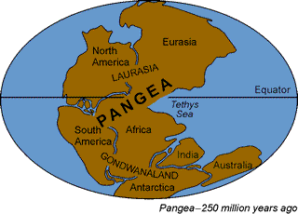
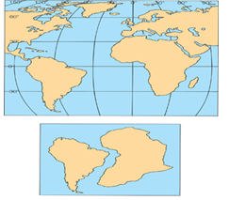
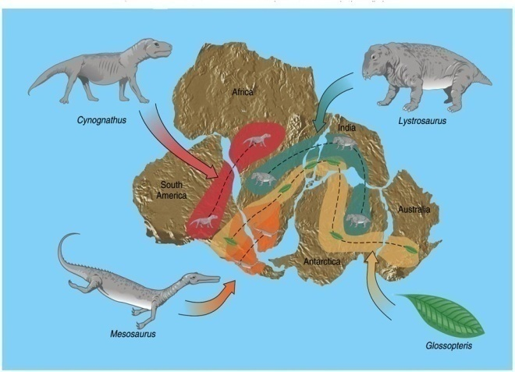
The continental drift: The Pangaea concept
Alfred Wegener 1912 Continental drift theory
250millions years ago, the world was one supercontinent “Pangaea”
Pangaea brook up into parts
His proof
Fossil evidence
Parts can be joint in a perfect fit like jigsaw puzzle
Scientists dismissed his theory till 1960

Slide 4
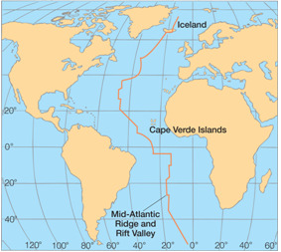
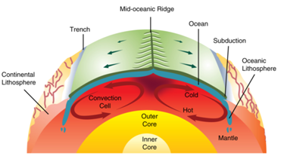
Seafloor Spreading
1950-1960 proved Wegener continental drift theory
- ocean crust contains mountains (ridges) and valleys like land
- Mid-Atlantic ridge divides ocean into two parts
- long valley along the ridge like a crack called rift
- magma forced up through rift forming new oceanic crust
- this spreads continents
C redit: B.Tillery, E. Enger, and F. Ross, ”Integrated science,” 3rd Ed. McGraw Hill, 2007.

Slide 5
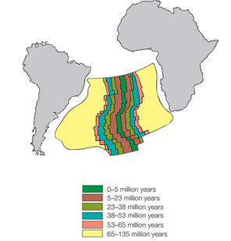
Seafloor Spreading Cont
By time the size of new crust increases
New crust near rift is younger than those far away and close to land
This proves that continentts move
Credit: B.Tillery, E. Enger, and F. Ross, ”Integrated science,” 3rd Ed. McGraw Hill, 2007.

Slide 6
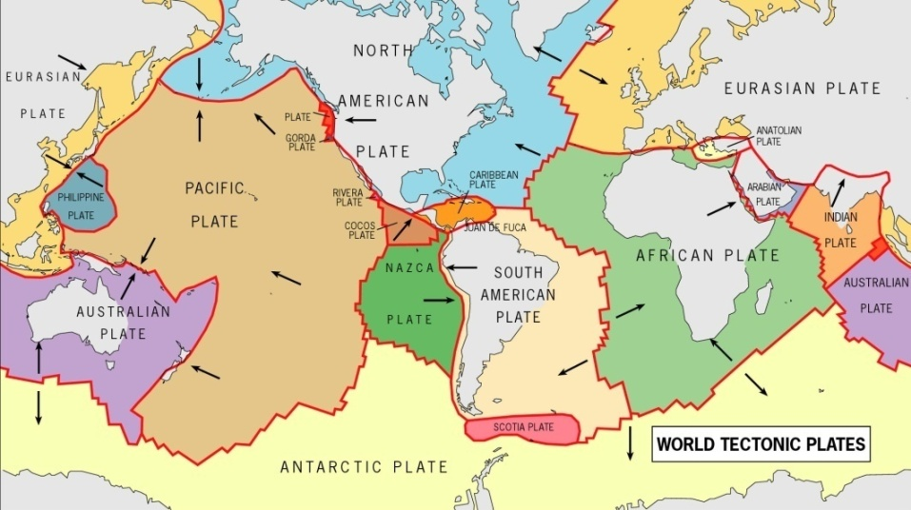
Plate Tectonics Theory
PTT explains continents movement
Earth is divided into 12 rigid plates
- plates are connected around earth (end by end)
Some plates are oceanic, others are land
Lithosphere (oceanic and land crust)
Plates move over the asthenosphere
- slow motion (1-6 cm/year)

Slide 7
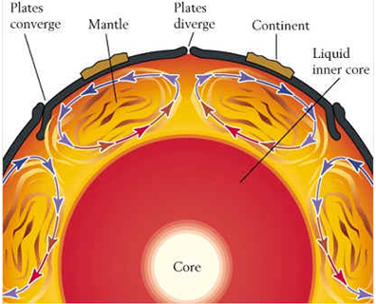

Slide 8
Plate Boundaries
At plate boundaries, earthquakes, volcanoes, and mountain formation occur
Two boundary movements
Divergent boundary movements
Convergent boundary movements

Slide 9
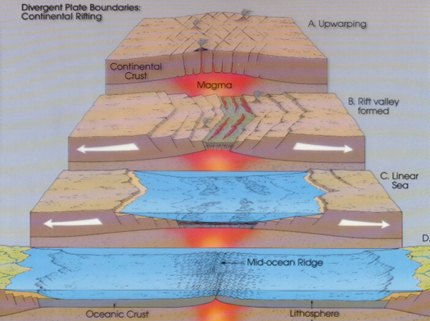
Divergent Boundary
Two plates move away from each other
Magma fills rift valley creates new gaps
Example: Oceans, and
Red Sea

Slide 10
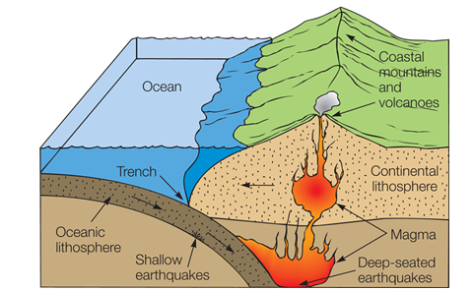
Convergent Boundary
Oceanic-continental convergence
Two plates with different crust density collide
- denser crust sinks (subduct) inside the
less dense crust
- trench, shallow and
deep earthquakes, and volcanoes resulted
Credit: B.Tillery, E. Enger, and F. Ross, ”Integrated science,” 3rd Ed. McGraw Hill, 2007.

Slide 11
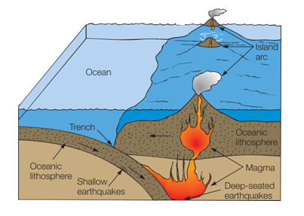
Convergent Boundary Cont
Oceanic-oceanic convergence
Two oceanic plates collide
- trench, shallow, deep earthquakes, and volcanoes resulted
- magma from melted subducted crust forms islands
- Island arc forms
- Examples: Indonesia and Japan
Credit: B.Tillery, E. Enger, and F. Ross, ”Integrated science,” 3rd Ed. McGraw Hill, 2007.

Slide 12
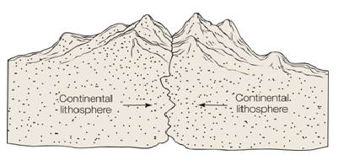
Convergent Boundary Cont
Continental-continental convergence
Leading edges collide, pile up and for mountain
Example: Himalayan Mountains formed when Indian plate collided
with Eurasian plate
Credit: B.Tillery, E. Enger, and F. Ross, ”Integrated science,” 3rd Ed. McGraw Hill, 2007.

Slide 13
Which boundary? Divergent or convergent?

Slide 14
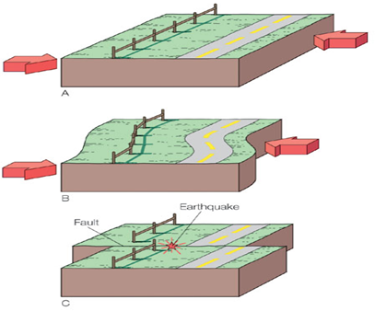
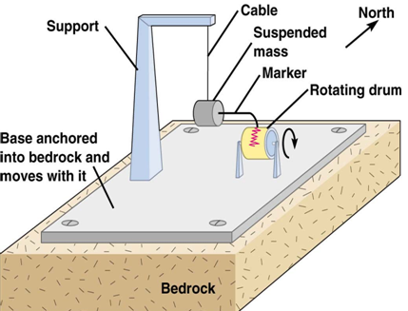
Earthquakes
Earthquake is shaking and vibrating of ground
Causes: stress on rocks caused by subduction effect
- rock breaks into blocks
- the break releases energy
- energy carried by seismic waves
Location: plate boundaries
seismograph

Slide 15
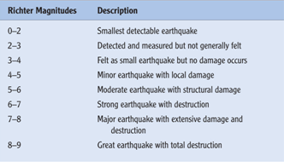
Intensity of Earthquake
Richter scale

Slide 16
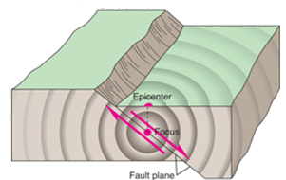
Seismic Waves
Body waves: P-wave, S-wave
- P-wave is faster and registered first on seismograph
Using body waves, scientists were able to determine earth’s layered structure
Focus: center of propagation
Epicenter: land point on top of focus

Slide 17
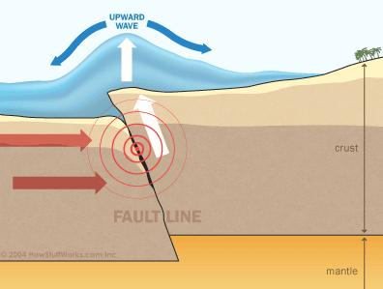
Tsunami
Tsunami is very large oceanic waves that travel at speeds about 700km/h
Causes: caused by an earthquake or volcanic eruption in the oceanic crust
Fault line is the line where the rock breaks

Slide 18
Volcanoes
volcano is a rocky structure in the form of a hill or mountain formed by the ejected lava from magma beneath the earth surface and deposit in a conical shape
Found in three places
- divergent boundary
- convergent boundary
- hot spot
Islands are deposits of oceanic magma overtime
Example: Iceland

Slide 19
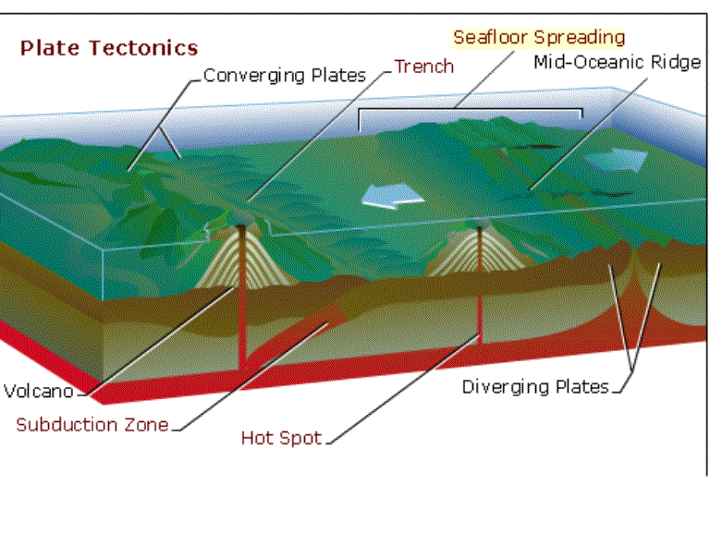
Volcanoes Cont
Hot spot or hot spring: mantle magma flows as lava, cools and solidify. When oceanic plate moves to its spot, islands are formed.
Example: Hawaiian Islands

Slide 20
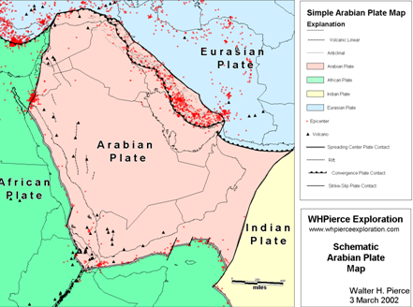
Location of volcanoes and earthquakes in Arabian plate

