Slide 1
Pg. 14
Chapter 2
Motion Along a Straight Line

Slide 2

Motion
Pg. 14
The world, and everything in it, moves.
Kinematics: describes motion.
Dynamics: deals with the causes of motion.

Slide 3
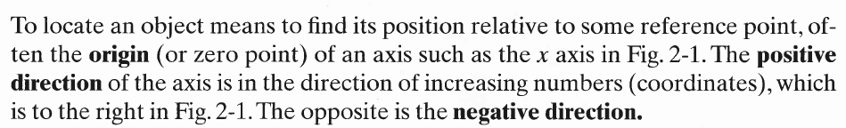
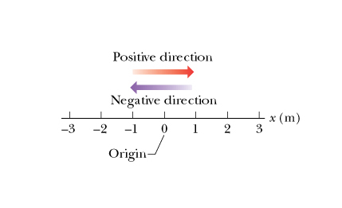
Pg. 14
Kinematics is the part of mechanics that describes the motion of physical objects. We say that an object moves when its position as determined by an observer changes with time.

Slide 4
Pg. 15
Displacement. If an object moves from position x₁ to position x₂ , the change in position is described by the displacement
For example if x₁ = 5 m and x₂ = 12 m then Δx = 12 – 5 = 7 m. The positive sign of Δx indicates that the motion is along the positive x-direction.
If instead the object moves from x₁ = 5 m and x₂ = 1 m then Δx = 1 – 5 = -4 m. The negative sign of Δx indicates that the motion is along the negative x-direction.
Displacement is a vector quantity that has both magnitude and direction.
.
.
.
O
x₁
x₂
x-axis
Δx
motion

Slide 5
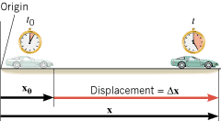
Displacement
Pg. 15
DISPLACEMENT is defined as the change of an object's position that occurs during a period of time.
The displacement is a vector that points from an object’s initial position to its final position and has a magnitude that equals the shortest distance between the two positions.
SI Unit of Displacement: meter (m)

Slide 6
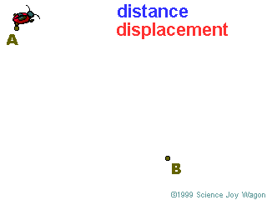

Slide 7

AVERAGE SPEED
distance
Average Speed =
time
Velocity
The speed of an object in a certain direction.

Slide 8
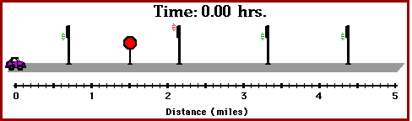
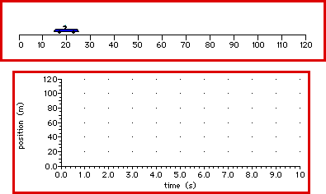

Slide 9
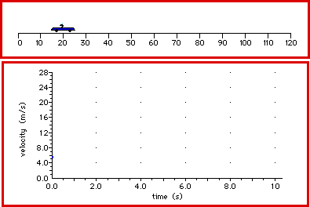

Slide 10
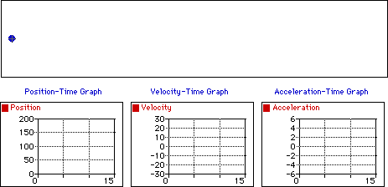

Slide 11
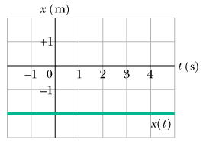

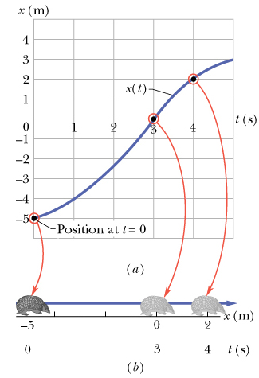
Pg. 15
Average Velocity:
The average velocity is the ratio of the displacement that occurs during a particular time interval to that interval.
Here x₂ and x₁ are the positions x(t₂) and x(t₁), respectively.
The time interval Δt is defined as Δt = t₂ – t₁. The units of v_{avg} are m/s.

Slide 12
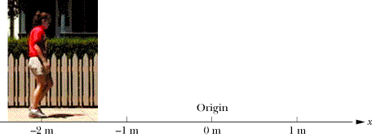
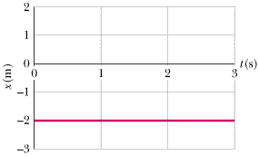
Velocity and Speed
A student standing still with the back of her belt at a horizontal distance of 2.00 m to the left of a spot of the sidewalk designated as the origin.

Slide 13
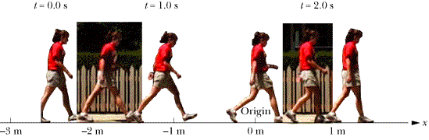
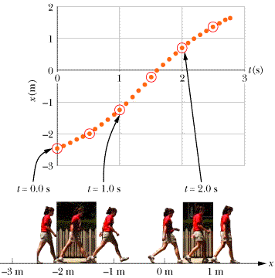
A student starting to walk slowly. The horizontal position of the back of her belt starts at a horizontal distance of 2.47 m to the left of a spot designated as the origin. She is speeding up for a few seconds and then slowing down.

Slide 14
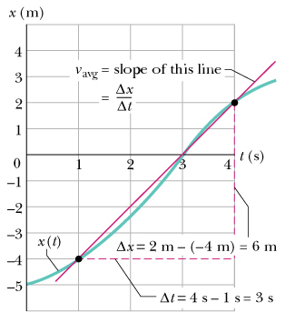
Graphical Determination of v_{avg}
On an x versus t plot we can determine v_{avg} from the slope of the straight line that connects point ( t₁ , x₁) with point ( t₂ , x₂ ). In the plot below, t₁=1 s and t₂ = 4 s. The corresponding positions are: x₁ = - 4 m and x₂ = 2 m.
Pg. 16
Average Speed s_{avg}
The average speed is defined in terms of the total distance traveled in a time interval Δt (and not the displacement Δx as in the case of v_{avg}).
Note: The average velocity and the average speed for the same time interval Δt can be quite different.

Slide 15
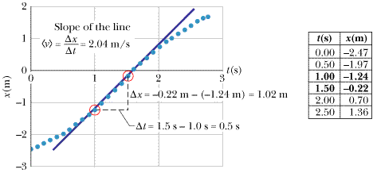
Pg. 16
Example 5: find the average velocity for the student motion represented by the graph shown in Fig. 2-9 between the times t₁ = 1.0 s and t₂ = 1.5 s.

Slide 16
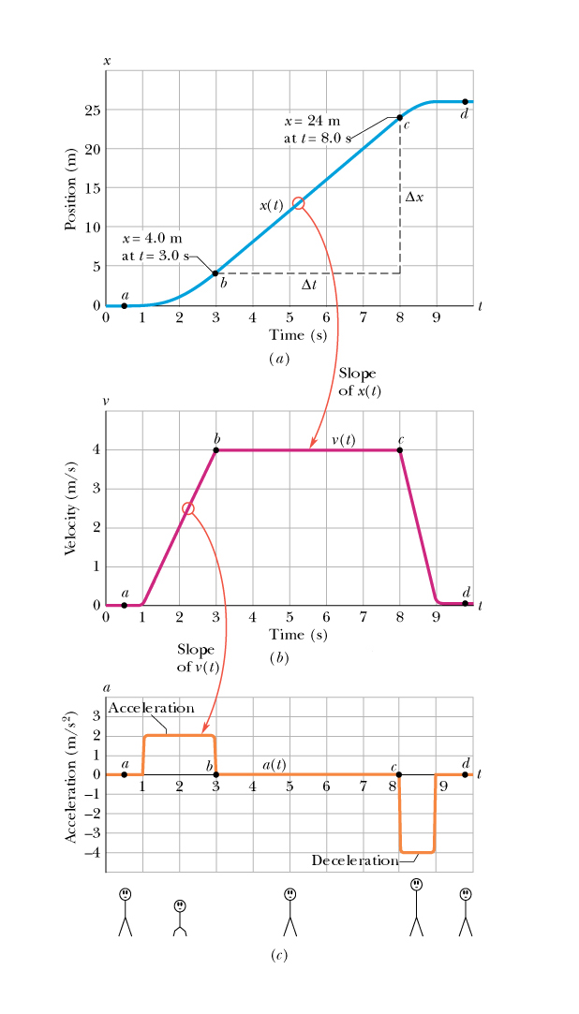
Instantaneous Velocity:
Instantaneous velocity is defined as the limit of the average velocity determined for a time interval Δt as we let Δt → 0.
Pg. 17
From its definition instantaneous velocity is the first derivative of the position coordinate x with respect to time. It is thus equal to the slope of the x versus t plot.
Speed
We define speed as the magnitude of an object’s velocity vector.

Slide 17

Acceleration is how quickly velocity changes over time.
0
Speed
3
1
2
Meters/second

Slide 18
Acceleration
how quickly velocity changes over time.
a = CHANGE IN VELOCITY/TIME
(V_{final} - V_{initial})
a =
___________
time

Slide 19

Average Acceleration
We define the average acceleration a_{avg} between t₁ and t₂ as:
Units: m/s²
Instantaneous Acceleration
If we take the limit of a_{avg} as Δt → 0 we get the instantaneous acceleration a, which describes how fast the velocity is changing at any time t.
The acceleration is the slope of the v versus t plot.
Note: The human body does not react to velocity but it does react to acceleration.
Pg. 19
(2-7)

Slide 20
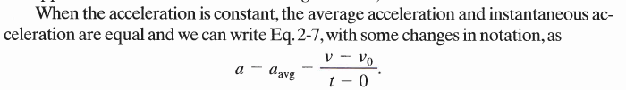
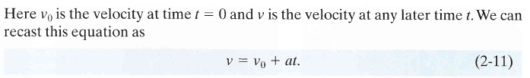
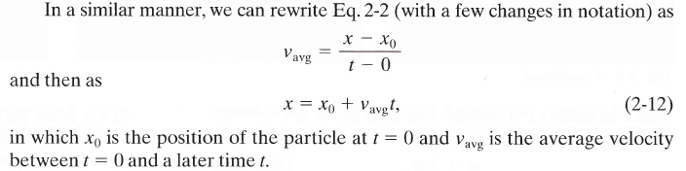
Pg. 21
Motion with Constant Acceleration
Motion with a = 0 is a special case but it is rather common, so we will develop the equations that describe it.

Slide 21
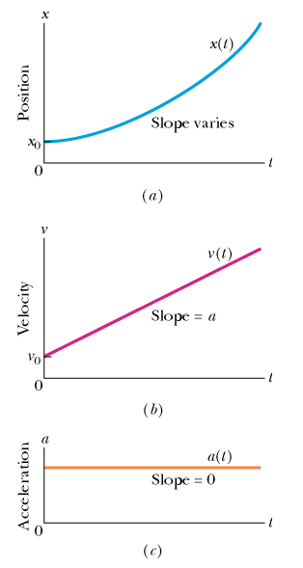
Pg. 21
The x(t) versus t plot is a parabola that intercepts the vertical axis at x = x₀.
The v(t) versus t plot is a straight line with slope = a and intercept = v₀.
The acceleration a is a constant.
(2-9)

Slide 22
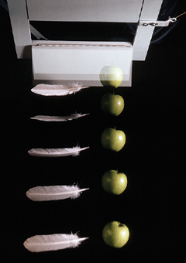
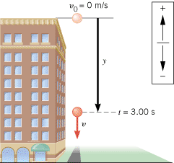
Free Fall

Slide 23

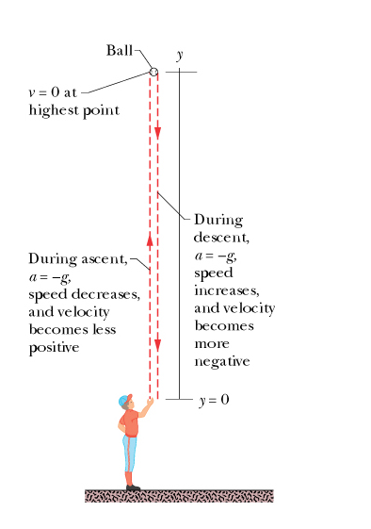
Free Fall:
Pg. 21
If we take the y-axis to point upward then the acceleration of an object in free fall a = -g and the equations for free fall take the form:
Note:
Even though with this choice of axes a < 0, the velocity can be positive (upward motion from point A to point B).
It is momentarily zero at point B.
The velocity becomes negative on the downward motion from point B to point A.
a
y
B
A

Slide 24
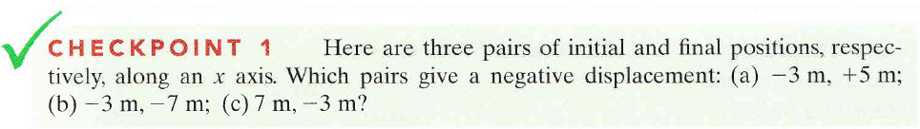


Slide 25
