Slide 1
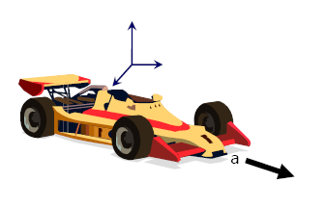
Chapter 3
Vectors

Slide 2
3.1 | Coordinate Systems
3.2 | Vector and Scalar quantities
3.3 | Some Properties of Vectors
3.4 | Components of vectors and Unit vectors

Slide 3

Physics deals with many quantities that have both
  Magnitude
  Direction
VECTORS !!!!!
y
ϑ
x
r

Slide 4


Scalar
A scalar quantity is a quantity that has magnitude only and has no direction in space.
Examples of Scalar Quantities:
Length
Area
Volume
Time
Mass

Slide 5
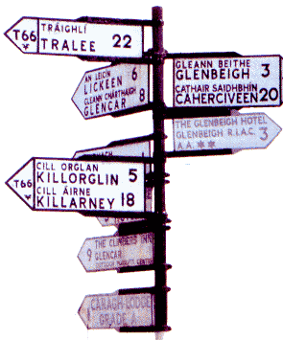


Vector
A vector quantity is a quantity that has both magnitude and a direction in space
Examples of Vector Quantities:
Displacement
Velocity
Acceleration
Force

Slide 6
A vector is a quantity that has both magnitude and direction. It is represented by an arrow. The length of the vector represents the magnitude and the arrow indicates the direction of the vector.
Blue and purple vectors have same magnitude and direction so they are equal.
Blue and green vectors have same direction but different magnitude.
Blue and orange vectors have same magnitude but different direction.
Two vectors are equal if they have the same direction and magnitude (length).

Slide 7
Examples include:
A = 20 m/s at 35° NE
B = 120 lb at 60° SE
C = 5.8 mph/s west

Slide 8
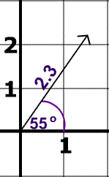
Example
The direction of the vector is 55° North of East
The magnitude of the vector is 2.3.

Slide 9
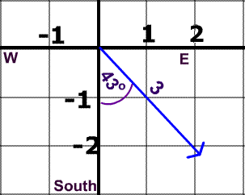
Try Again
Direction:
Magnitude:
43° East of South
3

Slide 10
Try Again
It is also possible to describe this vector's direction as 47 South of East.
Why?

Slide 11

How can we find the magnitude if we have the initial point and the terminal point?
Q
The distance formula
Terminal Point
magnitude is the length
direction is this angle
Initial Point
P
How can we find the direction? (Is this all looking familiar for each application? You can make a right triangle and use trig to get the angle!)

Slide 12
Although it is possible to do this for any initial and terminal points, since vectors are equal as long as the direction and magnitude are the same, it is easiest to find a vector with initial point at the origin and terminal point (x, y).
Q
Terminal Point
A vector whose initial point is the origin is called a position vector
direction is
this angle
Initial Point
P
If we subtract the initial point from the terminal point, we will have an equivalent vector with initial point at the origin.

Slide 13
Vector Addition
vectors may be added graphically or analytically
Triangle (Head-to-Tail) Method
1. Draw the first vector with the proper length
and orientation.
2. Draw the second vector with the proper length
and orientation originating from the head of
the first vector.
3. The resultant vector is the vector originating
at the tail of the first vector and terminating
at the head of the second vector.
4. Measure the length and orientation angle of
the resultant.

Slide 14
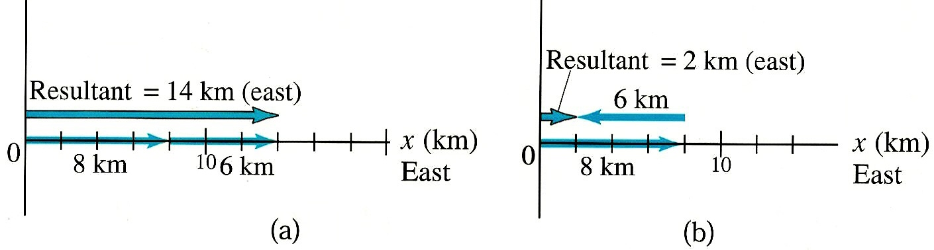
Adding vectors in same direction:
  Example: Travel 8 km East on day 1, 6 km East on day 2.
  Displacement = 8 km + 6 km = 14 km East
  Example: Travel 8 km East on day 1, 6 km West on day 2.
  Displacement = 8 km - 6 km = 2 km East
  “Resultant” = Displacement

Slide 15
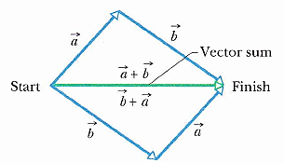

Slide 16
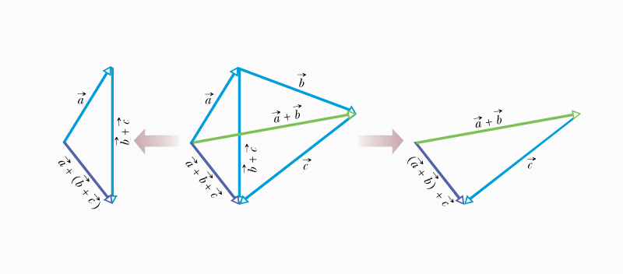
Adding more than two vectors graphically

Slide 17
Example:
A = 11 N @ 35° NE
Find the resultant
of A and B.
B = 18 N @ 20° NW
B
20° NW
R
R = 14.8 N
@ 57° NW
A
57° NW
35° NE

Slide 18
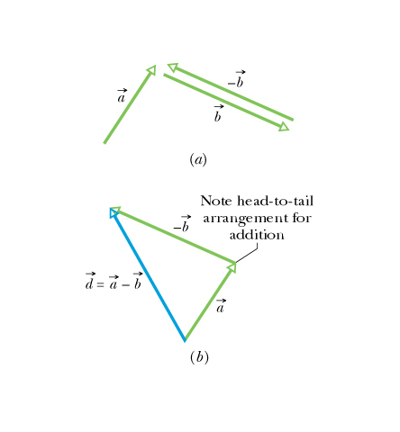
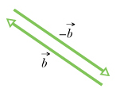
Subtraction of Vectors -graphically

Slide 19
Parallelogram (Tail-to-Tail) Method
1. Draw both vectors with proper length and
orientation originating from the same point.
2. Complete a parallelogram using the two
vectors as two of the sides.
3. Draw the resultant vector as the diagonal
originating from the tails.
4. Measure the length and angle of the
resultant vector.

Slide 20
Resolving a Vector Into Components
+y
The horizontal, or
x-component, of A is
found by A_{x} = A cos θ.
A
A_{y}
θ
A_{x}
The vertical, or
y-component, of A is found by A_{y} = A sin θ.
+x
By the Pythagorean Theorem, A_{x}² + A_{y}² = A².
Every vector can be resolved using these
formulas, such that A is the magnitude of A, and
θ is the angle the vector makes with the x-axis.

Slide 21
Analytical Method of Vector Addition
1. Find the x- and y-components of each vector.
A_{x} = A cos θ
A_{y} = A sin θ
B_{x} = B cos θ
B_{y} = B sin θ
C_{x} = C cos θ
C_{y} = C sin θ
R_{x}
R_{y}
2. Sum the x-components.
This is the x-component of the resultant.
3. Sum the y-components.
This is the y-component of the resultant.
4. Use the Pythagorean Theorem to find the
magnitude of the resultant vector.
R_{x}² + R_{y}² = R²

Slide 22
5. Find the reference angle by taking the inverse
tangent of the absolute value of the y-component
divided by the x-component.
θ = Tan⁻¹ R_{y}/R_{x}
6. Use the “signs” of R_{x} and R_{y} to determine the
quadrant.
NW
NE
(-,+)
(+,+)
(-,-)
(-,+)
SW
SE

Slide 23
VECTOR NOTATION
Components for a vector may be expressed in unit vector notation
  is a unit vector in the x direction
  is a unit vector in the y direction
  is a unit vector in the z direction

Slide 24
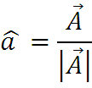




Unit Vectors
0
E.g. Find the vector which points from coordinates (0,0,0) to (3,4,1) and the associated unit vector
  a = =
  unit vector
z
(3,4,1)
k
j
y
i
x

Slide 25

Vector Addition
0
What is the resultant vector from:
(i) adding, a+b?
(ii) subtracting, a-b ?
a = 2 i
b = i + j
c = a + b = (a_{x}i + a_{y}j + a_{z}k) + (b_{x}i + b_{y}j + b_{z}k)
= (a_{x} + b_{x})i + (a_{y} + b_{y})j + (a_{z} + b_{z})k
= (2 + 1 )i + (0 + 1 )j = 3 i + 1 j
= 3i + j
c = a - b =(a_{x}i + a_{y}j + a_{z}k) - (b_{x}i + b_{y}j + b_{z}k)
= (a_{x} - b_{x})i + (a_{y} - b_{y})j + (a_{z} - b_{z})k
= (2 - 1 )i + (0 - 1 )j = i - j

