Slide 1
Chapter 4
Motion in Two Dimensions
In this chapter we will study
4.1 | The Position, Velocity and Acceleration vectors
4.3 | Projectile Motion
4.4 | Uniform Circular Motion
4.5 | Tangential and Radial Acceleration

Slide 2
Displacement Vector

Slide 3
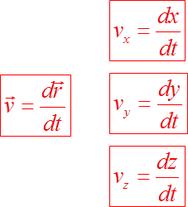
Average and Instantaneous Velocity
Following the same approach as in Chapter 2 we define the average velocity as
We define the instantaneous velocity (or more simply the velocity) as the limit:

Slide 4
Average and Instantaneous Acceleration
The average acceleration is defined as:
We define the instantaneous acceleration as the limit:
The three acceleration components are given by the equations

Slide 5
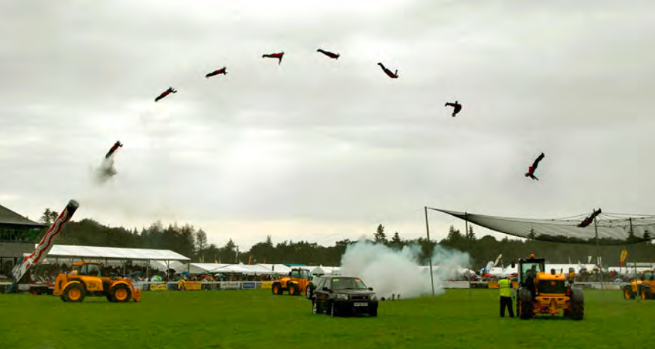
Projectile Motion
Sadia Khan
PHYS 101

Slide 6
In this lecture we will study
1 | Projectile Motion
2 | Some important Terms
3 | Horizontal “Velocity” Component
4 | Vertical “Velocity” Component
5 | Horizontally Launched Projectiles
6 | Vertically Launched Projectiles
7 | Time of Flight
8 | Horizontal Range
9 | Vertical Height

Slide 7
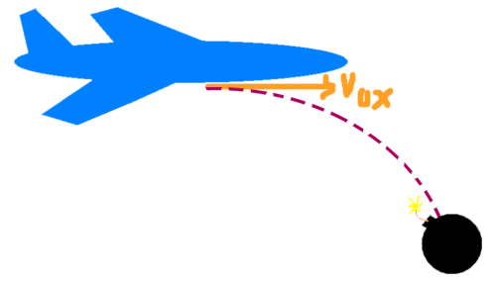

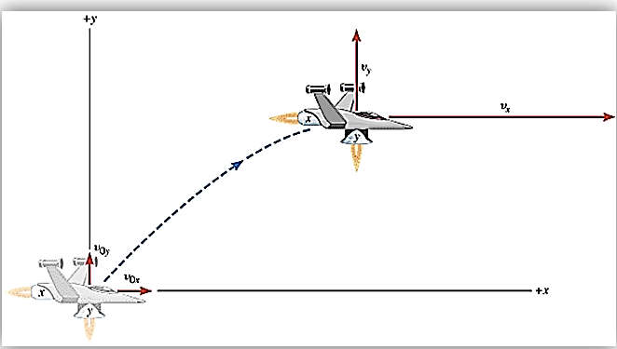
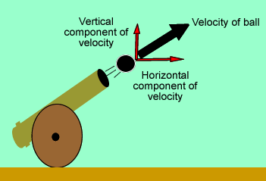
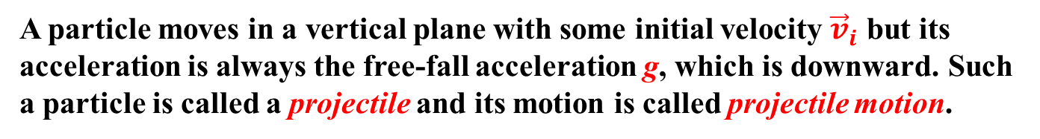
What is Projectile motion?
A particle moves in a vertical plane with some initial velocity ${\vec{v}}_{i}$ but its acceleration is always the free-fall acceleration g, which is downward. Such a particle is called a projectile and its motion is called projectile motion.

Slide 8
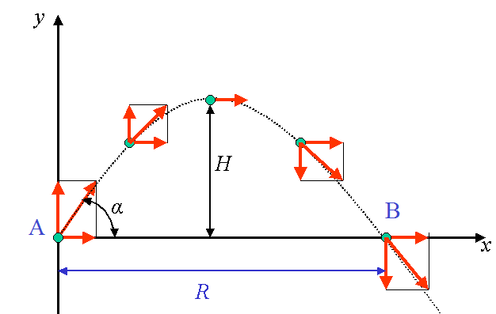
Some important terms
Point of projection: The point from where the object is projected.
Angle of projection: The angle made by the projectile at point of projection.
Time of flight: Time taken by the projectile to remain in air.
Point of landing: The point at which projectile strikes.
Range: Maximum horizontal distance covered by the projectile.
Height: Maximum vertical distance reached by the projectile.
Trajectory: Path followed by the projectile.

Slide 9
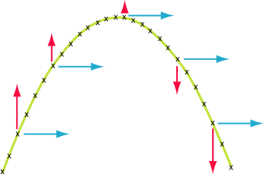
Projectiles move in TWO dimensions
Since a projectile moves in 2-dimensions, therefore its velocity has two components just like a resultant vector.
Horizontal and Vertical

Slide 10


Horizontal “Velocity” Component
It NEVER changes, covers equal displacements in equal time periods. This means the initial horizontal velocity equals the final horizontal velocity. $\left(v_{xi}=v_{xf}\right)$
In other words, the horizontal velocity is CONSTANT. BUT WHY?
Gravity DOES NOT work horizontally to increase or decrease the velocity.

Slide 11
Vertical “Velocity” Component
It changes (due to gravity), does NOT cover equal displacements in equal time periods.
Component | Magnitude | Direction
Horizontal | Constant | Constant
Vertical | Changes | Changes
Both the MAGNITUDE and DIRECTION change.
As the projectile moves up the MAGNITUDE DECREASES and its direction is UPWARD.
As it moves down the MAGNITUDE INCREASES and the direction is DOWNWARD.

Slide 12
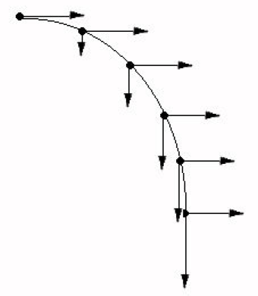
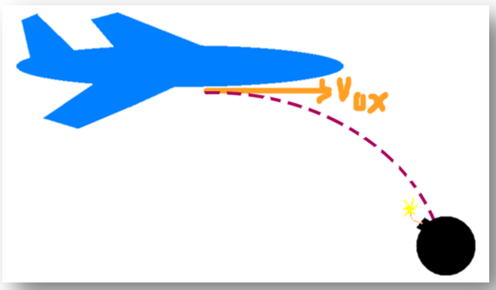


Horizontally Launched Projectiles
Projectiles which have NO upward trajectory and NO initial VERTICAL velocity.
$$v_{xi}=v_{xf}=cons\tan{t}$$
$$v_{yi}=0$$

Slide 13
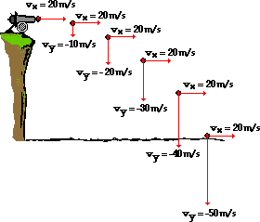
Launching a Cannon ball

Slide 14

Vertically Launched Projectiles
NO Vertical Velocity at the top of the trajectory.
Vertical Velocity decreases on the way upward
Vertical Velocity increases on the way down,
Horizontal Velocity is constant
Component | Magnitude | Direction
Horizontal | Constant | Constant
Vertical | Decreases up, Increases down | Changes

Slide 15
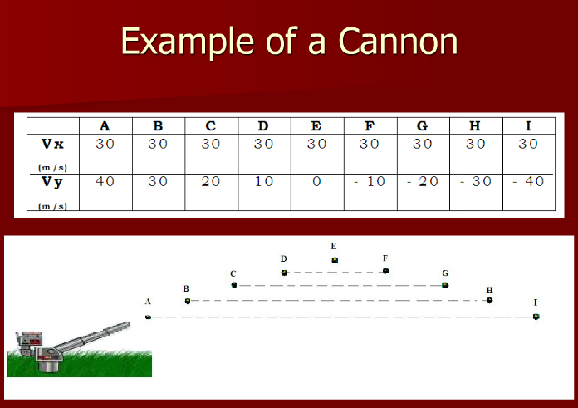

Slide 16
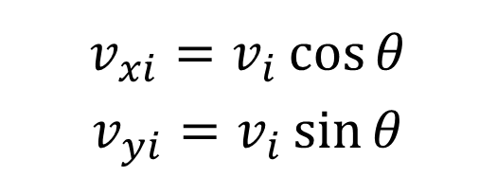
Vertically Launched Projectiles
Since the projectile was launched at a angle, the velocity MUST be broken into components!!!
v_{o}
v_{yi}
$$v_{xi}=v_{i}\cos{θ}$$
$$v_{yi}=v_{i}\sin{θ}$$
θ
v_{xi}

Slide 17
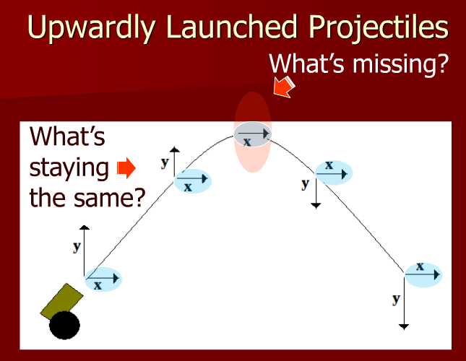

Slide 18
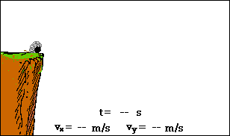

Slide 19

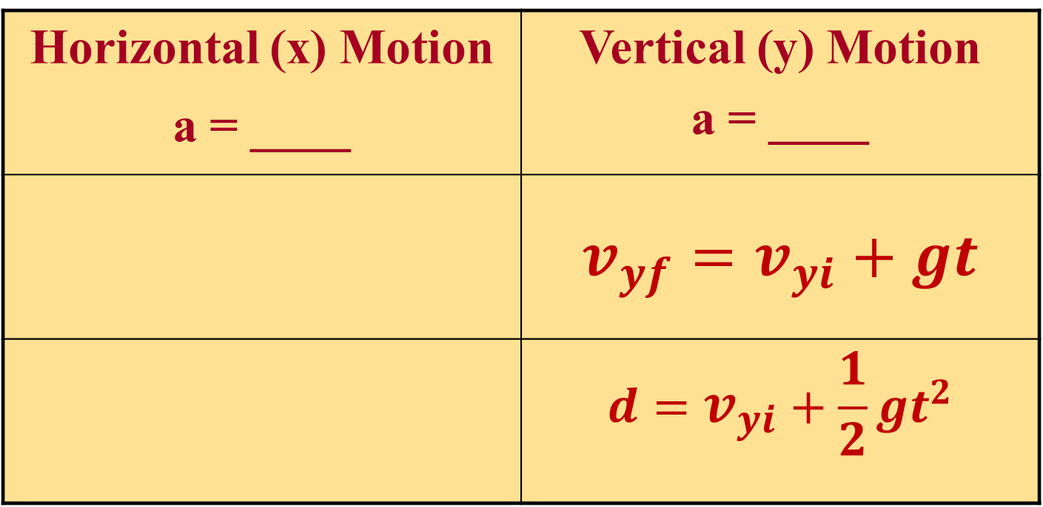
Projectile Motion Equations
$$Recall$$
Horizontal (x) Motion a = ____ | Vertical (y) Motion a = ____
 | $$v_{yf}=v_{yi}+gt$$
 | $$d=v_{yi}+\frac{1}{2}gt^{2}$$
0
g
Constant

Slide 20
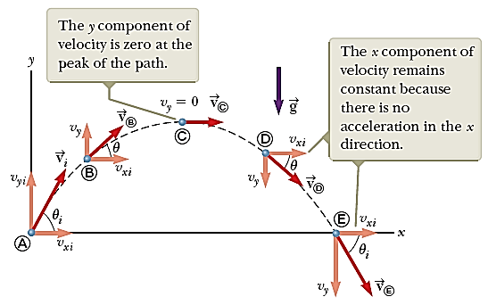
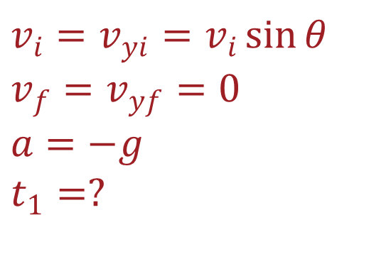
Time of Flight:
Time for upward motion + Time for downward motion
T = t₁ + t₂
$$v_{i}=v_{yi}=v_{i}\sin{θ}$$
$$v_{f}=v_{yf}=0$$
$$a=−g$$
$$t_{1}=?$$

Slide 21
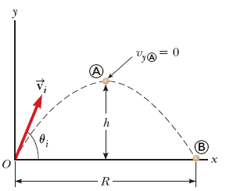

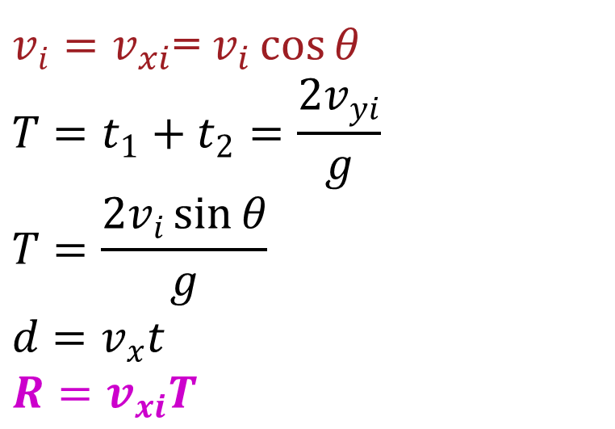
Horizontal Range:
$v_{i}=v_{xi}$= $v_{i}\cos{θ}$
$$T=t_{1}+t_{2}=\frac{2v_{yi}}{g}$$
$$T=\frac{2v_{i}\sin{θ}}{g}$$
$$d=v_{x}t$$
$$R=v_{xi}T$$

Slide 22
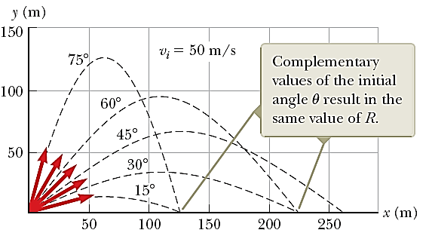
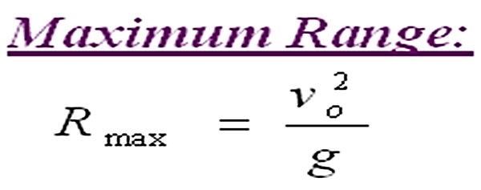
Horizontal Maximum Range
The maximum value of R can be calculated by the following equation. This result makes sense because the maximum value of Sin2θ = 1, which occurs when 2θ = 90°.
Therefore, R is maximum when θ = 45°

Slide 23
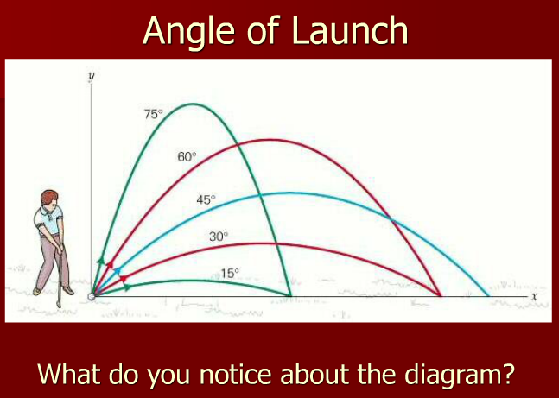

Slide 24
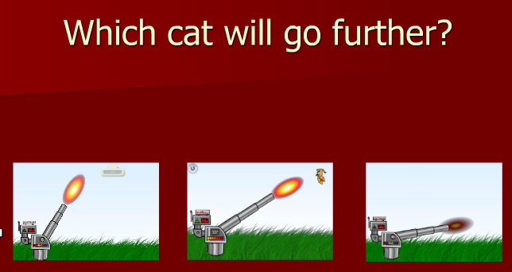

Slide 25
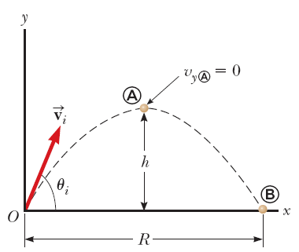

Maximum Height

Slide 26
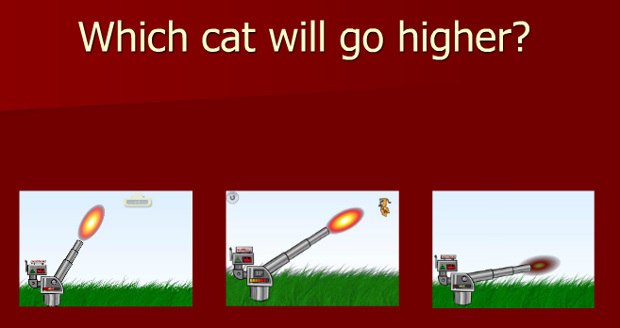

Slide 27
Example:
A long jumper leaves the ground at an angle of 20.0° above the horizontal and at a speed of 11.0 m/s.
How far does he jump in the horizontal direction?
7.94 m

Slide 28
Example:
A long jumper leaves the ground at an angle of 20.0° above the horizontal and at a speed of 11.0 m/s.
What is the maximum height reached?
0.722 m

Slide 29
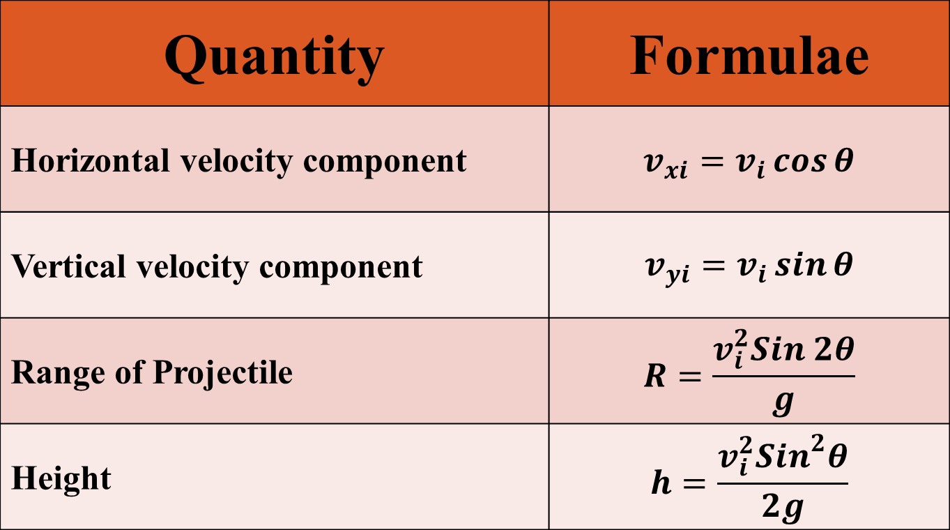
Quantity | Formulae
Horizontal velocity component | $$v_{xi}=v_{i}\cos{θ}$$
Vertical velocity component | $$v_{yi}=v_{i}\sin{θ}$$
Range of Projectile | $$R=\frac{v_{i}^{2}Sin 2θ}{g}$$
Height | $$h=\frac{v_{i}^{2}{Sin}^{2}θ}{2g}$$

Slide 30
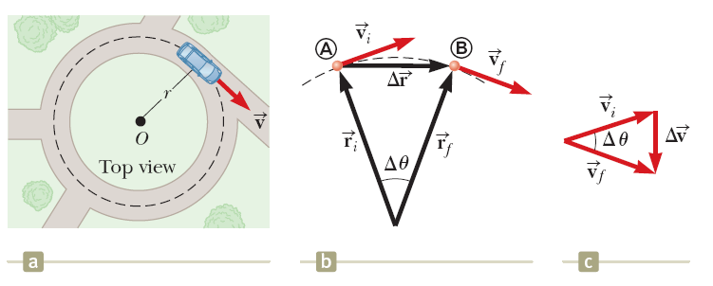


Uniform Circular Motion

Slide 31
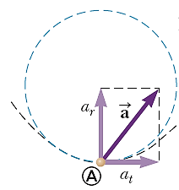


Tangential and Radial Acceleration
The tangential acceleration component causes a change in the speed v of the particle. This component is parallel to the instantaneous velocity, and its magnitude is given by
The radial acceleration component arises from a change in direction of the velocity vector and is given by

