Slide 1
Chapter 5
Force and Motion

Slide 2
Chapter 5
Force and Motion
In Chapters 2 and 4 we have studied “kinematics,” The branch of mechanics concerned with motion without reference to force or mass i.e., we described the motion of objects using parameters such as the position vector, velocity, and acceleration without any insights as to what caused the motion. This is the task of Chapters 5 and 6, in which the part of mechanics known as “dynamics” (The branch of mechanics concerned with the forces that cause motions of bodies) will be developed. In this chapter we will introduce Newton’s three laws of motion which are at the heart of classical mechanics. We must note that Newton’s laws describe physical phenomena of a vast range.

Slide 3
Newton’s First Law
Scientists before Newton thought that a force (the word “influence” was used) was required in order to keep an object moving at constant velocity. An object was thought to be in its “natural state” when it was at rest. This mistake was made before friction was recognized to be a force. For example, if we slide an object on a floor with an initial speed v₀ very soon the object will come to rest. If on the other hand we slide the same object on a very slippery surface such as ice, the object will travel a much larger distance before it stops. Newton checked his ideas on the motion of the moon and the planets. In space there is no friction, therefore he was able to determine the correct form of what is since known as “Newton’s first law”:
If no force acts on a body, the body’s velocity cannot change; that is, the body cannot accelerate.
(5-2)

Slide 4
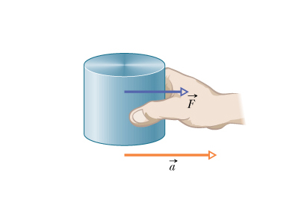
Force:
The concept of force was tentatively defined as a push or pull exerted on an object. We can define a force exerted on an object quantitatively by measuring the acceleration it causes using the following procedure.
We place an object of mass m = 1 kg on a frictionless surface and measure the acceleration a that results from the application of a force F. The force is adjusted so that a = 1 m/s². We then say that F = 1 newton The S.I unit of force is newton (N).
(5-3)

Slide 5
Newton’s Second Law
The results of the discussions on the relations between the net force F_{net} applied on an object of mass m and the resulting acceleration a can be summarized in the following statement known as “Newton’s second law.”
F_{net}
The net force on a body is equal to the product of the body’s mass and its acceleration.
m
a
In equation form Newton’s second law can be written as:
The above equation is a compact way of summarizing three separate equations, one for each coordinate axis:
(5-5)

Slide 6
Unit of Force
According to Newton’s second law,
“Force is the product of mass and acceleration”.
F = ma
1N = (1kg) (1 m/sec²)
Different units of Force in different systems:
System | Force | Mass | Acceleration
SI | Newton (N) | kilogram (kg) | m/sec²
CGS | dyne | gram (gm) | cm/sec²
FPS | pound (lb) | slug | ft/sec²

Slide 7
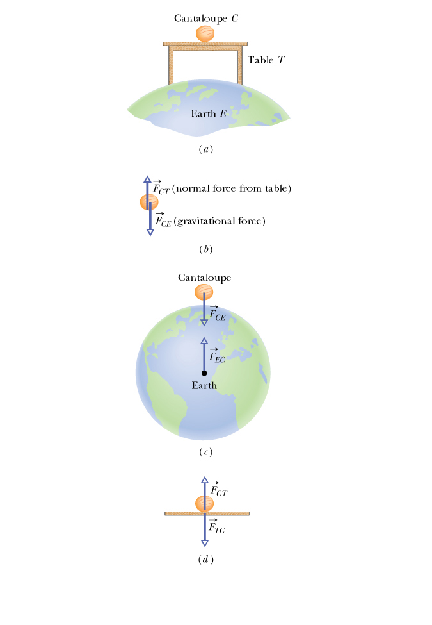
The Gravitational Force: It is the force that the Earth exerts on any object (in the picture a cantaloupe). It is directed toward the center of the Earth. Its magnitude is given by Newton’s second law.
y
F_{g}
Weight: The weight of a body is defined as the magnitude of the force required to prevent the body from falling freely.
g
W
y
mg
Note: The weight of an object is not its mass. If the object is moved to a location where the acceleration of gravity is different (e.g., the moon, where g_{m} = 1.7 m/s²), the mass does not change but the weight does.
(5-6)

Slide 8
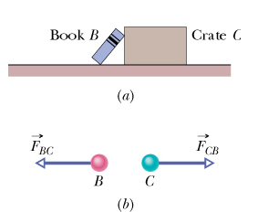
Newton’s Third Law:
When two bodies interact by exerting forces on each other, the forces are equal in magnitude and opposite in direction.
(5-9)

Slide 9
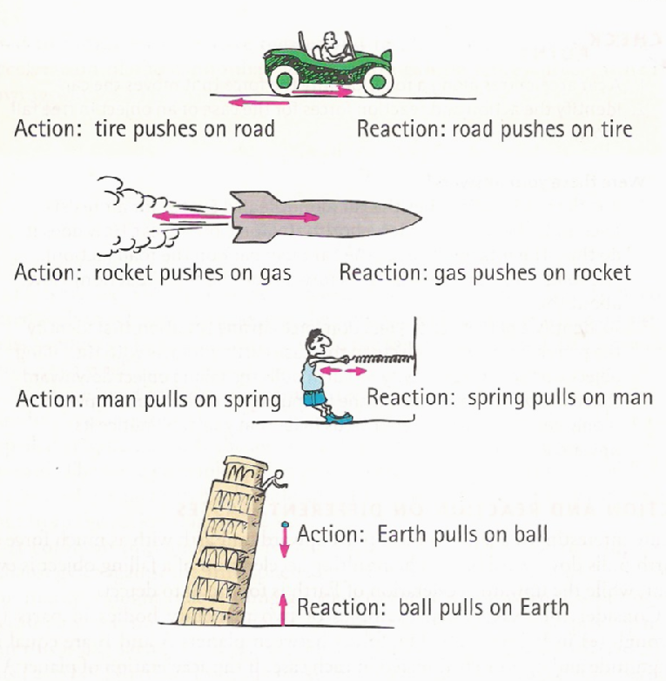
Examples of Newton’s Third Law:

Slide 10
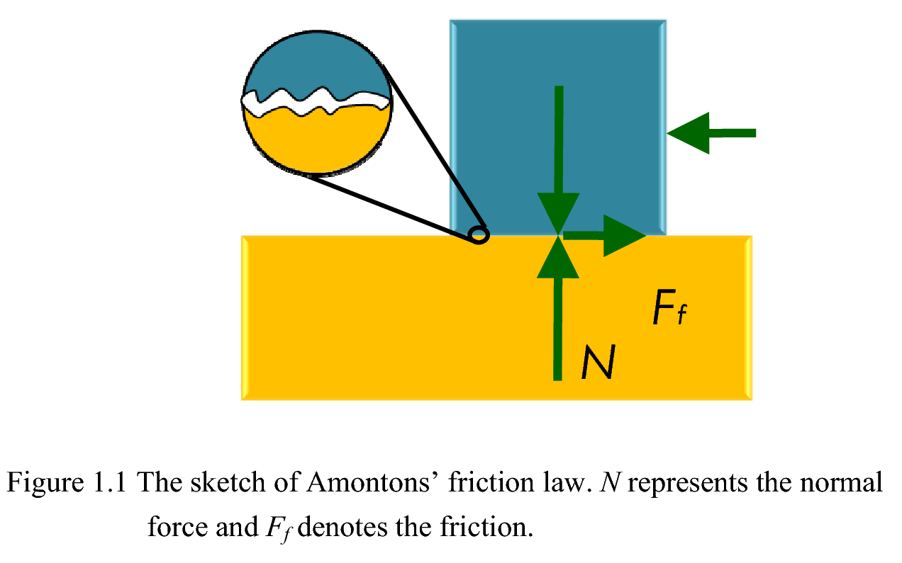
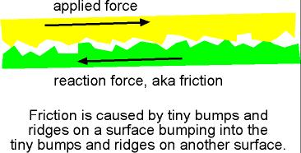
Definition of Friction
A force that resists the relative motion or tendency to such motion of two bodies or substances in contact.

Slide 11
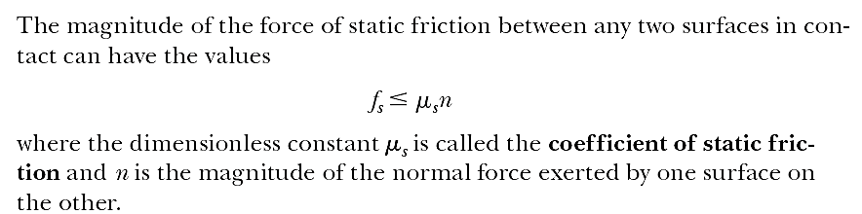
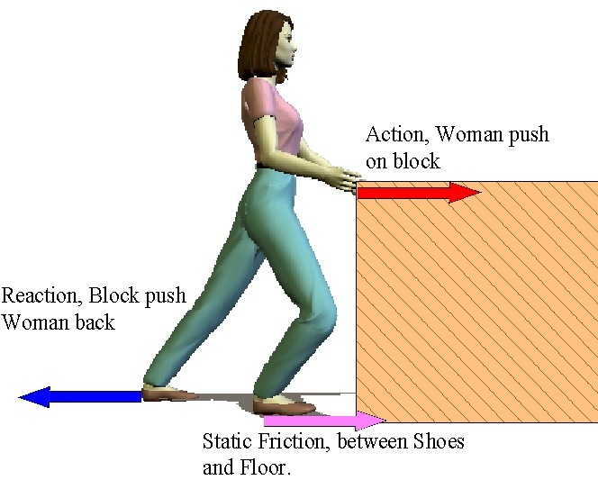

Static Frictional Force:
If the body does not slide, the frictional force is a static frictional force

Slide 12
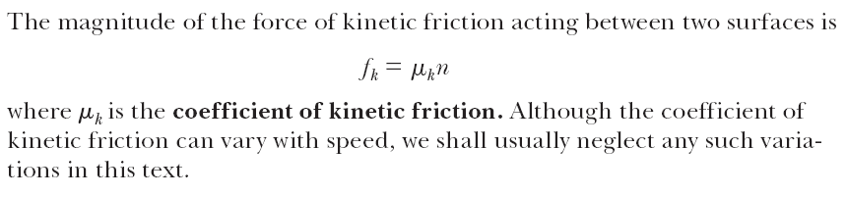

Kinetic Frictional Force:
If the body is sliding, the frictional force is a kinetic frictional force

Slide 13
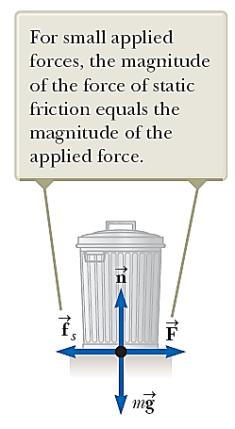
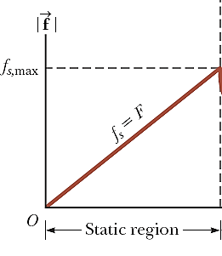
Example

Slide 14
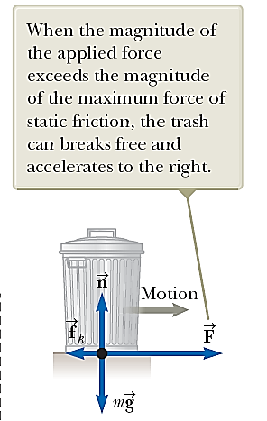
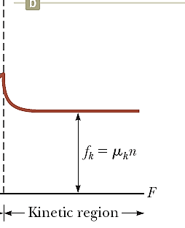

Slide 15
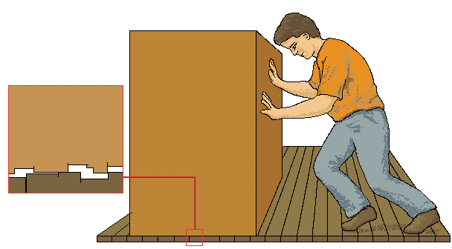
Friction is a Force
Force on box
by person
Force on person
by box
Force on floor by box
Force on box by floor
It’s the sum of all the forces that determines the acceleration.
Every force has an equal & opposite partner.

Slide 16
Friction Mechanism

Slide 17
Static and Sliding (Kinetic) Friction
Static frictional force: when nothing is sliding
Sliding frictional force: when surfaces are sliding
Static frictional forces always greater than sliding ones
Lubrication provides microscopic rollers between surfaces

Slide 18
Advantages of Friction

Slide 19
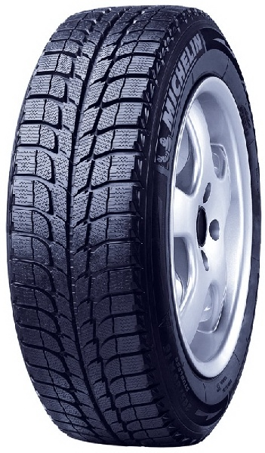
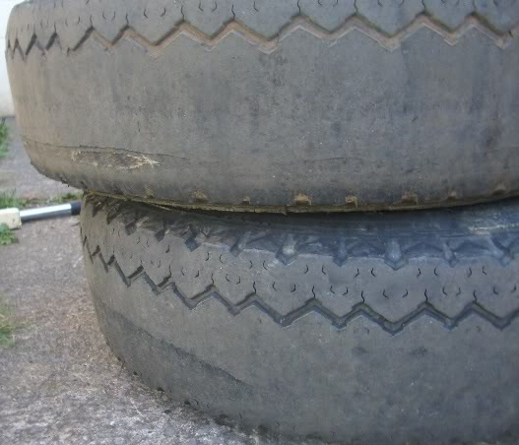

Slide 20


Slide 21
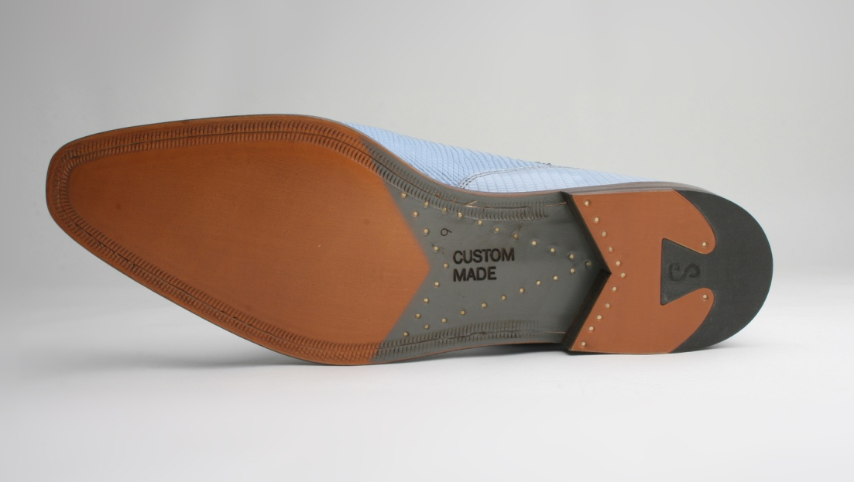


Slide 22
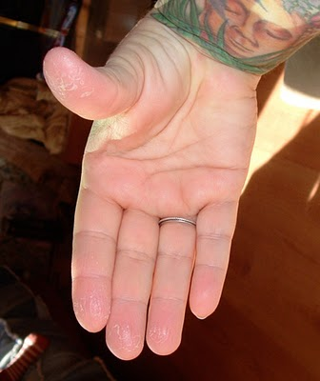
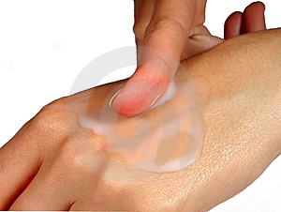



Slide 23
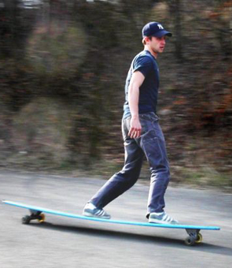

Slide 24
End of the Chapter

