Slide 1
Chapter 7
Kinetic Energy and Work
In this chapter we will introduce the following concepts:
7.2 | Work Done by a Constant Force
7.3 | The Scalar Product of Two Vectors
7.4 | Work Done by a Varying Force
7.5 | Kinetic Energy and the Work–Kinetic Energy Theorem
7.6 | Potential Energy of a System
7.7 | Conservative and Non conservative Forces
7.8 | Relation B/w Conservative Forces and Potential energy

Slide 2
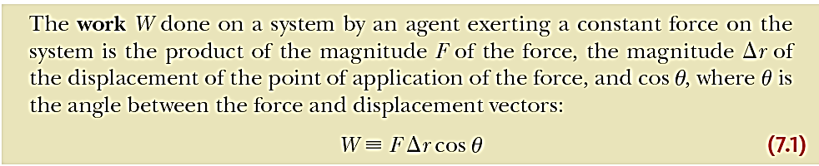
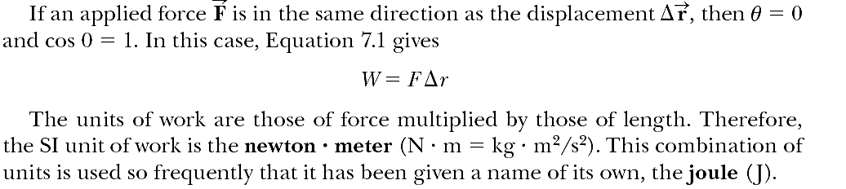
Work Done by a Constant Force

Slide 3
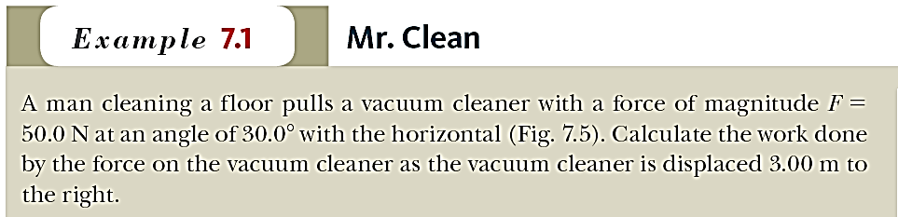
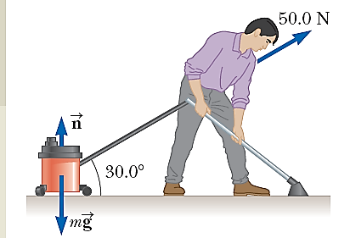


Slide 4
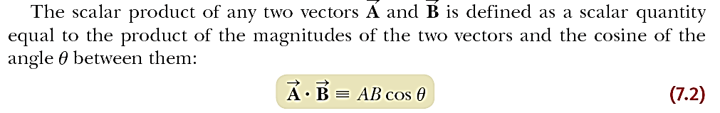
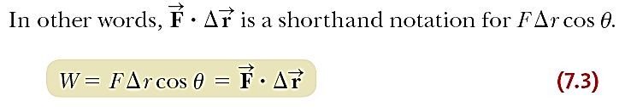
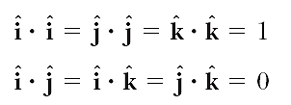
The Scalar Product of Two Vectors

Slide 5
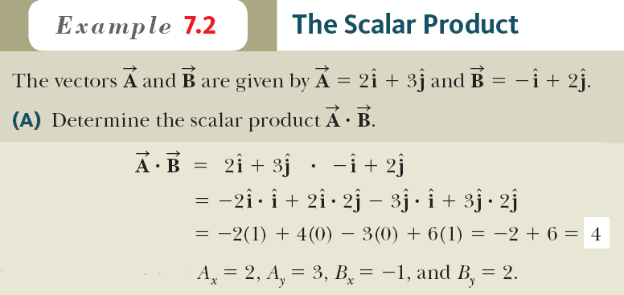
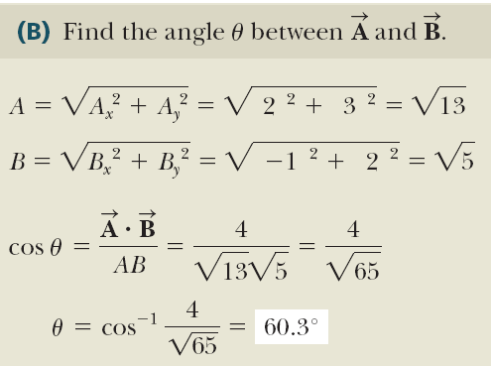

Slide 6
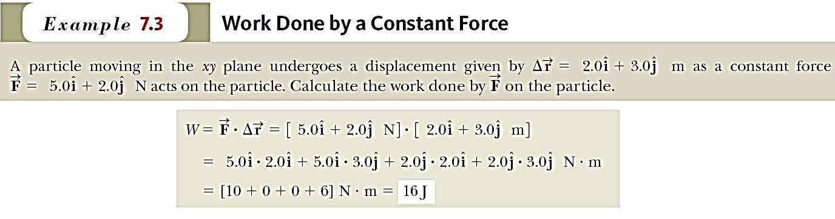

Slide 7
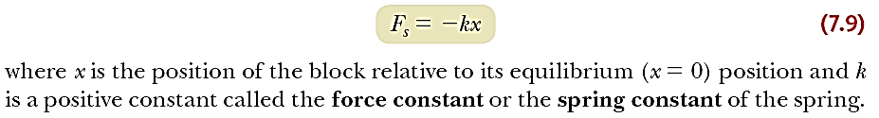
Work Done by a Spring

Slide 8


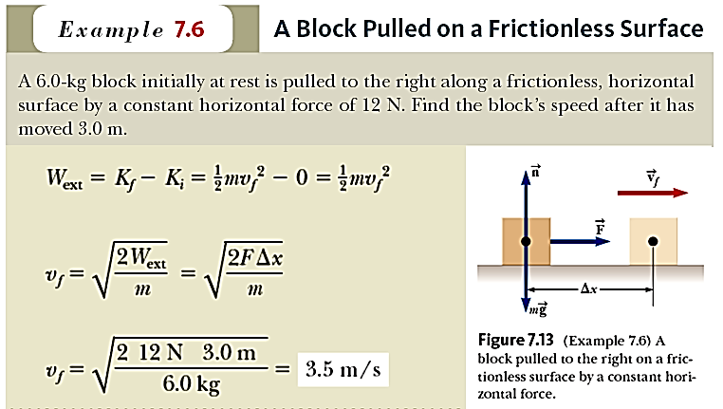
Kinetic Energy and the Work–Kinetic Energy Theorem

Slide 9

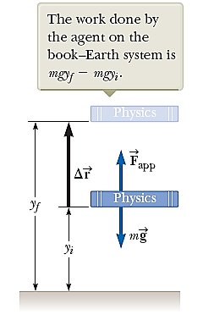
Potential Energy of a System

Slide 10


Elastic Potential Energy
The work done by an external applied force F_{app} on a system consisting of a block connected to the spring is given by the following equation:
The elastic potential energy function associated with the block–spring system is defined by

Slide 11
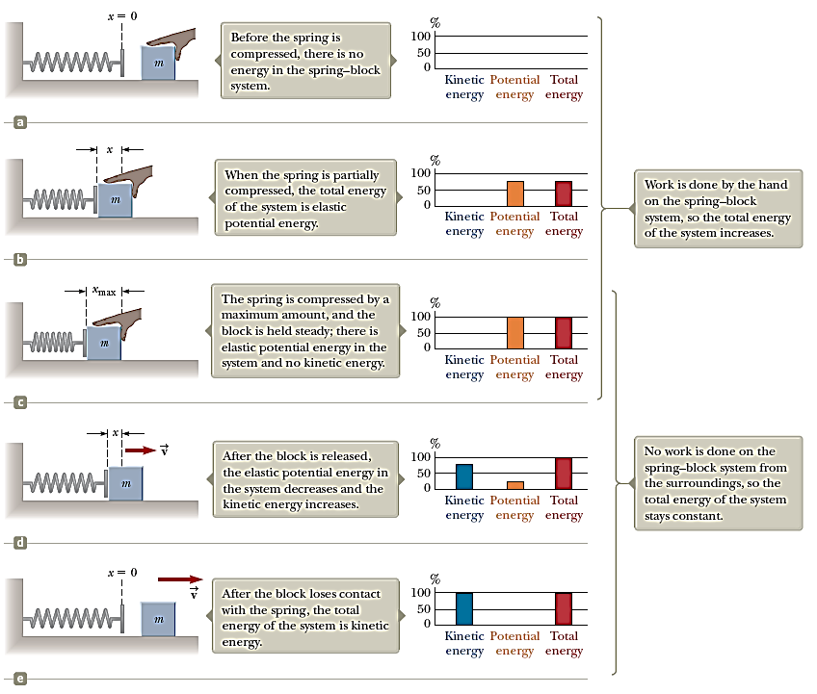

Slide 12

Conservative and Non conservative Forces
Conservative Forces
Conservative forces have these two equivalent properties:
1. The work done by a conservative force on a particle moving between any
two points is independent of the path taken by the particle.
2. The work done by a conservative force on a particle moving through any
closed path is zero. (A closed path is one for which the beginning point and
the endpoint are identical.)
Non-conservative Forces
A force is non conservative if it does not satisfy properties 1 and 2 for conservative forces. We define the sum of the kinetic and potential energies of a system as the mechanical energy of the system:

