Slide 1
Chapter 8
Potential Energy and Conservation of Energy
In this chapter we will introduce the following concepts:
8.1 | Non-isolated System (Energy)
8.2 | Isolated System (Energy)
8.5 | Power

Slide 2
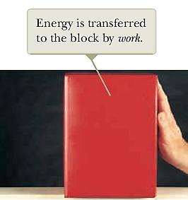
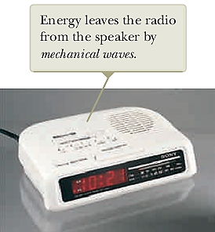
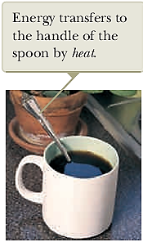
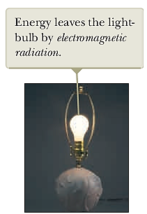
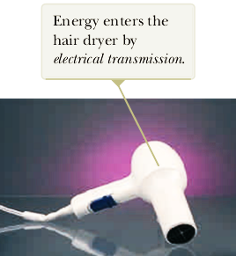
Energy Transfer Mechanism

Slide 3

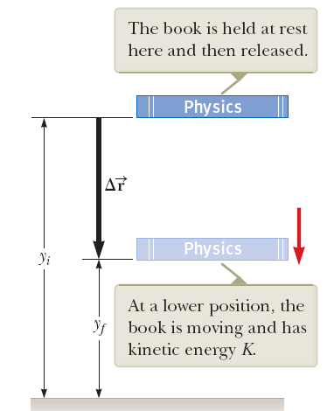




Isolated System (Energy)

Slide 4

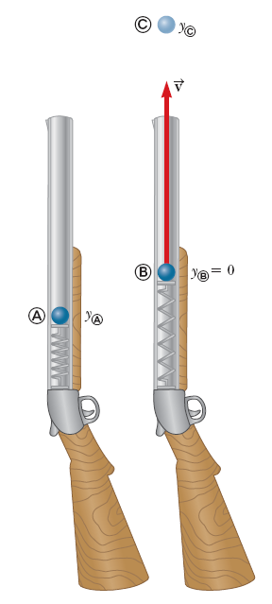
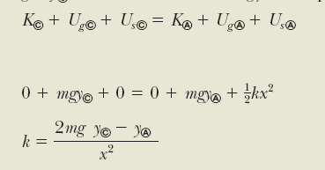



Slide 5



Conservation of Energy
Pg 182

Slide 6
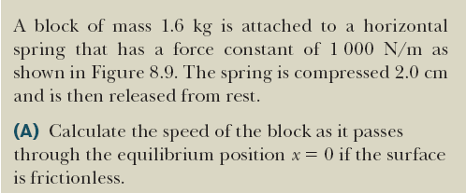
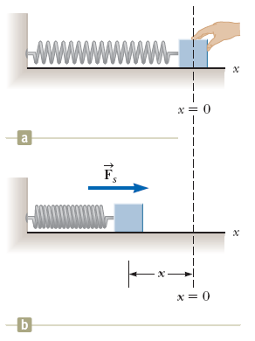



Slide 7





Power
If an amount of energy dE is transferred in an amount of time dt, the average power due to the force is

Slide 8
