Slide 1
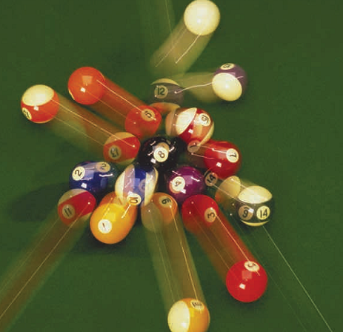
Chapter 9
Center of Mass and Linear Momentum

Slide 2
In this chapter we will introduce the following new concepts:
9.1 | Linear Momentum
9.2 | Isolated System (Momentum)
9.4 | Collisions in One Dimension
9.6 | The Center of Mass
9.7 | Systems of Many Particles

Slide 3
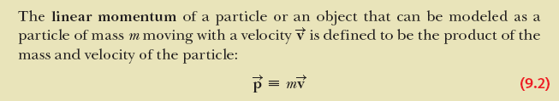

Linear Momentum

Slide 4
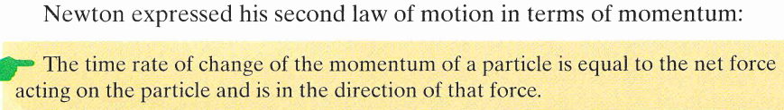



Slide 5
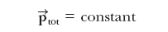
P_{1(initial)} + P_{2(initial)} = P_{1(final)} +P_{2(final)}
Law of Conservation of Momentum
If no net external force acts on a system, the total linear momentum of the system cannot change.
Or It can be stated that
The sum of a system's initial momentum is equal to the sum of a system's final momentum.
The law of conservation of momentum can be mathematically expressed as
Total momentum before collision = Total momentum after collision

Slide 6
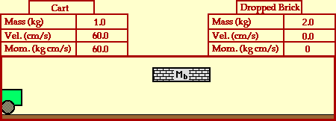

Slide 7
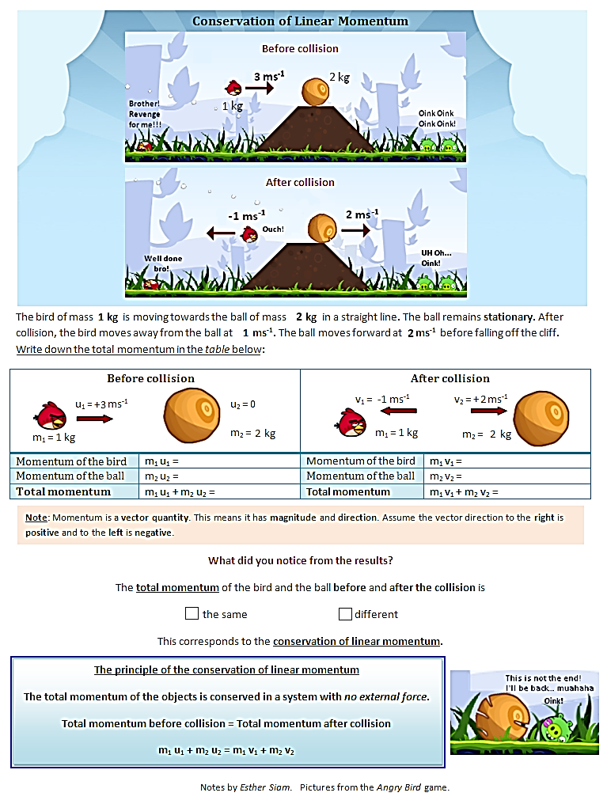

Slide 9
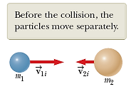
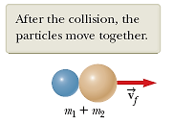


Inelastic Collisions
An inelastic collision is one in which
total kinetic energy is not the same before and after the collision (even though momentum is constant).

Slide 10
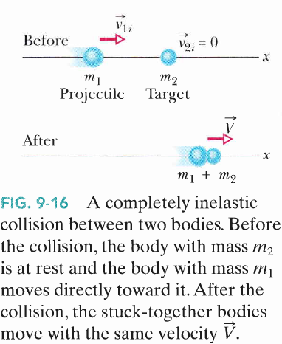
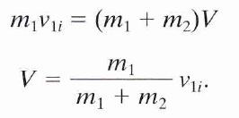

Slide 11


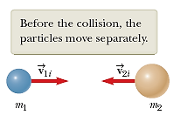

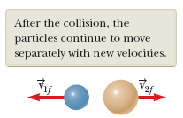

Elastic Collisions
An elastic collision is one in which
total kinetic energy (as well as total momentum) is the same before and after the collision.

Slide 12

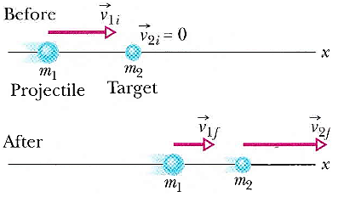
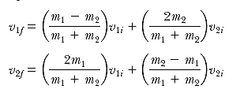
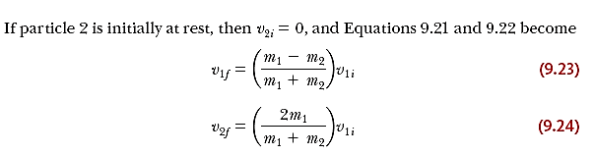

Slide 13
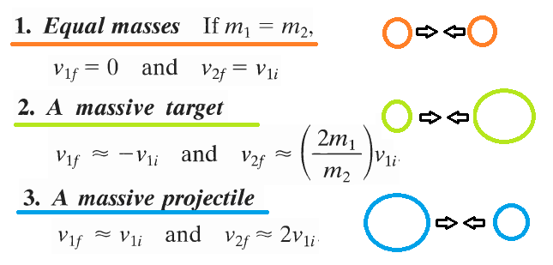
Special situations

Slide 14

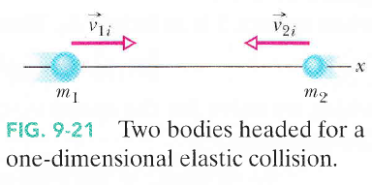


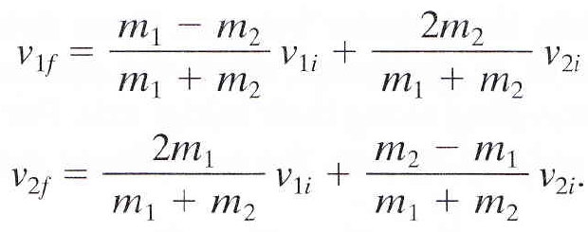

Slide 15
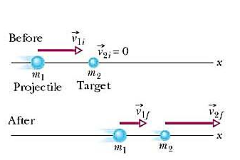
v_{1i}
v_{2i} = 0
x
m
m
v_{1f} = 0
v_{2f}
x
m
m

Slide 16
v_{1i}
v_{2i} = 0
x
m₁
m₂
v_{2f}
v_{1f}
x
m₁
m₂

Slide 17
v_{1i}
v_{2i} = 0
x
m₂
m₁
v_{1f}
v_{2f}
x
m₂
m₁

Slide 18
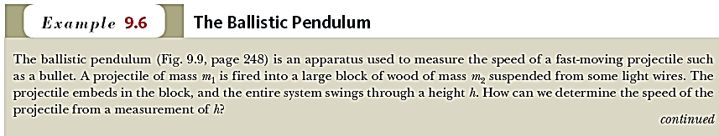
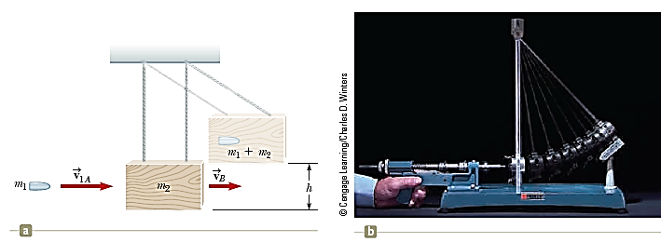


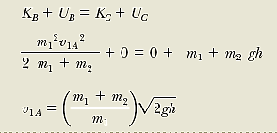


Slide 19


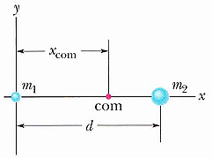
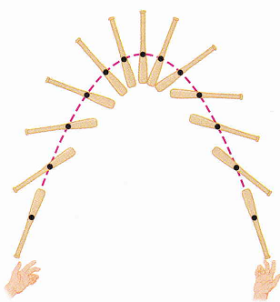
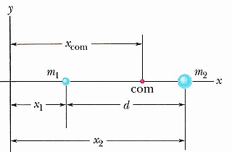
Center of Mass

Slide 20
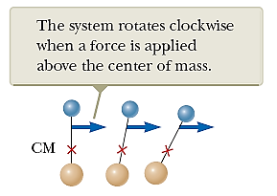
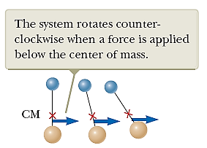
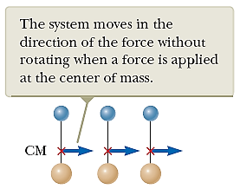

Slide 21
