Slide 1
Chapter 10
10.1 | Angular Position, Velocity, and Acceleration
10.2 | Rigid Object Under Constant Angular Acceleration
10.3 | Angular and Translational Quantities
10.4 | Rotational Kinetic Energy
10.6 | Torque

Slide 2
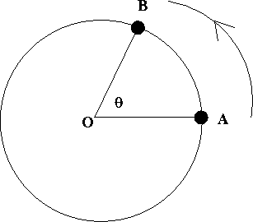

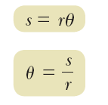

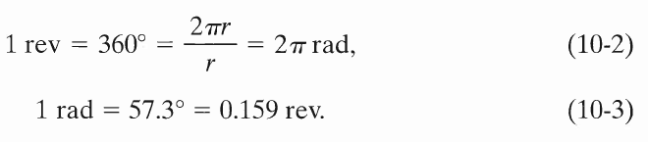
Angular Displacement
Δθ = θ − θ_{ο}
S
(Final Angle - Initial Angle)
The circumference of a circle is 2πr.
1 revolutions = 360 deg
360^{o =} 2π radian
r
To convert an angle in degrees to an angle in radians,

Slide 3
Radian
Radian (rad) is the angle subtended by an arc length, s, equal to the radius.
s=r
r

Slide 4
Average Angular Speed
SI unit : rad/sec
or 1/sec or sec⁻¹
Instantaneous Angular Speed

Slide 5
Average Angular Acceleration
Instantaneous Angular Acceleration
Units: rad/s² or s⁻²
Angular acceleration is positive if an object rotating counterclockwise is speeding up or if an object rotating clockwise is slowing down.

Slide 6
Example
A race car engine can turn at a maximum rate of 12 000 rpm. (revolutions per minute).
a) What is the angular velocity in radians per second.
a) Convert rpm to radians per second.ATA: The speed of sound is 343 m/s
= 1256 radians/s

Slide 7
b) If helicopter blades were attached to the crankshaft while it turns with this angular velocity, what is the maximum radius of a blade such that the speed of the blade tips stays below the speed of sound.
b) Known: v = 343 m/s, ω = 1256 rad./s
Find r
= .27 m

Slide 8



Rigid Object Under Constant Angular Acceleration
Imagine that a rigid object rotates about a fixed axis and that it has a constant angular acceleration. In this case, a new analysis model for rotational motion called the rigid object under constant angular acceleration.

Slide 9
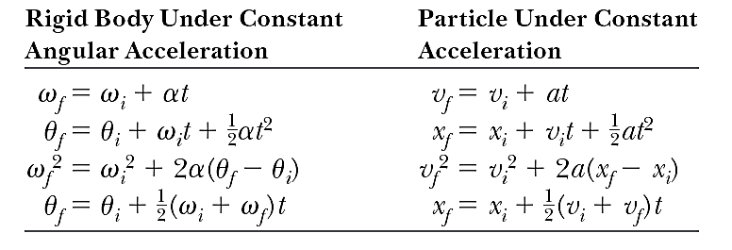
Relation Between Linear and Rotational Motion

Slide 10


Angular and Translational Quantities
Distance
Speed
Acceleration
Time for one revolution (PERIOD)

Slide 11
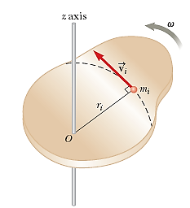
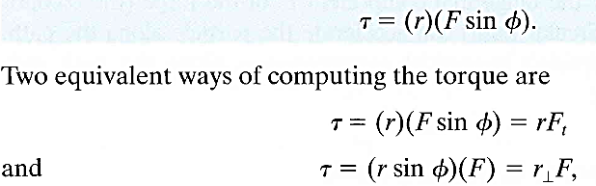
Kinetic Energy of rotation:
Moment of Inertia:
Torque:

Slide 12

S.I unit of torque is N-m
Torque

