Slide 1
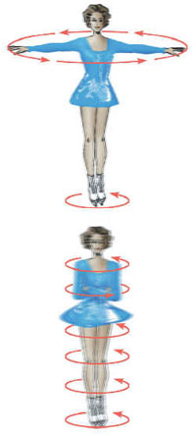
Chapter 11
Angular Momentum
11.1 | The Vector Product and Torque
11.2 | Non-isolated System (Angular Momentum
11.3 | Angular Momentum of a Rotating Rigid Object
11.4 | Isolated System (Angular Momentum)

Slide 2

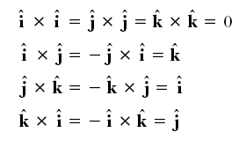
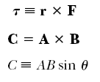
The Vector Product and Torque

Slide 3
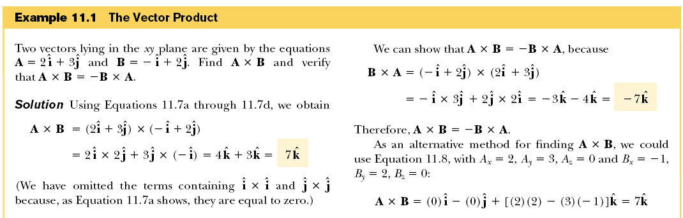
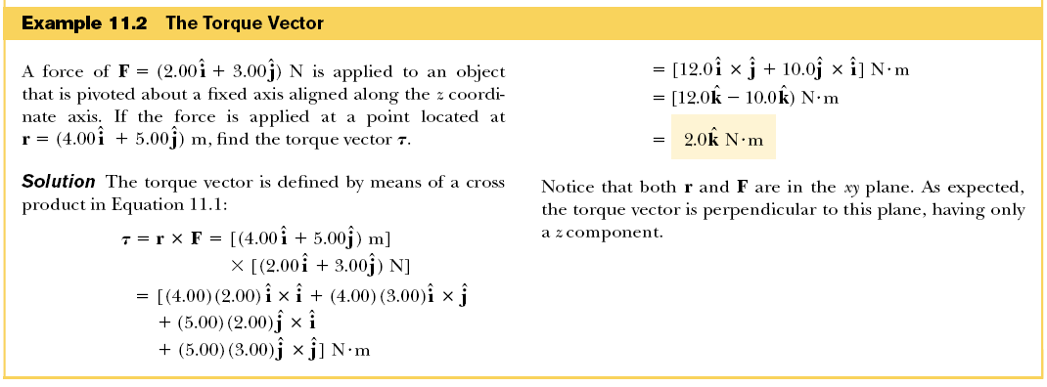

Slide 4
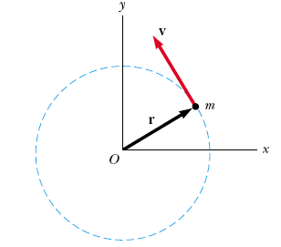



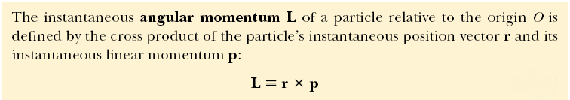


Angular Momentum

Slide 5



Slide 6






Angular Momentum of a System of Particles
Angular Momentum of a Rotating Rigid Object

Slide 7


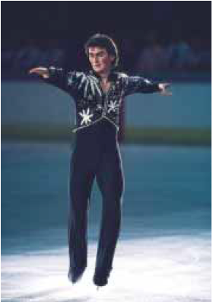
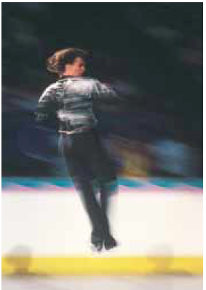
Conservation of Angular Momentum

Slide 8
