Slide 1
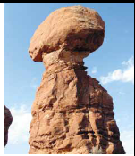
Chapter 12
Equilibrium and Elasticity
12.1 | Rigid Object in Equilibrium
12.3 | Examples of Rigid Objects in Static Equilibrium
12.4 | Elastic Properties of Solids

Slide 2
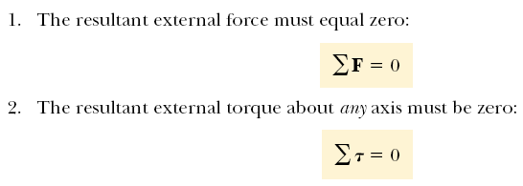
Conditions for equilibrium

Slide 3
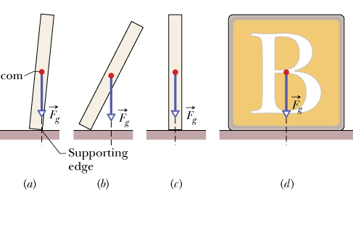

Slide 4
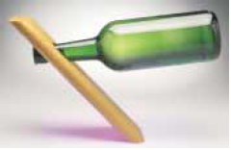
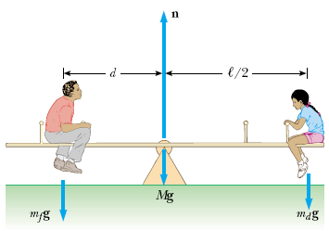
Examples of Rigid Objects in Static Equilibrium

Slide 5
Statics Problem Recipe
1. Draw a force diagram. (Label the axes.) 2. Choose a convenient origin O. A good choice is to have one of the unknown forces acting at O. 3. Sign of the torque τ for each force:
- If the force induces clockwise (CW) rotation + If the force induces counterclockwise (CCW) rotation
4. Equilibrium conditions:
5. Make sure that number of unknowns = number of equations

Slide 7

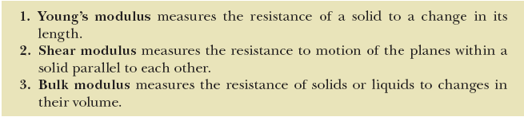
Elastic Properties of Solids

Slide 8

STRESS
Stress is the force that produces strain on a physical body without undergoing some sort of physical change.
Stress = σ = F/A
UNIT: N/m² or Pascal
STRAIN
Strain is the deformation of a physical body under the action of applied forces

Slide 9
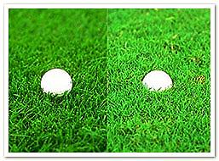
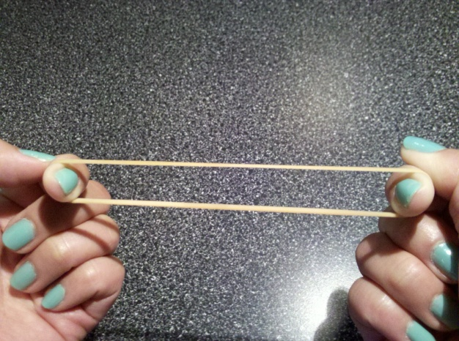

Elasticity
The tendency of a body to return to its original shape after it has been stretched or compressed
Rigidity
The physical property of being stiff and resisting bending

Slide 10

Stress and strain are directly proportional to each other. The constant of proportionality is called a modulus of elasticity, so that
Stress = Elastic modulus × Strain
We consider three types of deformation and define an elastic modulus for each:
Young’s modulus
Shear modulus
Bulk modulus

Slide 11

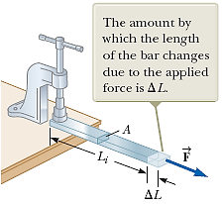
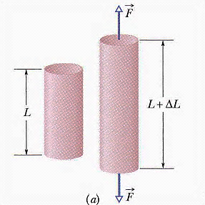
Young’s modulus or Elasticity in Length
It measures the resistance of a solid to a change in its length.

Slide 12
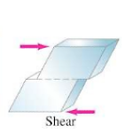

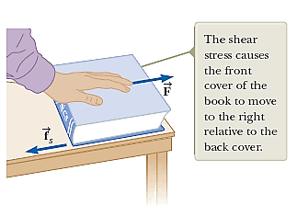
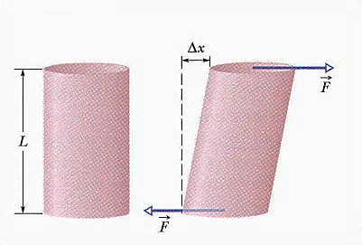
Shear modulus or Elasticity of Shape
It measures the resistance to motion of the planes within a solid parallel to each other.

Slide 13

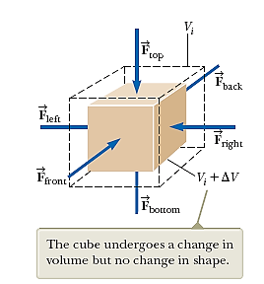
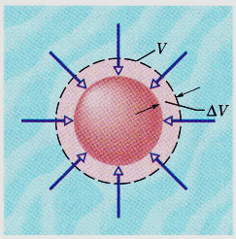
Bulk modulus or Volume Elasticity
It measures the resistance of solids or liquids to changes in their volume.

Slide 14
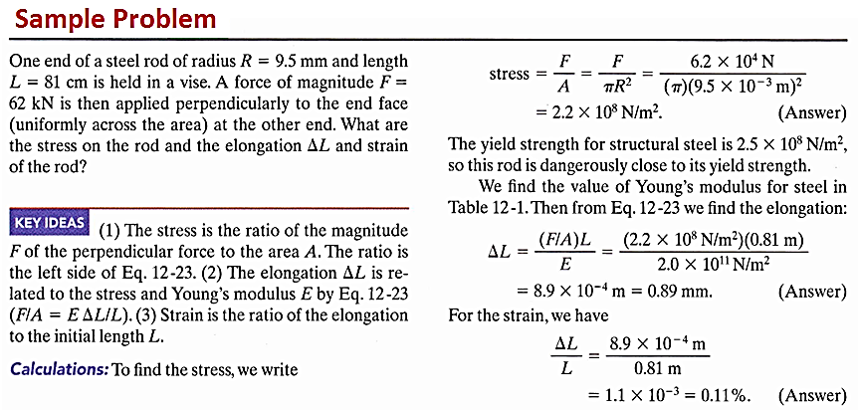

Slide 15
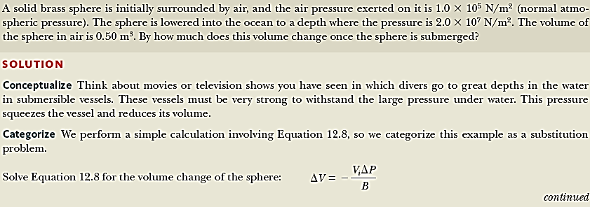
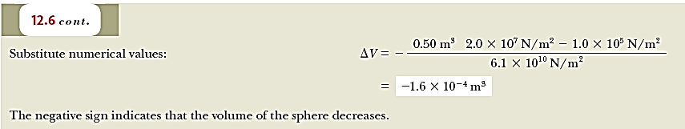

Slide 16
