Slide 1
Chapter 13
Universal Gravitation
13.1 | Newton’s Law of Universal Gravitation
13.2 | Free-Fall Acceleration and the Gravitational Force

Slide 2
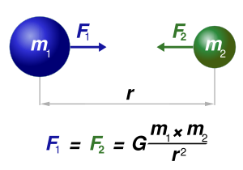
Newton’s Law of Universal Gravitation
Newton’s law of universal gravitation states that
Every particle in the Universe attracts every other particle with a force that is directly proportional to the product of their masses and inversely proportional to the square of the distance between them.

Slide 3



Newton’s Law of Universal Gravitation
where G is a constant, called the universal gravitational constant, that has been measured experimentally. Its value in SI units is

Slide 4

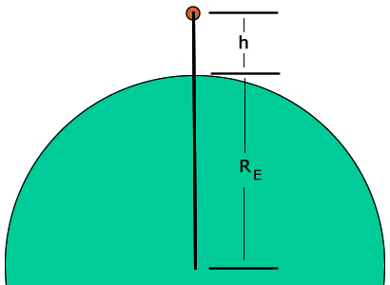


Free-Fall Acceleration and the Gravitational Force
Now consider an object of mass m located a distance h above the Earth’s surface or a distance r from the Earth’s center, where
r = RE + h. The magnitude of the gravitational force acting on this object is

Slide 5
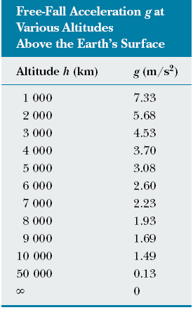


Slide 6
