Slide 1
Chapter 15
Oscillatory Motion
15.1 | Motion of an Object Attached to a Spring
15.2 | Particle in Simple Harmonic Motion
15.5 | The pendulum

Slide 2
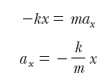
Motion of an Object Attached to a Spring
The Ideal Spring and Simple Harmonic Motion
The constant k is called the spring constant
That is, the acceleration of the block is proportional to its position, and the direction of the acceleration is opposite the direction of the displacement of the block from equilibrium. Systems that behave in this way are said to exhibit simple harmonic motion.

Slide 3
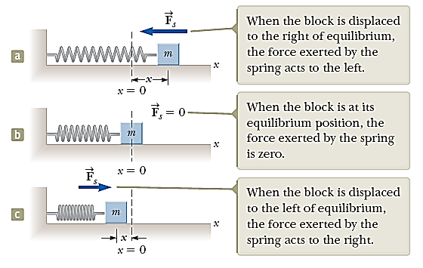

Slide 4
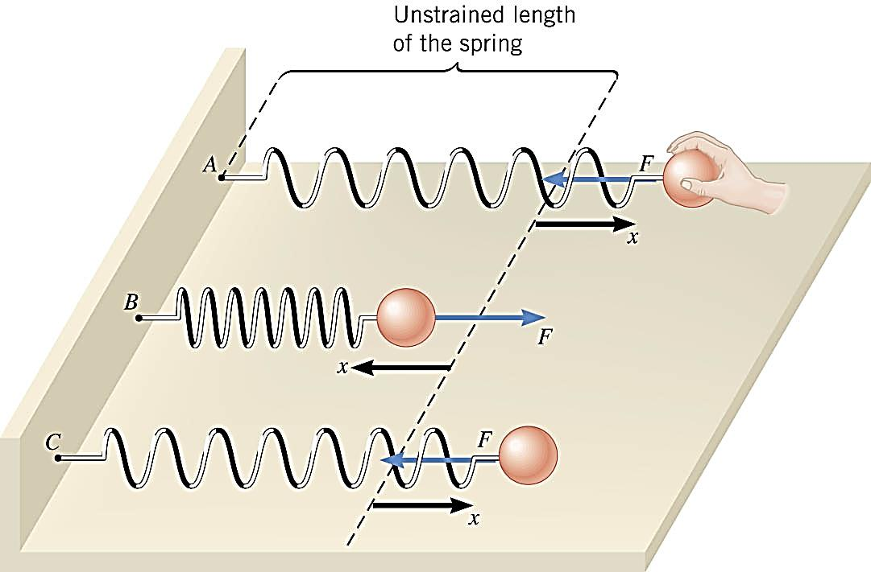
When the restoring force has the mathematical form given by F = –kx, the type of friction-free motion illustrated in the figure is designated as “simple harmonic motion.”

Slide 5





Particle in Simple Harmonic Motion

Slide 6




FREQUENCY (f)
Number of complete waves generated per second (or number of cycles/oscillations per second).
It is inverse of time period
is often called the angular frequency.
Measured in cycle per sec, vib./sec, beats/sec.
SI unit: hertz (Hz)

Slide 7
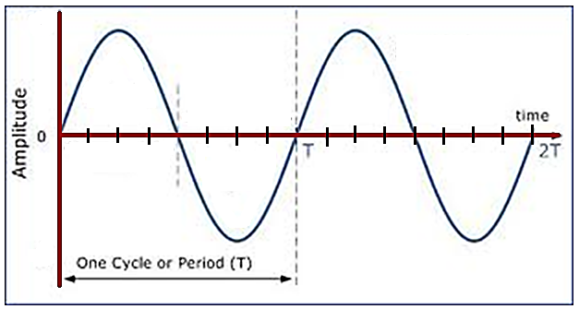

Period (T)
Time taken to complete one wave (or to complete one cycle)

Slide 8
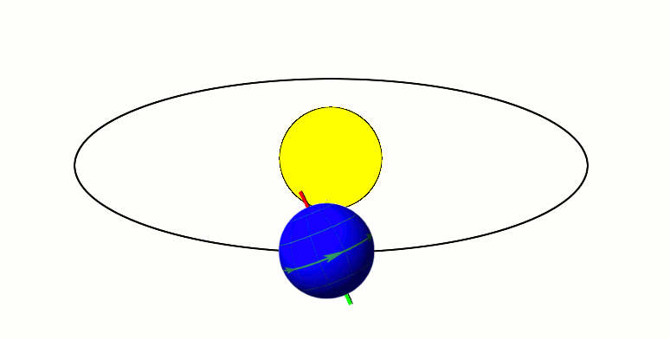
The period of one revolution around the Sun is referred to as 1 year or 365 days, 5 hr, 48 min, and 46 sec.

Slide 9
Relationship between T and f
As f increases, T decreases

Slide 10
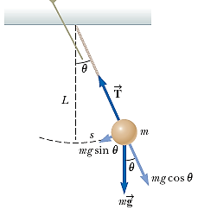

The Pendulum
The simple pendulum is another mechanical system that exhibits periodic motion.
It consists of a particle-like bob of mass m suspended by a light string of length L that is fixed at the upper end.
The simple pendulum can be used as a timekeeper because its period depends only on its length and the local value of g.

Slide 11
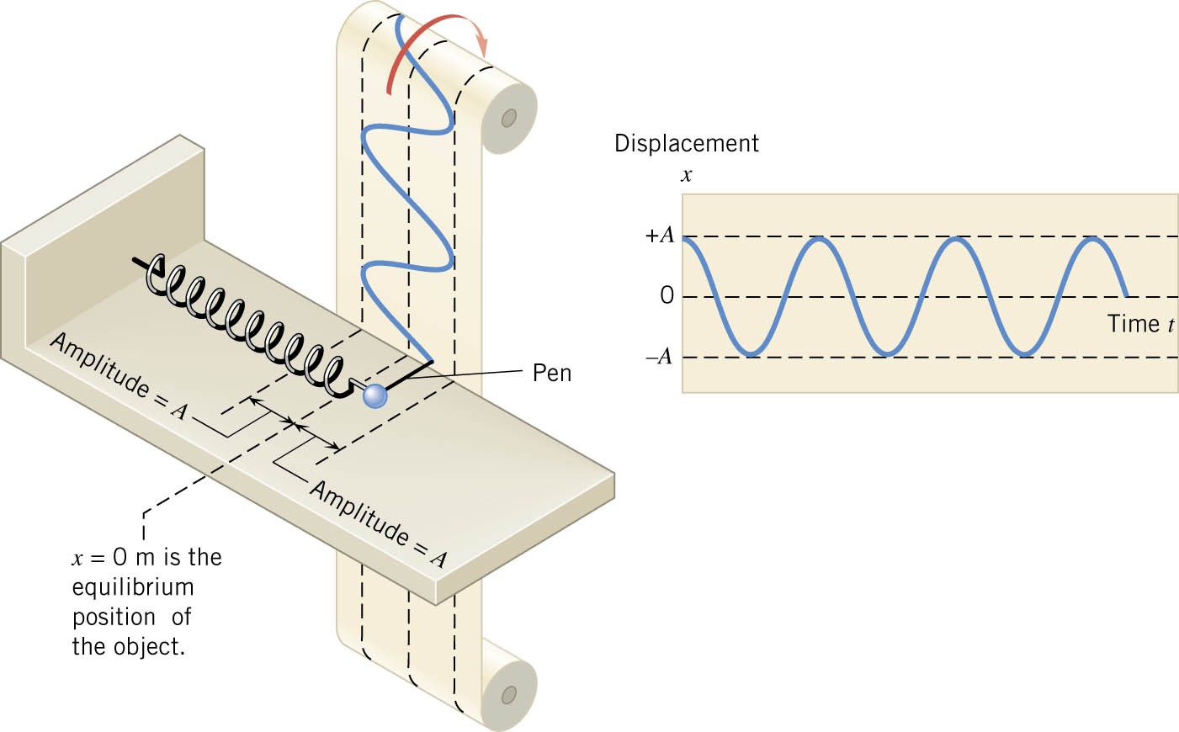
The maximum excursion from equilibrium is the amplitude A of the motion. The shape of this graph is characteristic of simple harmonic motion and is called “sinusoidal,” because it has the shape of a trigonometric sine or cosine function.

Slide 12
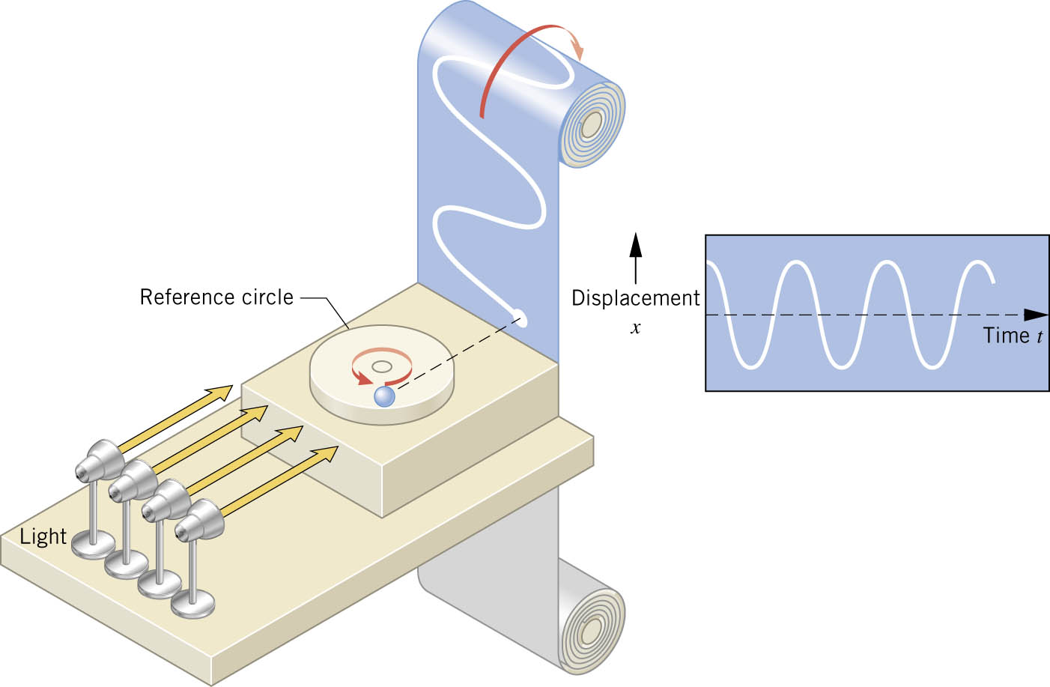
Simple Harmonic Motion and the Reference Circle
Simple harmonic motion, like any motion, can be described in terms of displacement, velocity, and acceleration.

